Slide 1
US Energy Efficiency Policy
September 13, 2018
Derek Greenauer
Director, Global Government Affairs
UL LLC
Derek.Greenauer@ul.com

Slide 2
US Energy Policy Update
Appliance & Equipment Standards (MEPS) Update
Affordable Clean Energy Rule
US State-level Activity and Progress.
Notes:
On August 3, President Obama announced the finalization of America's Clean Power Plan, the biggest step the US has ever taken to combat climate change. This plan sets the first-ever carbon pollution standards for power plants, while providing states and utilities with the flexibility they need to meet those standards. The Clean Power Plan sets achievable standards to reduce carbon dioxide emissions by 32 percent from 2005 levels by 2030.
PROGRESS:
The President’s Better Buildings Challenge, enlisted more than 250 partners in cities, states, utilities, manufacturers, school districts, and businesses to improve energy efficiency. Since the program’s launch in 2011, partners have saved 94 trillion units of energy and $840 million.
PROGRESS:
In President Obama's first term, DOE and HUD completed efficiency upgrades in nearly two million homes, saving many families more than $400 on their heating and cooling bills in the first year alone.
PROGRESS:
In December 2013, the Department of Agriculture announced it will provide up to $250 million to help businesses and residential customers in rural areas cut their energy bills through energy efficiency and renewable energy use.
PROGRESS:
In 2014, DOE issued nine proposed and 10 final energy conservation standards for appliances and equipment. If finalized and combined with rules already issued, the energy savings will help cut consumers' electricity bills by hundreds of billions of dollars.

Slide 3
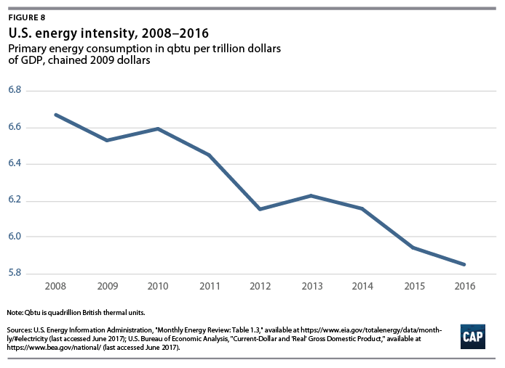
Trends: Reductions in Energy Intensity

Slide 4
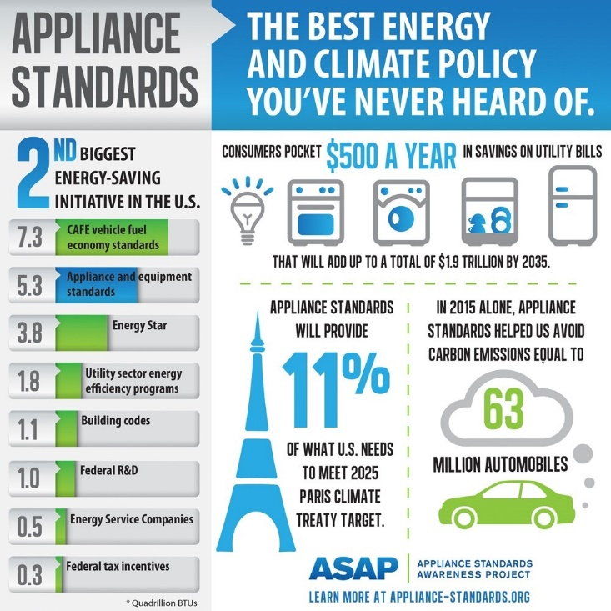
Impact of Federal Standards Activities
Source: Appliance Standards Awareness Project
Notes:
In 2011, Federal energy and water conservation standards saved an estimated 3.2 quads of primary energy, which is equivalent to 3% of total U.S. energy consumption. The estimated cumulative energy savings of appliance standards adopted from 1987 through 2011 amount to 176 quads over the period 1990-2070.

Slide 5
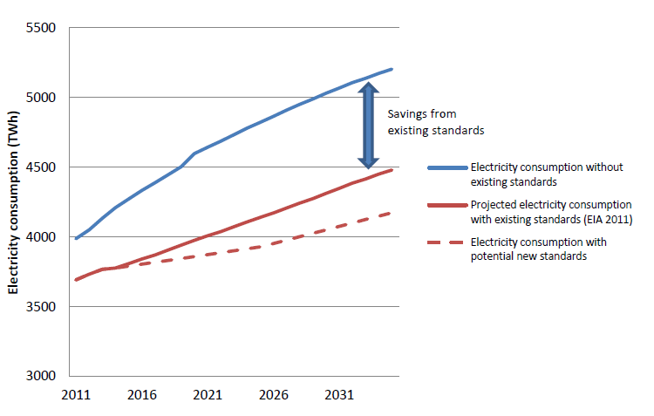
Savings Potential from Standards
Source: ACEEE and ASAP Report

Slide 6
2017 DOE MEPS Update - Implemented
US DOE Report to Congress – February 2018

Slide 7
2017 DOE MEPS Update – Revised Test Procedures
US DOE Report to Congress – February 2018

Slide 8
EPA Affordable Clean Energy (ACE) Rule
The proposed ACE Rule is informed by more than 270,000 public comments that EPA received as part of its December 2017 Advance Notice of Proposed Rulemaking (ANPRM).
Defines the “best system of emission reduction” (BSER) for existing power plants as on-site, heat-rate efficiency improvements;
Provides states with a list of “candidate technologies” that can be used to establish standards of performance and be incorporated into their state plans;
Updates the New Source Review (NSR) permitting program to further encourage efficiency improvements at existing power plants; and
Aligns regulations under CAA section 111(d) to give states adequate time and flexibility to develop their state plans.

Slide 9
Impact of ACE
Replacing the CPP with ACE could provide $400 million in annual net benefits.
Reduce the compliance burden by up to $400 million/yr vs. CPP.
All four scenarios find that the proposal will reduce CO2 emissions between 0.7 and 1.5% (5.3 million cars off the road) compared to CPP’s goal of 30% by 2030
Further, these illustrative scenarios suggest that when states have fully implemented the proposal, U.S. power sector CO2 emissions could be 33% to 34% below 2005 levels, higher than the projected CO2 emissions reductions from the CPP.
Additional 1,400 premature deaths and 48,000 cases of asthma each year.

Slide 10
State-level Energy Efficiency
Source: ACEEE 2017
Notes:
Scoring is based on 6 policies:
Utility and public benefits programs and policies
• Transportation policies
• Building energy codes and compliance
• Combined heat and power (CHP) policies
• State government–led initiatives around energy efficiency
• Appliance and equipment standards
California continued its efficiency progress with a series of major policy initiatives. The state undertook new building energy use benchmarking and data sharing mandates under AB 802 legislation. It also continued its work to double energy efficiency savings by 2030 under SB 350. This included efforts to integrate distributed energy resources on the grid and to help low-income customers access energy efficiency and renewable energy investments. In December, California also became the first state to approve efficiency standards for laptops, desktop computers, and monitors.
By contrast, 21 states fell in the rankings this year and 20 lost points, both because of changes in their performance and because we adjusted our methodology, including placing more emphasis on energy savings achieved by utilities. Iowa fell the farthest, losing 3.5 points. This drop was partly due to the temporary suspension of funding for several efficiency loan and grant programs administered by the Iowa Energy Center. Legislators voted in April to move the center from Iowa State University to the Iowa Economic Development Authority.

Slide 11
State-level Highlights
MA: Pathways to Zero Net Energy Program: $3.5 million grant program started in 2014 to spur the development of Zero Net Energy Buildings (ZNEB) in Massachusetts. $3.0M is being used to support residential and commercial ZNEB projects through feasibility studies, integrated design, and construction funding, and $500,000 is being used for public awareness, workforce development, efforts to develop and standardize best practices, and DOER resources.
CA, NY, NJ Investing $1.3 Billion for EV charging infrastructure over next 5 years.
Regional Greenhouse Gas Initiative: Connecticut, Delaware, Maine, Maryland, Massachusetts, New Hampshire, New York, Rhode Island, and Vermont to cap and reduce CO₂ emissions from the power sector. Proceeds fund EE programs.

Slide 12
Thank you!

