Slide 1

Testing and Compliance for Standards and Labelling in Australia
Tim Farrell
APEC EGEE&C 39th Meeting – 27-28 February 2012

Slide 2
Australia’s Equipment Energy Efficiency (E3) Program
Joint Australian and New Zealand governments program
22 regulated products across the residential, commercial and industrial sectors
Additional 2 products covered under voluntary programs or a code of conduct (swimming pool pumps & complex set-top boxes)
All regulated products must be registered

Slide 3
E3 Compliance Program
E3 undertakes verification testing, market surveillance and education
In Australia, currently state regulators provide enforcement – the ACCC takes action in severe cases.
E3 negotiates settlements including payments to consumers
National legislation (GEMS) is proposed for 2012 and will replace the various state/territory based legislation in Australia

Slide 4
MV&E activities in Australia
MV&E unit within appliance energy efficiency team – 3 staff
Contracts with accredited laboratories to do verification tests - >1,000 from 1991 to 2010
2011-2012 expect to test over 400 models – targeted toward products at higher risk of failure
Contract with market surveillance team (12 staff) to do store/ internet/ advertising checks on labelling
Forums, newsletters, outreach to highlight obligations and provide feedback

Slide 5
Results of 1000 checktests

Slide 6
What are the issues?
Making the most effective use of public funds
  maximising cost effectiveness through better targeting
Maximising compliance by raising the risk of detection
  ensure suppliers notified quickly and results are published
  “naming and shaming” is quite effective, but some well publicised enforcement goes a long way!
Ensure processes are fair, transparent and followed strictly
  needed to support any enforcement
  clarify staff responsibilities, provide training and infrastructure
Facilitate compliance
  ensure suppliers know what they must do
  make it easy for them to comply

Slide 7
What are the issues? (cont..)
Compliance activity is harder for some products
eg commercial and industrial
  innovative ways to reach this sector needed
Increase of internet sales
  need to focus monitoring efforts on this sector
Test laboratories
  lack of appropriately accredited test facilities for some methodologies/ products limits the number and speed in which check tests can be conducted

Slide 8
What could help?
Closer links/ coordination between regulators in different countries
  Raise the threat of detection through better intelligence/ information sharing
  Share approaches i.e. undertaking risk assessments, reaching sectors where compliance harder
Opportunities to transfer experiences and approaches between programs
  Work on developing a common language

Slide 9
What could help? (cont..)
Better communication with overseas stakeholders
  Test facilities, trade and industry groups, individual suppliers
Further round robin testing between Australian and international test laboratories in APEC region
Encourage more competitor complaints (with supporting evidence)

Slide 10
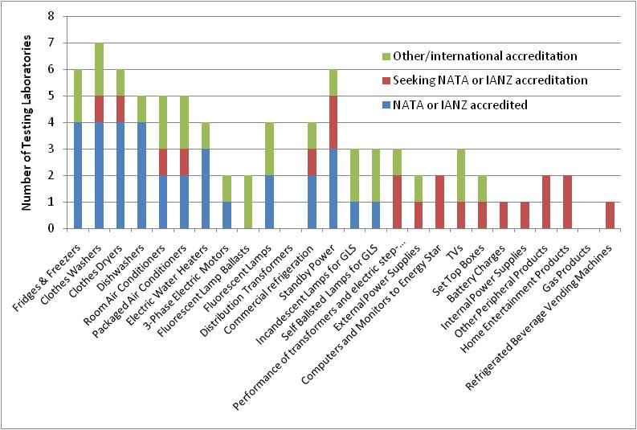
What are the testing Capacities?

