Slide 1
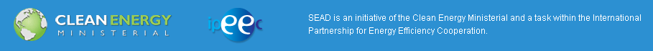
SUPER-EFFICIENT EQUIPMENT AND APPLIANCE DEPLOYMENT INITIATIVE
39th APEC EGEE&C
Sydney, Australia
Anna Lising, Senior Associate
CLASP

Slide 2
Upcoming Clean Energy Ministerial Meetings
CEM3:
April 25-26, 2012: London
(CEM3 Pre-meeting held on February 2-3 in New Delhi)
CEM4:
2013: New Delhi
CEM5:
2014: Seoul

Slide 3
















SEAD Today
**Note: China is an Observer to the SEAD Initiative
Australia
Brazil
Canada
European
Commission
France
Germany
India
Japan
Korea
Mexico
Russia
United Arab
Emirates
United Kingdom
United States
South Africa
Sweden

Slide 4
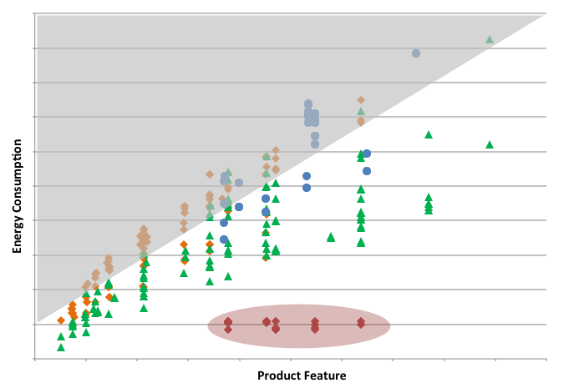
SEAD Goals
“Strengthen the Foundations” via robust Cross-cutting Technical Analysis
“Push” inefficient products out of the market via collaboration on Standards & Labels
“Pull” super-efficient products into the market via Awards, Incentives, and Procurement
Notes:
“raise the efficiency ceiling” by pulling super-efficient appliances and equipment into the market through cooperation on measures like incentives, procurement, awards, and R&D investments;
“raise the efficiency floor” by working together to bolster national or regional policies like minimum efficiency standards;
“strengthen the efficiency foundations” of programs by coordinating technical work to support these activities.

Slide 5
SEAD Goals
Provide a framework for global action on appliance and equipment efficiency.
Engage stakeholders (governments, the private sector, and NGOs) to tap the large global energy savings potential available through improved appliance and equipment efficiency.
Countries participate in working groups that focus on Awards, Public Procurement, Incentives, Technical Analysis, and Standards & Labeling Programs

Slide 6
SEAD Working Groups & Collaborations
Cross-cutting Technical Analysis
Awards
Incentives
Standards & Labels
  Integrative Analysis Subgroup
  Product-specific Collaborations: commercial refrigeration, computers, distribution transformers, motors, network standby, and televisions
Procurement

Slide 7
Cross-Cutting Technical Analysis
Goal: To “strengthen the foundations” by:
  Providing techno-economic analysis of product efficiency improvements and their incremental costs, and estimates of energy saving potential at the global and national level.
  Facilitating efficiency program implementation through deployment of an S&L policy analysis toolkit.
Accomplishments
Completed TV techno-economic analysis
Finalizing ceiling fan and room A/C analysis
Coordinating mapping & benchmarking activities with IEA 4E and its annexes
Notes:
Mapping & Benchmarking:
Representatives from SEAD and CLASP are collaborating with IEA 4E Mapping & Benchmarking Annex on plans for new or updated product studies.
Intend to finalize plans in first quarter of 2012.
Goal is to ensure work activities are complementary and to avoid overlap.

Slide 8
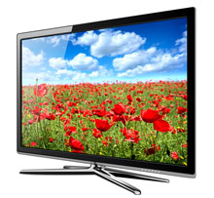
Awards
Goal: To “raise the efficiency ceiling”
Identify the most energy efficient product to the consumer
Incentivize manufacturers to innovate around energy efficiency
Accomplishments
Launch of SEAD Global Efficiency Medal competition for energy-efficient flat-panel televisions
Launch | Jan 6, 2012
Nomination Period | Feb 1 to May 31, 2012
Verification Testing | Jul 16 to Sep 15, 2012
Winner Announcement | Oct 1, 2012 (holiday season)

Slide 9
Incentives
Goal: To “raise the efficiency ceiling” through the development and implementation of energy efficiency incentive programs to:
  Increase market penetration of energy efficient appliances by encouraging manufacturers to produce and consumers to purchase highly efficient products
  Facilitate peer-to-peer information sharing on best practices related to incentive policies and incentive program design
Current Activities
  Program Design: Region-specific policy recommendations for regulatory reform and policy design; Upstream incentive programs for high-priority products (in partnership with RAP)
  Case Studies: Review of best practices in a guide for governments seeking to implement or improve domestic incentive programs
  Evaluation: Meta-study of incentive program evaluation, with the intent of developing a set of evaluation best practices
Notes:
Note work with RAP

Slide 10
Procurement
Goal: To “raise the efficiency ceiling” by leveraging the bulk procurement power of the public and private sectors to drive more super-efficient appliances into the market
Accomplishments
  Procurement Street Lighting Evaluation Toolkit
    Allows government procurement officials to simply and quickly evaluate lighting quality, energy consumption, and life cycle costs of street lighting alternatives
    Developed in collaboration with the Alliance to Save Energy
    Published on www.superefficient.org in September 2011
  Procurement Specifications Catalogue
    Energy consuming product specifications for public procurement
    Goal: Gap analysis in terms of energy efficiency and filling gaps
    Collected specifications from Canada, Mexico, Sweden, the Netherlands, Denmark, and the US

Slide 11
Standards & Labeling
Goal: To “raise the efficiency floor” by fostering peer-to-peer technical information exchange to help strengthen standard-setting work by participating governments and facilitate international harmonization of test methods.
Accomplishments
Established product-specific technical and policy collaborations in six key product areas:
Assembled database of regulatory/legislative activity schedules on product standards and labeling by participating governments;
Analyzed impact of actions completed or initiated since the launch of SEAD.
Commercial Refrigeration | Televisions
Distribution Transformers | Network Standby
Computers | Motors

Slide 12
SEAD S&L Product Collaborations
Product Collaboration | Participating Governments
Commercial Refrigeration | Canada, Germany, Japan, Korea (chair), Mexico, UK, US
Computers | Australia, Canada, Japan, Korea, UK (chair), US
Distribution Transformers | Australia, Canada (chair), Japan, Korea, UK, US
Motors | Australia, Canada, Japan, Korea, UK, US (chair)
Network Standby | Australia (chair), Canada, Japan, Korea, UK, US
Solid-State Lighting | Australia, Canada, France, Germany, Japan, Korea, Mexico, UK, US
Televisions | Australia, Canada, France, Japan, Korea, UK, US (chair)
Possible future product collaborations:
Lighting: SSL and CFL
Air-Conditioners
Heat Pumps
Notes:
Commercial Refrigeration
Milestones:
Identified 4 product categories to focus collaboration activities: retail display cabinets, commercial service cabinets, vending machines, and commercial version of domestic refrigerators
Collated information on existing policies and scheduled regulatory activities for participating governments
Current and Future Activities:
Conduct gap analysis of existing programs to progress harmonization of test procedures and standards
Establish energy consumption baselines for each product and develop toolkits that can be adopted by countries to assist the launch or acceleration of national programs
Computers
Proposed activities:
Harmonization of standards and test methods for desktops, integrated desktop PCs, notebooks, workstations, thin clients, small scale servers, tablet PCs, mobile workstations, and power supply units
Develop toolkits that would include a SEAD-endorsed test method and level definitions to assist the launch or acceleration of national programs
Distribution Transformers
Current and Future Activities:
Conduct technical analysis of test methods
Harmonization of test methods
Define criteria for determining harmonized level definitions Collect data on transformer stock, material availability, installation issues, transformer loading, and the effect of a retrofit and refurbishing market
Motors
Current and Future Activities:
Evaluate and draft harmonized compliance, certification, and enforcement requirements
Define product scope for expansion of electric motors
Televisions
Current and Future Activities:
Information sharing on television S&L programs to identify harmonization opportunities
Potential projects include testing 3D and OLED televisions and analyzing how the increased use of network-connected TVs will influence energy efficiency and standards programs
Network Standby
Milestones:
Established a technical advisory committee, which recommended and prioritized projects for the collaboration’s 2012 work plan
Current and Future Activities:
Develop test procedures to accurately measure network standby
Conduct field studies to measure effects of network standby
Identify consumer expectations, user acceptance, and consumer levels of tolerance for network standby products

Slide 13
For more information:
Visit the SEAD website at www.superefficient.org
Contact Anna Lising at alising@clasponline.org with questions or comments.

