Slide 1
Progress Report of Low-Carbon Model Town (LCMT) Project
Oct. 2017
LCMT-TF Secretariat
METI, Japan

Slide 2
Background, APEC LCMT Project
Declaration of the 9th APEC Energy Ministerial Meeting
(Fukui, Japan, Sep. 2010)
- Establish a Task Force (LCMT-TF)
- Develop the concept of Low Carbon Town
- Share best practices
To encourage creation of low-carbon communities in urban development plans
Instruction of the 12th APEC Energy Ministerial Meeting
(Cebu, the Philippines, Oct. 2015, Extract)
We instruct the LCMT-TF to move the current LCMT Project into the next stage in order to disseminate Low-Carbon Towns in the Asia-Pacific region.

Slide 3
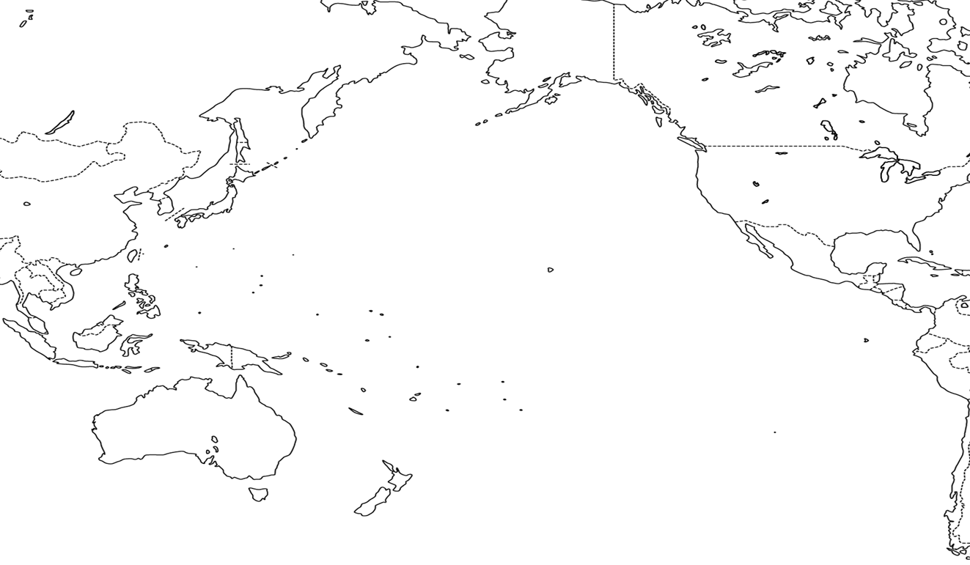
Case Towns of Feasibility Study and Policy Review
Phase 7
Krasnoyarsk
Russia
Phase 1
Tianjin
China
Inland region with high demand for heating and cooling
Central
Business
District(CBD)
Phase 3
Da Nang
Viet Nam
Phase 6
Mandaue
Philippine
Redeveloping
mixed-use
urban district
Cooperation with neighboring cities
Phase 4
San Borja
Peru
Phase 2
Samui
Thailand
Phase 5
Bitung
Indonesia
Residential areas
Island
resort area
Industrial area

Slide 4
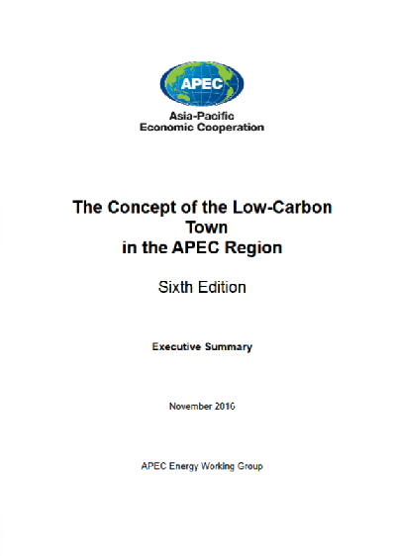
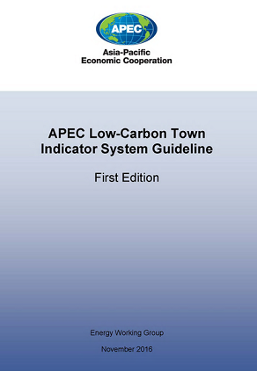
The Concept and the LCT-Indicator System
The Concept of the Low-Carbon Town in the APEC Region (Sixth Edition)
http://publications.apec.org/publication-detail.php?pub_id=1796
APEC Low-Carbon Town Indicator System Guideline (First Edition)
http://publications.apec.org/publication-detail.php?pub_id=1797

Slide 5
APEC Low Carbon Town-Indicator system
Image of assessment result
Overall Assessment Result
Overall Rank
Radar Chart
Demand Side
Governance
Supply Side
Total Point
average of (1)to(15)
2.5
CO2 Reduction
Environment & Resource
Demand & Supply Side
470
t-CO2/year
Individual Assessment (more than 30 items)
Required ・・・
Optional ・・・
Total (average)

Slide 6
Transition of LCMT Project
Phase 1 – Phase 6 (2011-2016)
Refinement of the “Concept” (including the LCT-I System)
Feasibility Study (full scale)
of the Case Town
Policy Review
of the Case Town
Phase 7 (July 2016 - December 2017)
Feasibility Study (full scale)
of Krasnoyarsk city
Policy Review
of Krasnoyarsk City
Volunteer Towns
Nomination/Selection
LCMT Symposium
（Sep. 2017)
Dissemination Phase 1 (Aug. 2017 – Dec. 2018)
Feasibility Study (specific area) of 3 Volunteer Towns
Volunteer Towns
Nomination/Selection
2nd LCMT Symposium
Dissemination Phase 2 (The Concept Note to be submitted for APEC fund)
Feasibility Study (specific area) of Volunteer Towns
Volunteer Towns
Nomination/Selection
3nd LCMT Symposium

Slide 7
Transition of LCMT Project
Krasnoyarsk city
FS Consultant: Nikken Sekkei Research Institute
Phase 7 (July 2016 - December 2017)
Feasibility Study (full scale)
of Krasnoyarsk city
Policy Review
of Krasnoyarsk City
Volunteer Towns
Nomination/Selection
LCMT Symposium
（Sep. 2017)
Banda Aceh City, Indonesia
Hang Tuah Jaya, Malaysia
Shah Alam City, Malaysia
FS Consultant will be selected through open tendering process
Dissemination Phase 1 (Aug. 2017 – Dec. 2018)
Feasibility Study (specific area) of 3 Volunteer Towns
Volunteer Towns
Nomination/Selection
2nd LCMT Symposium
Call for nomination - Next Volunteer Towns

Slide 8
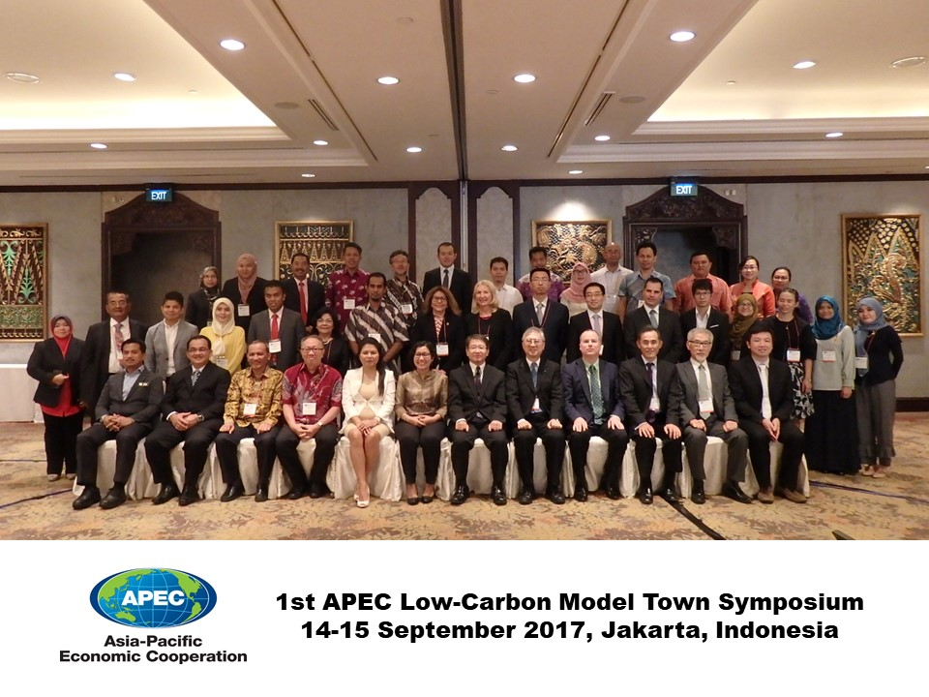

Slide 9
Key Objectives of Dissemination Phase
To disseminate the basic ideas and effective approaches of the Concept through utilizing the LCT-I System, which helps evaluate the progress and status of low-carbon development of various area in the APEC region;
To provide Feasibility Studies of a specified area of low-carbon development projects selected as the LCT-I volunteer towns in the LCMT Project and identify how to improve the low-carbon development plans through the Feasibility Studies; and
To share best practices and real-world experiences of low-carbon town design with planners and policy makers throughout the APEC region.

Slide 10
Thank you for your kind attention!

