Slide 1
Korea’s
Testing & Compliance for
Standards & Labeling
< 39th APEC EGEE&C Meeting >
February 27-28, 2012
Jennifer KIM
jennifer@kemco.or.kr
KEMCO

Slide 2
Contents
Overview of Korea’s Energy Efficiency programs
Major Compliance Issues in Korea
How to Improve Compliance rates
Korea’s Testing Capacities
KEMCO

Slide 3
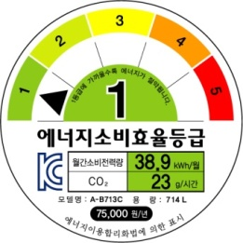

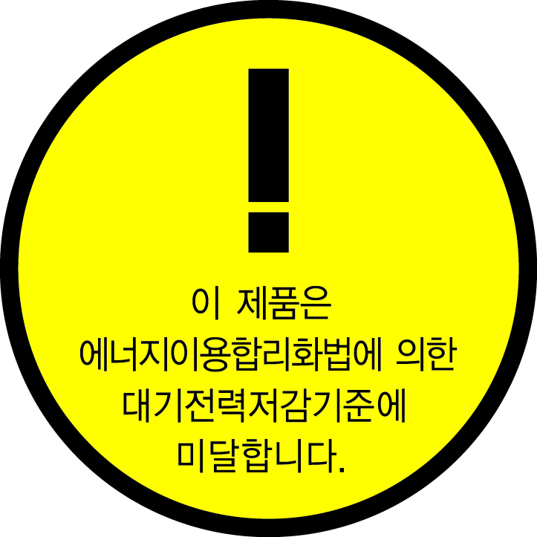
Overview of Korea’s EE Program
3 programs in Energy Labels & Standards
Energy Efficiency
Label and Standard Program
(including MEPS)
Mandatory
5-grade labeling & MEPS
37 items : Refrigerators, Air-conditioners,
TVs, Window sets, etc
High-efficiency Equipment
Certification Program
e-Standby Program
Voluntary
34 items : LED Lighting
equipment, etc
Mandatory & Voluntary
Standby Korea 2015
22 items : Computers, etc
KEMCO

Slide 4
Overview of Korea’s EE Program
New Target Products
in Energy Efficiency Label & Standards Program
Electric fan heaters, Electric stoves (Dec. 15th. 2011)
VRF multi-split heat pumps (April. 1st. 2012)
TVs, Window sets, Transformers, Dehumidifiers
(July. 1st. 2012)
Tyres (Dec. 1st. 2012)
New Target Products in e-Standby Program
Servers, Hand dryers (July. 1st. 2011)
KEMCO

Slide 5
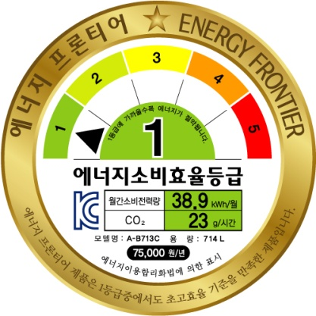
Major Compliance Issues I
Adopting the Standards of Energy Frontier
What is Energy Frontier?
- Target consumption efficiency
or target energy use standards
for ULTRA HIGH efficiency products
where the energy efficiency is 30~50% higher
than 1st grade efficiency.
- The standards for Energy Frontier are upgraded
in every 3 years.
KEMCO

Slide 6
Major Compliance Issues I
Adopting the Standards of Energy Frontier
What is Energy Frontier?
- From 2012, Energy Frontier is
applied to TVs, Refrigerators,
Air conditioners and Drum washing
machines where their technology and efficiency
levels are world class.
What kinds of incentives will be given to Energy Frontier products?
KEMCO

Slide 7
Major Compliance Issues II
Accomplishments of the Standby Korea 2010
First phase (2005~2007)
Voluntary 1W policy
Second phase (2008~2009)
Preparatory period for stable transition to mandatory regulation and mandatory regulation is in effect for limited products
Third phase (from 2010)
Mandatory 1W policy
KEMCO

Slide 8
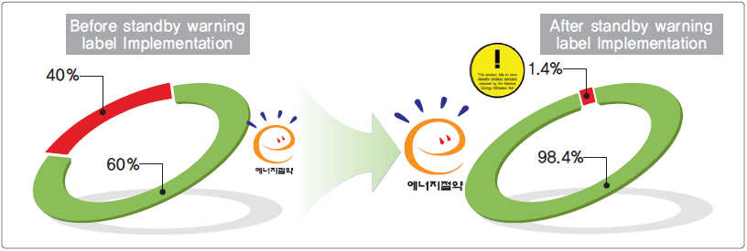
Major Compliance Issues II
Accomplishments of the Standby Korea 2010
KEMCO

Slide 9
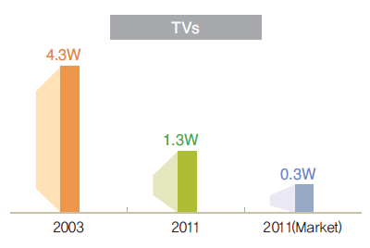
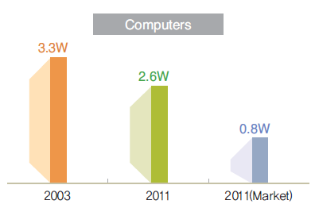
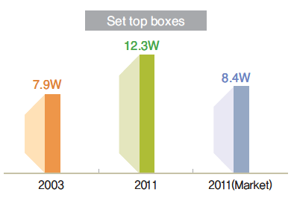
Major Compliance Issues II
Accomplishments of the Standby Korea 2010
Can we reduce the standby power of Set top boxes?
Do we have PLANS after Standby Korea 2010?
KEMCO

Slide 10
Major Compliance Issues II
Establish Plans for Standby Korea 2015
Standby Korea
2015
Standby Power 0.5W
by 2015
Networked standby
: Mandatory of Set-top boxes’ Passive standby power mode
Adopting TEC
(Typical Energy Consumption)
: Computers, etc
Adopting On-mode
: Monitors
KEMCO

Slide 11
How to Improve Compliance rates I
PR [Public Relation]
Web sites, press release can help stakeholders
do their duties when the new regulations are
phase in and the regulations are changed.
Holding public hearings and presentation
meetings are one of the best way to improve
compliance rates.
KEMCO

Slide 12
How to Improve Compliance rates II
Monitoring Program
Monitoring is very important and necessary to
operate the S&L Program.
In case of violation, heavy punishment can help
improve compliance rates.
Challenge Process :
Stakeholders (Manufactures, Consumer Protection
Board, etc) can request for check test and require
the follow-up conducting.
KEMCO

Slide 13

How to Improve Compliance rates II
Status of Monitoring program of
Energy Efficiency Label and Standard program
2011
total : 203 models
offences : 12 models
2010
2009
total : 184 models
total : 179 models
offences : 10 models
offences : 9 models
KEMCO

Slide 14
How to Improve Compliance rates III
Incentive
Financial rebates
Priority purchase from the public procurement
service
Mandatory use by public organizations
Mandatory or recommended consideration of
building codes
Financial supports for testing fees
KEMCO

Slide 15
Korea’s Testing Capacities
Independent Testing Laboratory
Self Testing Laboratory
The scope of test items for “Regulation on
energy efficiency label and standards” shall be
accredited by “National Standard Law Article 23”
Persons and facilities are qualified with “Korea
Laboratory Accreditation Scheme, Article 35”
by “National Standard Law Article 23”
KEMCO

Slide 16
Korea’s Testing Capacities I
Independent Testing Laboratory (25 Labs)
Refrigerators
KTL, KTC, KTR, KRAAC, Busan TP, Intertek
Compact Fluorescent Lamps
3 phase induction motors
KERI, KTL, SBC, KTC, Gyeong-Nam TP
KTL, KTC, KILT, KTR
Self Testing Laboratory (1 company)
Refrigerator,
Kimchi refrigerators,
Washing machines,
Drum Washing machine
Daewoo Electronics
KEMCO

Slide 17
Korea’s Testing Capacities II
Independent Testing Laboratory (25 Labs)
LED Lamps
(internal/external converter)
Gwangju-Jeonnam SMBA, KTL, KTC, KOPTI, KILT, KTR
Pumps
KTL, KTC, SBC, Gyeongnam Regional Office SMBA
KEMCO

Slide 18
Korea’s Testing Capacities III
Independent Testing Laboratory (29 Labs)
Modem, Home gateway
KTC, KERI, TTA
Computers, Monitors,
Printers, etc
KTL, KTC, KTR, TTA, Nemko Korea, Digital EMC, IST, SK TECH, CTK etc.
Self Testing Laboratory
Computers
Samsung Electronics, LG Electronics, TG Computers, etc.
Printers, Multifunctional Devices
Canon Korea, Fuji-Xerox, etc.
KEMCO

Slide 19

Thank you!!
For more information,
E- mail : jennifer@kemco.or.kr
KEMCO homepage : http://www.kemco.or.kr/eng
KEMCO

