Slide 1
TESTING AND COMPLIANCE
FOR STANDARD AND LABELLING
Indonesia
The 39th APEC EGEEC Meeting
Sydney, Australia, 27-28 March 2012

Slide 2
GOVERMENT REGULATION NO. 70/2009 ON ENERGY CONSERVATION
Gov’t Regulation No.70/2009
on ENERGY CONSERVATION
CONTENT
1
2
3
4
5
RESPONSIBLE OF CENTRAL GOV’T, LOCAL GOV’T, PRIVATES,
AND COMMUNITY
IMPLEMENTATION ON ENERGY CONSERVATION
STANDARD &
LABEL
FACILITATION, INCENTIVE & DISINCENTIVE
GUIDANCE AND SUPERVISION
energy performance standard for electric appliances , and energy efficiency label
Energy efficiency label should be implemented by producer and importer of energy appliances
Notes:
Since the issuance of government regulation no. 70/2009 on the conservation of energy, then at least there are 5 great work that needs to be done:
All components of society, both government and private sector needs to have responsibility for energy saving efforts
Producer energy (including power generation, transmission lines, power distribution and use of energy such as industrial and commercial building should make efforts in energy savings without decreasing the quality of service
In future the government will also provide facilities and incentives for energy conservation.
To implementation of energy conservation program, the government will make guidance and supervision to support the success of this program

Slide 3
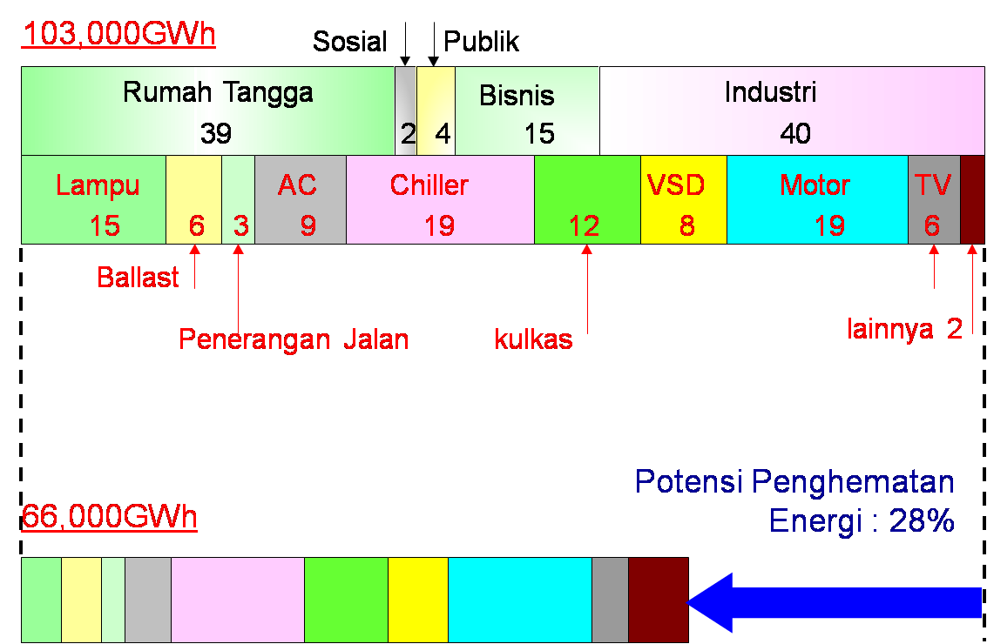
Potensial Electricity Saving from Household Appliances
Electricity consumption by consumer category and by appliances 2005 (%)
Social
Public
Household
Business
Industry
Lighting
Ballast
Street Lighting
Refrigerator
Others
36%
Potential Electricity Saving
Notes:
3

Slide 4
Energy Efficiency Label : SNI 04-6958-2003 (Comparative Label)
LOGO
4 stage rating system
EE level
Product model
Registration No.

Slide 5

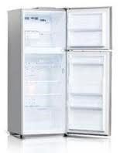
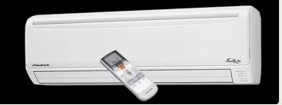
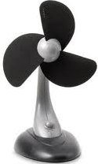
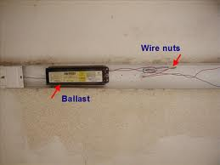
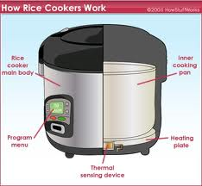
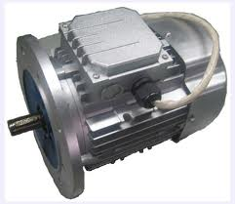
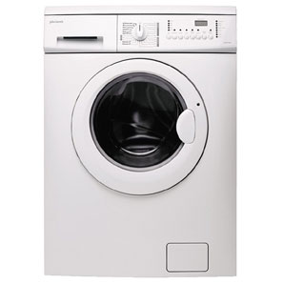
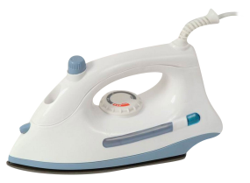
Target Products for Labeling
Compact Fluorescent Lamp
Refrigerator
Room Air Conditioner
Television
Electronic Ballast
Electric Fans
Electric Iron
Rice Cooker
Motor
Washing machine

Slide 6
S & L Plan in 2011 - 2015
 | Year
 | 2011 | 2012 | 2013 | 2014 | 2015
CFL
Refrigerator and Air Conditioner
Electric Ballast, fan, and TV
Rice cooker and Electric motor
Elecric iron and Washing machine

Slide 7





Product Standardization Policy and
Regulation Authority
REGULATION AUTHORITY
STANDARDIZATION
DISTRIBUTION
ENERGY EFFICIENCY
PERFORMANCE STANDARD
SAFETY STANDARD
MINISTRY OF ENERGY AND MINERAL RESOURCES
MINISTRY OF TRADE
MINISTRY OF INDUSTRY
NEED INTENSIVE AND CLOSE COORDINATION AMONG THOSE MINISTRIES
Notes:
After some intensive discussion among Ministry of Energy and Mineral Resources, Ministry of Industry and Ministry of Trade, the policy and regulation authority of the SNI dan EE Labeling seems to be as the following.
First, the EE standard will be put on the top of SNI. It means that to get EE label, the product have to pass the SNI standard and get the SNI label. So, only the product having SNI label can be applied to get the EE label.
Second, the standardization of EE label is responsibility of MEMR, and for SNI is responsibiliy of MOI.
Third, the monitoring for product distribution in the market is responsibiliy of Ministry of Trade.
This scheme has not yet been formally approved, but the discussion among those ministries so far, seems to be convergerd to his scheme.
In general it seems to be a conclusion for the coordination mechanism among those ministrise. But still there are many homework to be completed in order to make the implementation of EE labeling implemented.

Slide 8
LS Pro & Testing Laboratory
LS Pro
Acredited by KAN or appointed by Government
Issue Product Certification.
Testing Lab
Acredited by KAN or appointed by Government
Verify Testing Result.
Issue Testing Result & Opinion.
Arrange Testing.
Independent
Check & ensure all provided data are correct.
Perform Testing based on Testing Standard and criteria.
LS Pro : Labeling Certification Body

Slide 9
LS Pro & Testing Laboratory on ESL Program
Producer/Importer
Accredited LS-Pro
Accredited Testing Laboratory
Proposed
Processing Time
(Depend on Product)
Application
Contract
2 days
Had Product tested by Accredited Lab
No
Perform
Testing
14-30 days
Yes
Revision/
Correction
No
Testing Result Verification
Testing Result
2 days
Yes
Product Certificate
Issue Product certification
1 day

Slide 10
Availabel Testing Lab
Government
P3TKEBTKE
Private
PT Sucofindo
PT Panasonic
B4T
BPPT
LIPI
BPMB
PT Polytron
Baristan
PLN LitBang

Slide 11
Testing Capability of Laboratories
Products | Available Laboratories | Number of Accredited Labs
CFLs | 8 | 5
Refrigerator | 6 | 1
AC | 3 | 1
TV | 3 | N/A
Ballast | 10
Fan | 1 | N/A
Rice cooker | 3 | N/A
Motor Pump | N/A | N/A
KAN = National Acreditation Committe

Slide 12
MINISTERIAL DECREE NO. 6 YEAR 2011 ON ENERGY EFFICIENCY LABELING FOR CFL
The manufacturer or importer must issue a written declaration of conformity before the EE Label put in that product.
Declaration of conformity submitted to the Ministry of Energy and Mineral Resources cq DG NREEC.
Violations of the provisions of the Declaration of conformity may be sanctioned according to regulations.
CFL production in domestic that do not bear signs of energy-saving label is pulled from the market.
CFL imports that do not bear the label of energy saving signs are prohibited entry into Indonesia and must be re-exported or destroyed.

Slide 13
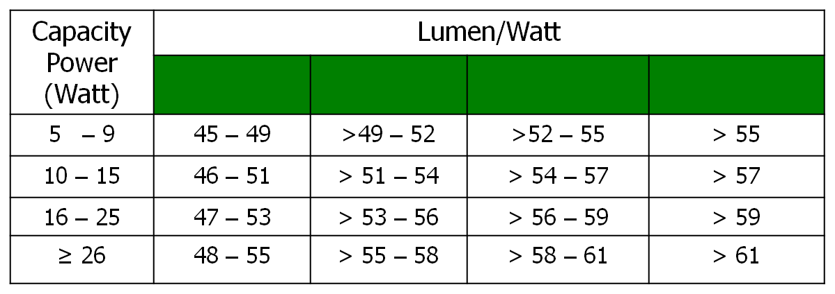
Energy Efficiency Rating for CFL
MEMR Regulation No. 06/2011 on Energy Efficiency labeling (star rating) for CFL
Presently 4 Manufacturers already informed their willingness to put EE label in their products in 2012.
The Government plan to release the EE Labeling CFL in the Market by April 2012
.

Slide 14
Barriers on Implementing of Labeling Program
Policy and Regulation Aspects
Government Regulation No. 70/2009 mandates the producer/importer to implement energy efficiency labeling for home appliances, however there is lack of guideline to implement this regulation
Bureaucracy is too convoluted, too many regulation body are included in systems
Technical Aspects
Lack of accredited testing laboratories and labeling certification body
Not all appliances already had performance standard
Most of the appliances do not have energy efficiency rating
Lack of human resource capacity on testing laboratories
Lack of support from Industrial assosiation
Economic and Social Aspects
High efficient products are costly, and domestic market is low price oriented
Lack of knowledge and awardness on energy saving

Slide 15
Thank You

Slide 16
The Question :
What are the major compliance issues faced by your economy
What would help your economy to improve compliance rate
What testing capacities exist within your economy

