Slide 1
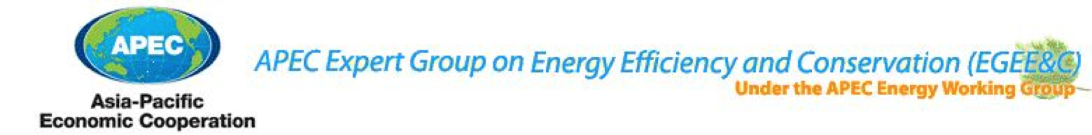
Survey of market compliance mechanisms for energy efficiency programs in APEC economies
Mark Ellis
Mark Ellis & Associates

Slide 2
Today
Context to the APEC EGEE&C Compliance Project
Progress with the APEC Compliance Survey
Preliminary Results of the Survey
Ideas for the Workshop

Slide 3
Terminology - what are we talking about?
All S&L programs have ‘rules’
  Mandatory and voluntary programs
  In legislation, regulation or administrative guidelines or a combination
The rules establish the processes to be followed by stakeholders
  The rules vary (although there are only a few basic models)
  Scheme design influenced by existing legislation, political ambition, national governance issues, resources (in-house and external), stakeholder attitudes, etc
  Obligations may apply to different stakeholders: suppliers, importers, retailers, wholesalers, on-line suppliers, etc
“Compliance” means adherence to these sets of rules
The “compliance regime” is the monitoring, verification and enforcement processes and activities used by an economy to ensure compliance

Slide 4
Aims of compliance regimes
Common to ‘Best Practice’ compliance regimes in many sectors
To encourage stakeholders to be compliant:
  Make sure all stakeholders understand their obligations
  Minimise the transaction costs for demonstrating compliance
  Increase the risk that instances of non-compliance will be discovered
  Take corrective action quickly to minimise damage (to all)
  Make penalties proportional to the extent of transgression but sufficient to be an effective deterrent
  Taking corrective action visibly to deter others

Slide 5
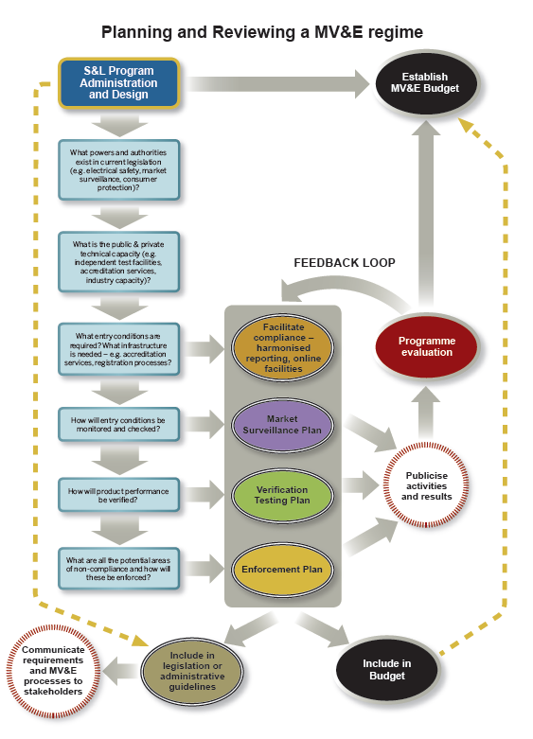
Key Elements
These key elements are interrelated :
Facilitate compliance - info & processes
Market surveillance
Verification testing
Enforcement
Communication, reporting, feedback
Legal and administrative framework
Budget
Evaluation
Effective compliance regimes include all of these elements

Slide 6
2011-12 APEC ECEE&C Project
    APEC Project Survey similar to surveys in Europe (2009) & G20 (2010) for comparable results
Phase 1 – Conduct Survey of Energy Efficiency Market Compliance Strategies
Phase 2 – Reporting of results
Phase 3 – Outreach Workshop on Best Practice

Slide 7
Background to the APEC Project
2008: IEA International Conference, Paris: “Meeting Energy Efficiency Goals: Enhancing Compliance, Monitoring and Evaluation”
2009: Survey of EU Member States (Fraunhoffer)
2010: Survey of EU Member States (ATLETE)
2010: Survey of G20 countries +Tunisia & Chile (CLASP, Ellis)
2010: “Compliance Counts: A Practitioner’s Guidebook on Best Practice Monitoring, Verification, and Enforcement for Appliance Standards & Labeling” (CLASP, Ellis)
2010: IEA Policy Pathways: “Improving compliance within equipment energy efficiency programmes”
2010: 4E London Conference “Saving More Energy Through Compliance”
2010/11: Survey of EU Member States (CLASP, Navigant)
2011/12: Survey of APEC economies & Workshop

Slide 8
Summary of international & regional activities
 | 2008 | 2009 | 2010 | 2011 | 2012
International conferences | IEA |  | IEA 4E / CLASP |  | APEC Workshop
Surveys |  | EU | EU G20 | EU APEC
Best Practice Publications |  |  | CLASP IEA

Slide 9
APEC Project
2008 IEA workshop concluded:
  Insufficient attention paid to ‘compliance’ issues by many programs – given the impact on savings
  Opportunities for economies to learn from one another to improve MV&E processes and to collaborate to improve enforcement
  Need to better understand compliance regimes in different economies and establish mechanism for sharing
APEC EGEE&C project an important contribution to this international picture

Slide 10
APEC EGEE&C Survey
Aims to:
Describe the compliance regime in APEC economies for Standards and Labelling (S&L) energy efficiency programs
Provide information on compliance activities where possible
Identify ‘good practice’, interesting approaches, etc
Identify common issues, concerns, areas for improvement
Compare results to surveys in other regions
It does NOT aim to:
Compare or rank each economy (no objective measure)

Slide 11
Survey procedure
Survey designed and distributed to economies
Completed surveys returned
Follow-up questions
Research
Draft country summaries returned for approval
Analysis & draft report for comment
Final report

Slide 12
Economy-Program Coverage
 | Standards | Comparative Label | Endorsement Label | Endorsement Label (ENERGY STAR)
Australia | ✓ | ✓ | O | ✗
Canada | ✓ | ✓ | O | ✓
Chile | ✗ | ✓ | O | O
China PRC | ✓ | ✓ | ✗ | O
Chinese Taipei | ✓ | ✗ | ✓ | ✗
Hong Kong, China | O | ✓ | ✓ | O
Indonesia | ✗ | ✗ | ✓ | O
Japan | ✓ Top Runner | ✓ | ✗ | ✗
Korea | ✓ | ✓ | ✓✓ | O
Malaysia | ✗ | O | ✓ | O
Mexico | ✓ | ✓ | ✓ | O
New Zealand | ✓ | ✓ | O | ✗
Peru | O | O | ✓ (ELI) | O
Philippines | ✓ | ✓ | ✗ (ELI) | O
Singapore | ✓ | ✓ | O | O
Thailand | ✓ | O | ✓ | O
USA | ✓ | ✗ | O | ✓
Vietnam | ✓ | ✓ | ✓ | O
KEY
✓ | Covered
✗ | Program but not covered
O | No program

Slide 13
APEC survey coverage
18 economies – all have one type of program
50 Standards and Labelling programs

Slide 14
APEC S&L Programs - overview
Some mature programs (USA, Australia, Mexico)
  other new programs (Indonesia, Vietnam, Singapore)
Some with many products (USA, Canada, Korea, China)
  and with fewer products (Malaysia, Philippines)
Provides good opportunity to share experience and expertise
Some programs under consideration or about to start
  MV&E regime to be designed (Vietnam, Indonesia, Peru)
Some mature programs improving systems (US DOE, US ENERGY STAR, Australia)

Slide 15
Issues – MV&E design
A small number of different ‘models’:
  Third-party certification prior to entry – verification by third-party (Canada, US Energy Star, Chile)
  Registration prior to entry – verification government agencies (Australia/NZ, Singapore)
  Small variations e.g. industry certification
Examples of each type that appear to work well

Slide 16
Issues - MV&E design

Slide 17
Issues - legal & organisational framework for MV&E
Most programs appear to have adequate legal basis
  Although some enforcement procedures appear unwieldy
  Not many examples of public guidelines on MV&E processes
  Voluntary labels tend to be less ‘regulated’
Majority of respondents were able to clearly identify the entity or entities responsible for MV&E
  Market surveillance/monitoring & enforcement may be the responsibility of separate organizations
  may be justified to avoid the potential for conflicts of interest
  issues of co-ordination that need addressing

Slide 18
Issues - resources
Only a few programs replied to questions on overall budgets or expenditure on individual activities
Does this indicate:
  A lack of defined budget allocations?
  Our contact is sufficiently senior?
  Unwillingness to divulge?
  Other?

Slide 19
Labelling display surveillance
Most labelling programs undertake some market surveillance
  Increasing in recent years- extending to on-line sales
  But few have readily available records on the extent follow-up activities

Slide 20
Verification testing & enforcement
Most programs have some process for verifying claimed performance
Quantity of testing varies considerably
Individual test costs vary considerably by product
  some much more expensive
Issues of costs (budget) & capacity (capable test facilities)
Very little data on enforcement action
Issues of record keeping, capacity to respond (human, authority, culture)

Slide 21
Public disclosure

Slide 22
Public disclosure
Less public disclosure than other regions
  Applies to MV&E activities and results
Tends to be less where third-party certification is involved

Slide 23
Preliminary conclusions
Findings very consistent with previous studies
Programs are increasingly aware they need to address compliance
Most programs appear to have adequate legal basis
  Some enforcement procedures appear unwieldy – need to ensure that enforcement actions can be scalable to match degree of transgression
All respondents were able to clearly identify the entity or entities responsible for MV&E. MV&E may be the responsibility of separate organizations
  issues of co-ordination that need addressing
Significant number of programs appear to lack planning, implementation, record keeping and reporting
  Although several are revising compliance regimes
Opportunity to improve compliance through more public disclosure
  Raising perception that non-compliance will be detected and acted upon

Slide 24
Finalising the report
We wish to make the report as accurate as possible
  We have communicated with 60 people from 18 economies over several months
  Drawn information from over 30 other reports
All respondents have been very generous with their time!
We need a little more effort from each economy to:
  Ensure that the Draft Summary of your economy is accurate
  Respond to our questions seeking clarification

Slide 25
Workshop proposal
2 Days
  Day 1: MV&E S&L Program Practitioners Workshop
  Day 2: MV&E Industry Workshop
  Dinner between Day 1 & 2
Location
  Beijing
Date
  June 2012 (to be confirmed)
  Currently constrained by terms of APEC contract
Host
  China Institute of Standardisation (CNIS)
Sponsors
  CLASP, International Copper Association (ICA), plus others?

Slide 26
 | Day 1
Aim | - To share information on best practice in MV&E design and implementation amongst S&L practitioners in APEC economies. - To provide feedback from the survey of MV&E regimes in APEC economies. - To discuss further initiatives to assist in the development of MV&E amongst APEC economies.
Audience | S&L Program managers and staff responsible for MV&E Related Agency staff where they have a role in MV&E (i.e. enforcement agencies). Mainly government staff.
Content | Presentation and discussion of the survey of APEC economies Presentation and discussion of case studies Discussion of strengths and weaknesses of MV&E regimes in APEC economies Identification of opportunities for collaborations and other initiatives to support MV&E in the region
Number of participants: | 15-25
Materials | CLASP/MEA Best Practice Guidebook Report on APEC Survey

Slide 27
Workshop attendees – responses from EGEE&C delegates to date
Country | APEC Representative to attend conference
Australia | Shane Holt, Tim Farrell and Simone Tiele
Chile | Virginia Zalaquett, Marcelo Padilla
Hong Kong | TBA
Indonesia | Totok Sulistiyanto, Feby Misna, Mr. Harris
Japan | TBA
Malaysia | TBA
Mexico | Fernando Hernandez Pensado
Philippines | Raquel Huliganga, Genesis Ramos
Thailand | TBA

Slide 28
 | Day 2
Aim | - To provide the opportunity for a dialogue between major suppliers and managers of S&L Programs on MV&E issues. - For APEC economies (and perhaps others, e.g. Europe) to explain their MV&E processes to industries supplying appliances. - To discuss further initiatives to assist in the development of MV&E amongst APEC economies.
Audience | Representatives from industry associations in APEC region Representatives from major test laboratories Managers of S&L Programs
Content | Presentation and discussion of MV&E regimes in a selection of major economies Presentation by industry of case study experiences of MV&E processes within companies – challenges and barrier Discussion of opportunities: - to reduce compliance burdens - for collaborations & initiatives to support MV&E in the region
Number of participants: | Approx 50
Materials | Report on APEC Survey

Slide 29
MV&E Workshop organisation
Fix date of workshop
Invite participants for Day 1 from APEC economies
Identify invitees for industry day – EGEE&C DELEGATES assist?
CNIS issue invitations
Finalise Agendas
Approach speakers
Take bookings
Organise catering/dinner
Can we do all this by June?

Slide 30
Thank you
Mark Ellis
mark@energyellis.com
+612 4360 2931

Slide 31
Improving MV&E regimes
Personal opinion
MV&E regimes need sustained investment to plan, establish processes and train staff
Most programs need to plan their approach to MV&E better, and more resources to organise and implement MV&E
The transference of information in MV&E between countries provides an effective means to promote good practice rapidly.
Enforcement capacity can be built through the sharing of data between programs.
Dialogue with participating industry often reveals better ways to integrate MV&E at lower cost.
Greater exploration of industry certification and other schemes.
Programs are always changing – lots of opportunities to do things better!

Slide 32
Possibilities amongst APEC economies - personal opinion
Test facilities
  Better understand the testing capabilities across the region
  Explore ideas for mutual recognition & shared testing resources
  Share experiences with testing facilities
Verification testing
  Share results (see Asia Lighting Compact), notify enforcement actions
  Explore opportunities for co-ordinated testing
  Explore industry role i.e. certification
Facilitation
  Mechanism for communication amongst programs - Regional network of regulators/MV&E authorities (See ADCO in EU)

