Slide 1
50th APEC Expert Group on Energy Efficiency and Conservation APERC’s Energy Efficiency Cooperative Activities Update: Peer Review on Energy Efficiency
Martin Brown-Santirso
4-7 October 2017, Moscow, Russia

Slide 2
1. APERC background

Slide 3
APERC Background
APERC was established in Tokyo in 1996 after the Osaka APEC leaders meeting in 1995
Primary Objectives is to foster a common understanding of energy challenges facing APEC member economies.
Through analysis of the supply and demand outlook,
The development of energy markets, and
Discussion of policy responses

Slide 4
APERC Background
Advisory body to EWG
EGEEC
(EG on Energy Efficiency & Conservation)
EMM
(Energy Ministers Meeting)
EGNRET
(EG on New & Renewable Energy Technologies)
EWG
(Energy Working Group)
EGCFE
(EG on Clean Fossil Energy)
APERC
(Asia Pacific Energy Research Centre)
EGEDA
(EG on Energy Data & Analysis)
LCMT TF
(Low-Carbon Model Town TF)
ERTF
(Energy Resiliency TF)

Slide 5
2. PREE

Slide 6
PREE
Initiated by APEC Energy Ministers’ 2007 Darwin Declaration
Broad review of energy efficiency policies and measure
Provide recommendations on potential improvements
Peer review by visiting experts
PREE has been hosted by 11 Economies
New Zealand, Chile, Viet Nam, Thailand, Chinese Taipei, Peru, Malaysia, Indonesia, Brunei Darussalam, and Mexico.
Follow-up PREE hosted by 3 economies
Viet Nam, Philippines, Thailand.
http://aperc.ieej.or.jp/publications/reports/pree.php

Slide 7
PREE
PREE also includes:
Energy Efficiency Policy Workshop (EEP)
One-day capacity building workshop
Topic selected in consultation with APEC economies
Three carried out to date
Energy Efficiency Policy Compendium
Repository for energy policies of APEC member economies.
Latest update from 2015 available from:
http://aperc.ieej.or.jp/publications/reports/compendium.php

Slide 8
PREE
PREE in Mexico:
6 – 10 March 2017
Team of 11 international and APERC experts including: New Zealand, United States, Thailand, China, Chinese Taipei, Mexico, Philippines, and Japan.
Complete review of energy efficiency in the economy.
Some highlights include:
Mexico is implementing a significant energy reform to liberalize energy markets.
A growing and increasingly wealthy population is likely to increase energy demand significantly in coming years.
Efficiency can provide much needed relief from this growth.
Report will be available before the next EGEEC meeting.

Slide 9
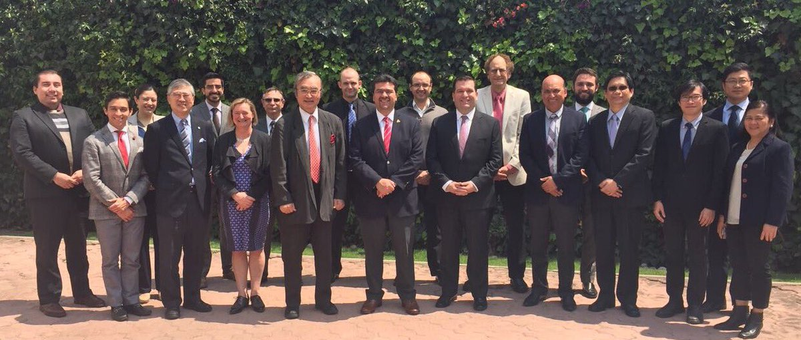
PREE
PREE in Mexico

Slide 10
Energy Efficiency Policy Workshop (EEP)
Held in Jeju Island, Korea
27 March 2017
Hosted in conjunction with EGEEC 49
Topic: Energy efficiency Policy evaluation.
30 Attendees from 15 economies
China, Japan, Korea, Malaysia, Indonesia, Thailand, Philippines, United States, Hong Kong, Chinese Taipei, Mexico, Russia, Vietnam, Malaysia, and New Zealand.
Included international experts presenting best practice case studies.
The summary report will available from the APEC website.

Slide 11
Energy Efficiency Policy Compendium
Published in May 2016
Compendium has been collected in a survey format requiring significant input from economies.
Included responses from 18 economies (Only missing United States, Russia, and Papua New Guinea)
Includes information on the existing policies, government departments in charged of policy, implementation, and existing programs.
http://aperc.ieej.or.jp/publications/reports/compendium.php

Slide 12
3. Next steps

Slide 13
PREE - Next
Preliminary agreement from Malaysia to host Follow up PREE
End of March 2018
Topics: Urban Transport and Thermal Efficiency.

Slide 14
Energy Efficiency Policy Workshop (EEP) - Next
To be held alongside EGEE&C 51
First half of 2018
Economy feedback will be sought for topic selection. Proposed topics:
Policy roadmap development
EE in Industry – Implementation of BATs
EE in Transport – Fuel economy regulations
Behavioural economics – Influencing responses.
Please consult with your economy representative and send feedback to: m.brown-santirso@aperc.ieej.or.jp
Notes:
Road map development - This topic can be applied to all areas of energy efficiency policy. Also, this would enable economies to have rational policy plans for implementation.
Behavioral economics (Influencing Behavior) - This can also be applied to all areas of efficiency. Also, this is an area that has not been explored at EGEEC very much. When this topic was touched briefly on the first EEP and garnered a lot of attention.
Industry adoption of Best Available Technologies (BATs). This is a topic that has not had attention from APERC and has significant potential in APEC. As such it will have strong interest from economies.
Transport (Fleet fuel economy regulation) - This is area of high potential. While many economies have labeling schemes for vehicles, few actually regulate fuel economy. This topic will be of interest to APEC economies.

Slide 15
EEP Framework
Energy efficiency policies
Regulations
MEPS
energy audits & management
Utility obligations
Fiscal measures
Grants, subsidies, tax incentives
Direct procurement of EE
Promotional / market transform
Info campaigns
Labelling / certification
Financial remediation
Revolving funds
Contingent financing
Capacity building
Creation of ESCOs
Training programmes
Pricing mech.
Tiered tariffs
Tech dev’t
Research, dev’t & demonstration
Foundations for energy efficiency
Enabling frameworks
Institutional arrangements
Co-ordination mechanisms
Laws and decrees
Implementing agencies
Governmental co-ordination
Resourcing requirements
Strategies and action plans
Targets
Role of energy providers
Funding mechanisms
Stakeholder engagement
Monitoring & evaluation
Public-private cooperation
International assistance

Slide 16
Energy Efficiency Policy Compendium - Next
Changes to the future of EE Compendium
APERC’s cooperative activities rely on the support of economies to provide quality outputs
Data collection
Results review and endorsement
Workshop participation
In order to reduce the burden to economies APERC intends:
Stop the annual Compendium survey update.
Change the format to make it easier to review and update

Slide 17
Energy Efficiency Policy Compendium - Next
Compendium in 2017
Last major update of Compendium.
New format to display information more clearly and make it more user friendly.
The format more clearly displays the different sections of information, and focuses on short sharp descriptions.
The Compendium will include links to local sources when available to enable researchers access to greater information if needed.

Slide 18
Energy Efficiency Policy Compendium - Next
Timeline
15 economy responses.
Currently being endorsed by EWG prior to Publication
Activity | Schedule | Status
Chapter drafting by APERC | From May 2017 | Completed
Review and edit | July 2017 | Completed
Economy review and endorsement | August 2017 | Completed
Final editing | September 2017 | Completed
EWG Endorsement and Publication | October 2017 | In progress
Upkeep | As needed. | As needed

Slide 19
Energy Efficiency Policy Compendium - Next
Compendium from 2018 onwards:
Information will be updated through the APEC Overview process.
Yearly energy overview of APEC economies
Looks at supply, demand, policy, and major projects.
Including energy efficiency
Ad-hoc updates for individual economies as needed
All the changes aim to provide a more useful output and lower the workload for economies

Slide 20
APERC Requests
Please provide feedback on topic of next EEP
Kindly send comments by email.
Please provide feedback on the new Compendium format
Kindly send emails by email before the end of April.
M.brown-santirso@aperc.ieej.or.jp

Slide 21
Thank you for your kind attention

