Slide 1
USA: Key Energy Efficiency Developments
Cary Bloyd
EGEEC-39
Chinese Taipei
November 7-8, 2012

Slide 2
Presentation Overview
Office of Energy Efficiency & Renewable Energy (EERE) annual appropriation
American Recovery and Reinvestment Act (ARRA) of 2009
State Energy Efficiency Resource Standards
Selected Energy Efficiency Examples

Slide 3
U.S. DOE Energy Efficiency Activities are Led by the Office of Energy Efficiency & Renewable Energy (EERE) (1)*
Advanced Manufacturing Office
  The Advanced Manufacturing Office focused on energy efficiency at the industrial and manufacturing fields
Buildings
  The Building Technologies Program supports building energy efficiency for residential and commercial buildings
Federal Energy Management
  The Federal Energy Management Program (FEMP) provides services, tools, and expertise to federal agencies to help them achieve their legislated and executive-ordered energy, greenhouse gas, and water goals
*http://www1.eere.energy.gov/office_eere/ee_main.html

Slide 4
U.S. DOE Energy Efficiency Activities are Led by the Office of Energy Efficiency & Renewable Energy (EERE) (2)
Weatherization and Intergovernmental
  The Weatherization and Intergovernmental Program provides grants, technical assistance, and information tools to states, local governments, community action agencies, utilities, Indian tribes, and overseas U.S. territories for their energy programs
Vehicles
  The Vehicle Technologies Program helps transition alternative fuels and vehicles into the marketplace.

Slide 5
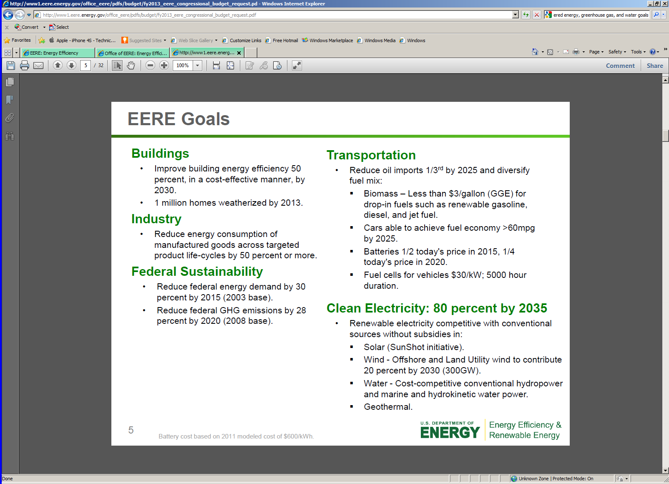
EERE Has Set Clear Efficiency Goals*
*http://www1.eere.energy.gov/office_eere/pdfs/budget/fy2013_eere_congressional_budget_request.pdf

Slide 6
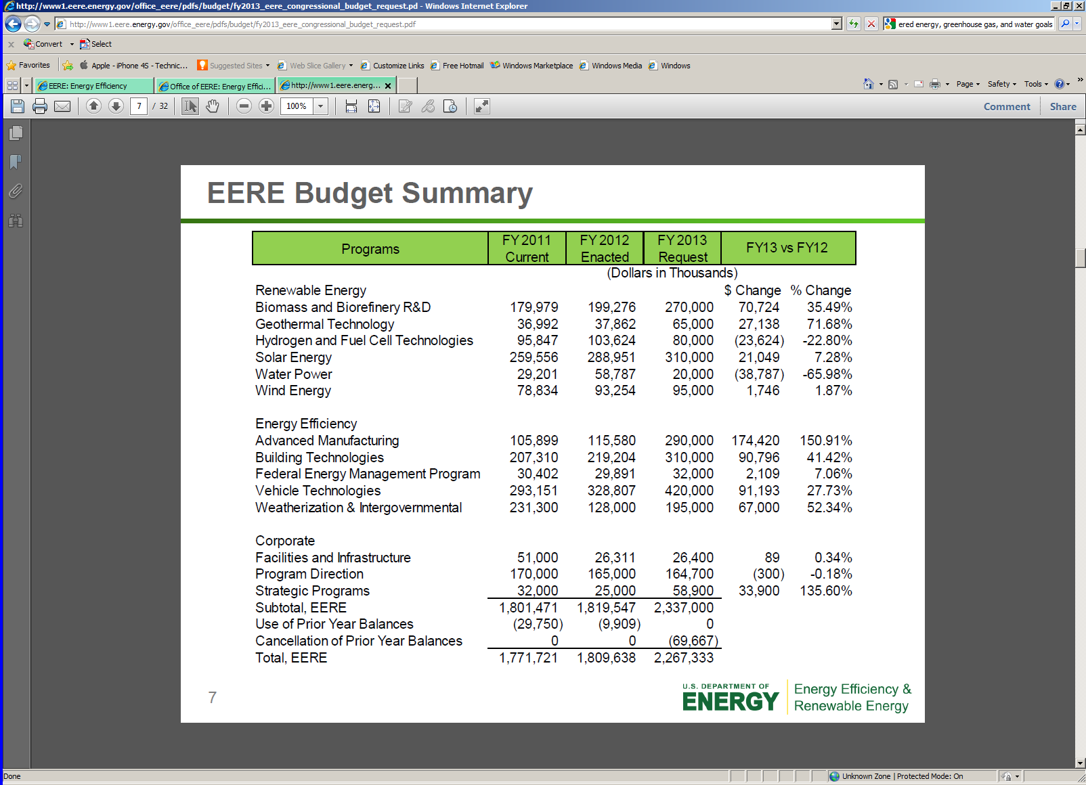
EERE Budget summary

Slide 7
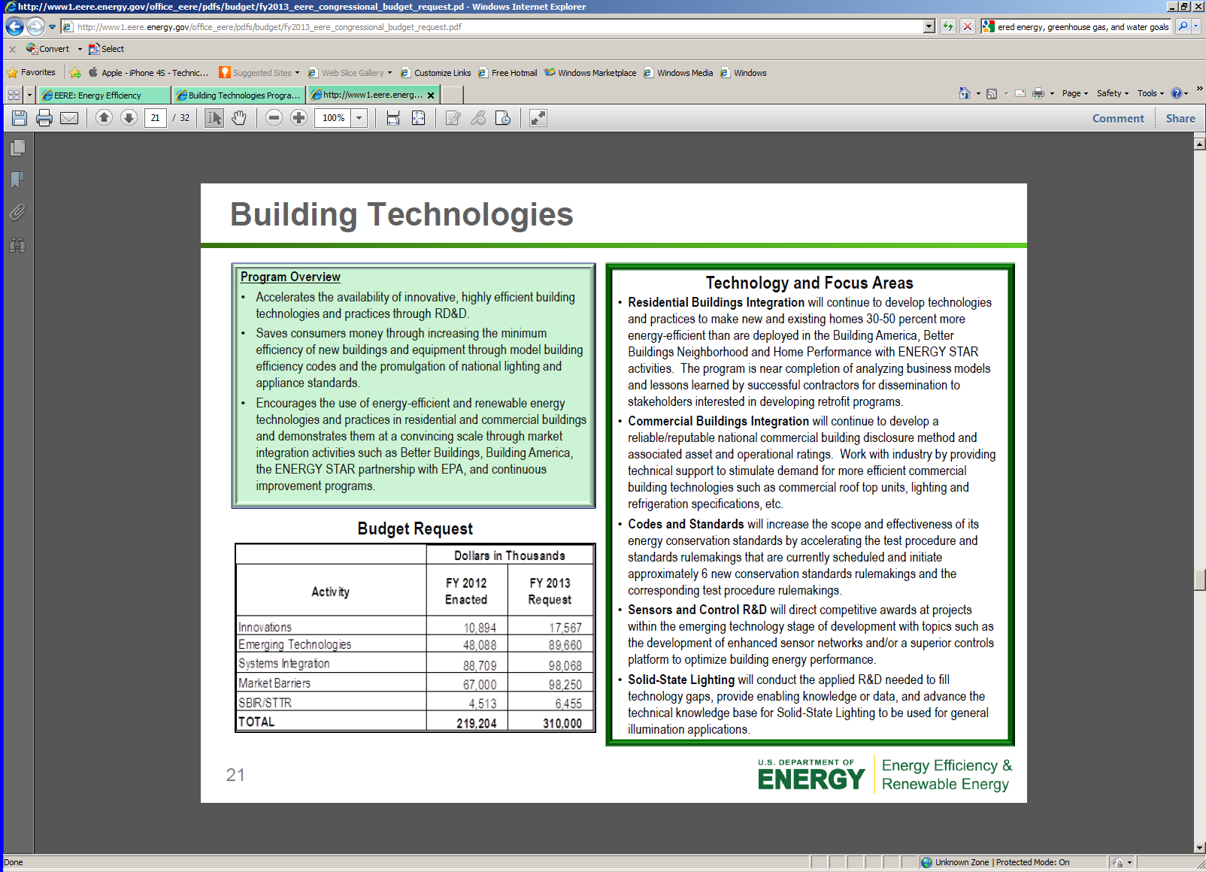
Building Technologies Focus Areas

Slide 8
EERE Received $16.8 billion ARRA Funding (1)*
Building Technologies
  Hi-Efficiency Solid-State Lighting Development
  and Manufacturing $46.2 million
  Advanced Energy-Efficient Building Technologies
  and Commercial Building Training Programs $74.64 million
Federal Energy Management
  Federal Energy Management Program $21.73 million
Industrial Technologies
  Information and Communications
  Technology (Data Centers) $36.02 million
  Industrial Energy Efficiency Projects $160.1million
*http://www1.eere.energy.gov/recovery/

Slide 9
EERE Received $16.8 billion ARRA Funding (2)
State and Local Energy Programs
  Energy Efficiency and Conservation Block Grants $2,800 million
  State Energy Program $3,100 million
  BetterBuildings $ 452 million
Weatherization Assistance
  Weatherization Assistance Program $4,980 million

Slide 10





Energy Efficiency Resource Standards.
www.dsireusa.org / October 2012..
20 states have Energy Efficiency Resource Standards.
(7 states have goals).
Note: See following slide for a brief summary of policy details. For more details on EERS policies, see www.dsireusa.org and www.aceee.org/topics/eers.

Slide 11
EERS Policy Details
Arizona: 22% cumulative electricity savings by 2020; 6% cumulative gas savings by 2020.
Arkansas: 0.75% of 2010 electric sales reduction by 2013; 0.4% of 2010 gas sales reduction by 2013.
California: Varies by utility.
Colorado: Electricity sales and demand reduction of 5% of 2006 numbers by 2018 (statutory requirement); natural gas savings requirements vary by utility .
Connecticut: 4% of retail load (includes CHP and waste heat recovery).
Delaware: Electricity and peak demand savings equivalent to 15% of 2007 numbers by 2015; natural gas savings equivalent to 10% of 2007 natural gas consumption by 2015.
Florida: 7,842 GWh cumulative reductions from 2010-2019 (statewide goal); 3,024 MW cumulative summer peak demand reduction from 2010-2019, 1,937 MW, cumulative winter peak demand reduction from 2010-2019 (statewide goal).
Hawaii: 4,300 GWh reduction in electricity use by 2030.
Illinois: 2.0% reduction of 2008 electricity sales by 2015; 1.1% reduction of 2008 peak load demand by 2018; 8.6% cumulative natural gas savings by 2020.
Indiana: 2.0% electricity sales reduction by 2019.
Iowa: Varies by utility.
Maine: 30% reduction of electricity and natural gas sales by 2020.
Maryland: 15% reduction in per capita energy consumption by 2015, compared to 2007; 15% reduction in per capital peak demand by 2015, compared to 2007.
Massachusetts: Reduce 1,103 GWh electricity in 2012 (statewide); reduce 24.7 million therms by 2012 (statewide).
Michigan: 1.0% annual reduction of previous year retail electricity sales by 2012; 0.75% annual reduction of previous year retail natural gas sales by 2012.
Minnesota: 1.5% reduction of previous 3-year average retail electric sales by 2010; 1.5% reduction of previous 3-year average retail natural gas sales by 2010.
Missouri : 9.9% cumulative electricity savings by2020; an additional 1.9% each year thereafter.9% cumulative peak reduction by 2020; an additional 1% each year thereafter.
New Mexico: 10% of 2005 total retail kWh sales by 2020.
New York: 15% reduction relative to projected electricity use in 2015; gas savings of 112 Bcf annually by 2020.
Ohio: 22.0% reduction of previous 3-year average retail electricity sales by 2025.
Pennsylvania: 3% of projected June 2009 - May 2010 electricity consumption by May 31, 2013; 4.5% of measured June 2007 - May 2008 peak demand by May 31, 2013.
Rhode Island: Varies by utility.
Texas: 25% reduction in annual growth in demand 2012; 30% reduction in annual growth in demand 2013.
Vermont: 320,000 MWh electricity savings (3-year goal for 2012, 2013, 2014); summer peak kW savings: 60,800 (3-year goal for 2012, 2013, 2014).
Virginia: 10% electricity savings by 2022 relative to 2006 base sales.
Washington: Varies by utility.
Wisconsin: 2011-2014: Net annual electric energy savings of 1,816,320,000 kWh; net annual natural gas savings of 73,040,000 therms.
Note: For more details on EERS policies, see www.dsireusa.org and www.aceee.org/topics/eers.

Slide 12
Selected Energy Efficiency Examples*
Report: More Efficient and Renewable Energy Technologies Used in 2011 (10/31/12)
  Americans used less energy in 2011 than in 2010 due mainly to a shift to more energy efficient residential and transportation technologies, according to the Energy Department's Lawrence Livermore National Laboratory (LLNL)
  https://www.llnl.gov/news/newsreleases/2012/Oct/NR-12-10-08.html
Energy Department Partnership to Certify Zero Net-Energy Ready Homes (8/22/12)
  The Energy Department on August 20 announced a new partnership between its Challenge Home program and the Passive House Institute US (PHIUS) on a voluntary certification process for energy-efficient homes. The Challenge Home program certifies homes that are 40% to 50% more energy efficient than typical homes
  http://apps1.eere.energy.gov/news/progress_alerts.cfm/pa_id=787
GSA Slates 30 Federal Buildings for Deep Energy Retrofits (4/11/12)
  The U.S. General Services Administration (GSA) on March 22 announced that 30 of its federal buildings, totaling nearly 117 million square feet, are participating in a challenge to achieve deep energy savings. The Deep Retrofit Challenge is asking energy service companies to make these buildings more energy efficient using energy service performance contracts (ESPCs)
  http://www.gsa.gov/portal/content/129983
  *http://www1.eere.energy.gov/buildings/news_archives.html?year=2012

Slide 13
Thank you for your attention!
Cary.Bloyd@pnnl.gov

