Slide 1
Korea’s EE
Key developments in 2012
< 40th APEC EGEE&C Meeting >
November 8-9, 2012
Jennifer KIM
jennifer@kemco.or.kr
KEMCO

Slide 2
Contents
Overview of Korea’s Energy Efficiency programs
EE Management of Electric Heating Equipment
Designation of Energy Intensive Equipment
as EE Management target products
Establishing Plans for Standby Korea 2015
KEMCO

Slide 3
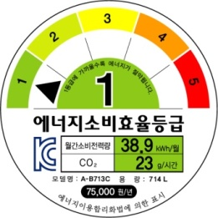


Overview of Korea’s EE Program
3 programs in Energy Labels & Standards
Energy Efficiency
Label and Standard Program
(including MEPS)
Mandatory
5-grade labeling & MEPS
37 items : Refrigerators, Air-conditioners,
TVs, Window sets, etc
High-efficiency Equipment
Certification Program
e-Standby Program
Voluntary
39 items : LED Lighting
equipment, etc
Mandatory & Voluntary
Standby Korea 2015
22 items : Computers, etc
KEMCO

Slide 4
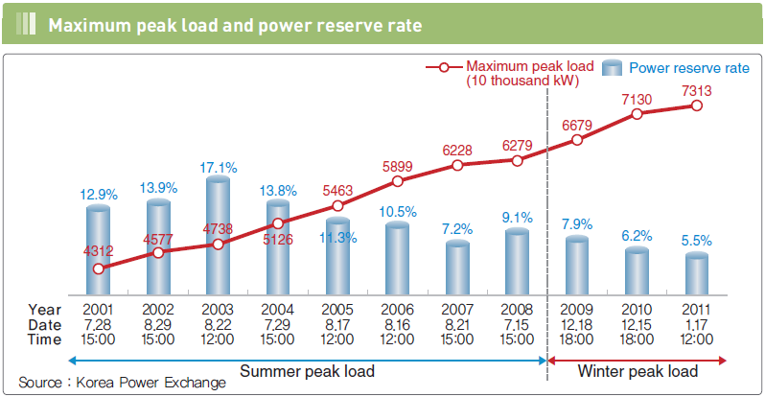
EE Mgmt of Electric Heating Equipment
KEMCO

Slide 5
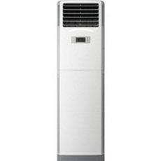
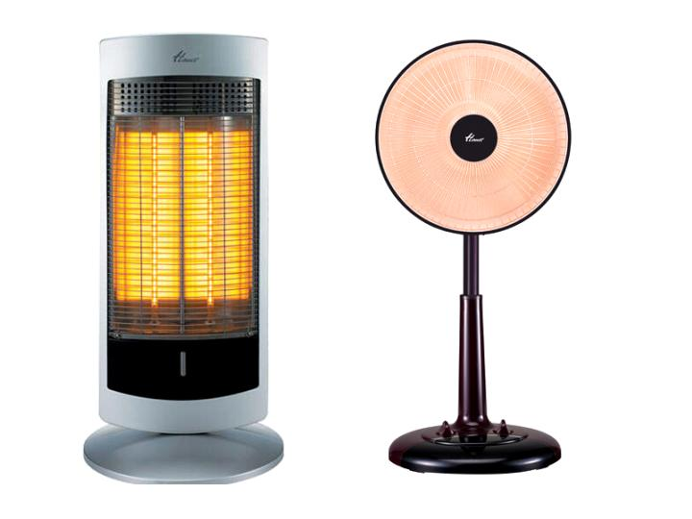
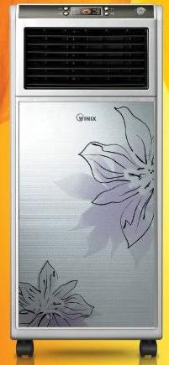
EE Mgmt of Electric Heating Equipment
Implementing electric rates displaying scheme
Electric fan heaters
Electric stoves
KEMCO

Slide 6
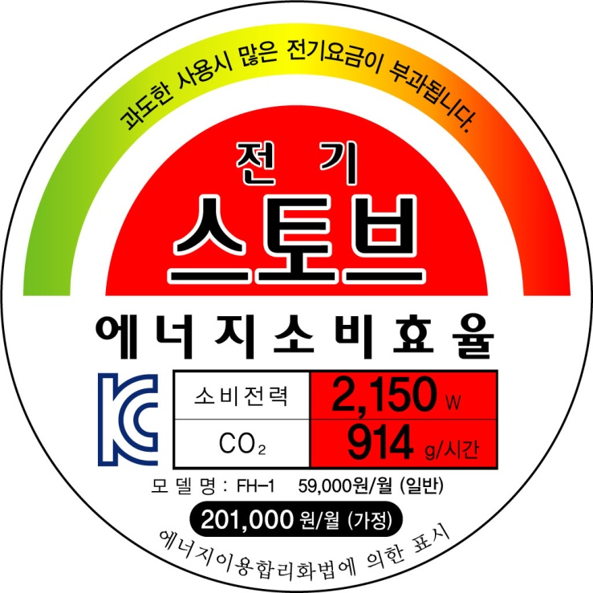
EE Mgmt of Electric Heating Equipment
Label for electric fan heaters
Please aware that you will have big energy charges if you use this product for a long time
Power consumption (W)
Name of model
CO2 emission per hour (g/h)
Monthly energy cost
(applied big progressive rate, 384 KWR/kWh)
KEMCO

Slide 7
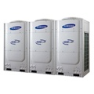
EE Mgmt of Electric Heating Equipment
Switching to EE L&S Program for VRF multi-split
heat pumps
Test Condition
- Model scope : Unit model of outdoor
- Pipeline length : 50m
- Heating temperature : 7℃, -15℃
MEPS & Energy Efficiency Level
R | Grade
3.5 ≤ R | 1
3.25 ≤ R < 3.50 | 2
3.00 ≤ R < 3.25 | 3
2.75 ≤ R < 3.00 | 4
2.40 ≤ R < 2.75 | 5
R = EERa = (IEER+COP)/2
Unit
Model
(unit : W/W)
EERa | IEER (100%, 75%, 50%, 25%) | COP | COP2 (-15℃)
2.40 | 2.80 | 2.00 | 1.50
EERa = (IEER+COP)/2
KEMCO

Slide 8
Designation of Energy Intensive Equipment
as EE Mgmt Target Products
New Target Products
in Energy Efficiency Label & Standards Program
Electric fan heaters, Electric stoves (Dec. 15th. 2011)
VRF multi-split heat pumps (April. 1st. 2012)
TVs, Window sets, Transformers, Dehumidifiers
(July. 1st. 2012)
Tyres (Dec. 1st. 2012)
KEMCO

Slide 9

Designation of Energy Intensive Equipment
as EE Mgmt Target Products
Adopting MEPS & E E grade(1 to 5) for TVs
  KS C IEC 62087
R(Energy Efficiency Level Index)
  =
Power consumption at operational mode (W)
The square root of display area (sqrt(m²))
R | Standby power (passive standby mode) | Level
R ≤ 130 | ≤ 1.0W | 1
R ≤ 165 | - | 2
165 < R ≤ 205 | - | 3
205 < R ≤ 260 | - | 4
260 < R ≤ 440 | - | 5
KEMCO

Slide 10
Establishing Plans for Standby Korea 2015
Standby Korea
2015
Standby Power 0.5W
by 2015
Networked standby
: Mandatory of Set-top boxes’ Passive standby power mode
Adopting TEC
(Typical Energy Consumption)
: Computers, etc
Adopting On-mode
: Monitors
KEMCO

Slide 11
Establishing Plans for Standby Korea 2015
Adopting TEC standard for Computers
  Energy Star Program Ver. 5.0
  ECMA-383 Categories and Allowances for Desktop and Notebook Discrete Graphics
Platform | Requirements | Capability Adjustments
Notebooks | TEC (kWh) Cat A: ≤40.0 Cat B: ≤53.0 Cat C: ≤88.5 | Memory: 0.4 kWh (per GB over 4 GB) Discrete GPU (FB Width): ECMA-383 Categories Additional storage: 3 kWh Discrete TV tuner : 2.1kWh
Desktop, Integrated DT | TEC (kWh) Cat A: ≤148 Cat B: ≤175 Cat C: ≤209 Cat D: ≤234 | Memory: 1 kWh (per GB over base) Base Memory: CAT A, B, and C 2GB; CAT D 4GB Discrete GPU (FB Width): ECMA-383 Categories Additional storage: 25 kWh Discrete TV tuner : 14kWh Discrete Audio card : 14kWh
KEMCO

Slide 12
Establishing Plans for Standby Korea 2015
TEC power consumption (kWh)
  = (8760/1000) x (Poff x Toff + Psleep x Tsleep
  + Pidle x Tidle)
TEC Weighting
 | Desktop, Integrated DT | Notebook
Toff | 55% | 60%
Tsleep | 5% | 10%
Tidle | 40% | 30%
KEMCO

Slide 13
Establishing Plans for Standby Korea 2015
Adopting On-mode standard for Monitors
  Energy Star Program Ver. 5.0
Requirements
Category | On-mode Power Consumption | Sleep mode | Off mode
Screen size < 76cm Megapixels ≤ 1.1MP | 6 x megapixels+ 0.00775 x viewable area + 3 | ≤2.0W | ≤0.5W
Screen size < 76cm Megapixels > 1.1MP | 9 x megapixels+ 0.00775 x viewable area + 3
Screen size 76-153cm | 0.04185 x viewable area + 8
KEMCO

Slide 14

Thank you!!
감사합니다.
For more information,
E- mail : jennifer@kemco.or.kr
KEMCO homepage : http://www.kemco.or.kr/eng
KEMCO

