Slide 1
Update from the United States
Energy Related Work in the Sub Committee on Standards and Conformance
April 2014

Slide 2
M CTI 02/12 A Role of Standards and Conformity Assessment Measures in Enhancing the Performance and Energy Efficiency of the Commercial Building Sector
U.S.-led APEC green building Multi-Year Project runs 2013-2015
Builds on work begun in 2011
EGEE&C is partner APEC fora
Cooperation with ASEAN ACCSQ

Slide 3
Objectives
Encourage consistent, transparent, and appropriate green building standards-related measures, thus avoiding the creation of unnecessary obstacles to trade.
Identify best practices in standards and code development, and testing and rating of building products that support a cleaner, more energy efficient commercial building sector.
The

Slide 4
Workshop 1: Sharing Experiences in the Design and Implementation of Green Building Codes March 2013 Lima, Peru
A joint APEC – ASEAN workshop , developed and implemented in collaborative partnership with Peru
Informed by:
Peru survey - “Sharing Experiences in the Design and Implementation of Green Building Codes in the APEC Economies”
U.S. study – “Building Codes and Green Codes in the APEC Economies” Sharing of information, experiences, and best practices among APEC and ASEAN economies

Slide 5
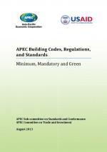
Study: Building Codes, Regulations, and Standards
Objective: Understand how economies utilize building codes
to increase building performance.
For each of the 21 APEC economies, the study provides in-depth information about:
Approach to building regulation
Development, adoption, administration, enforcement
Roles of government and private sector
Existing building codes
Minimums for key elements
Referenced standards
Green elements of existing codes
Stand-alone green codes
Protocols for monitoring, review, and assessment
Available at: http://publications.apec.org/publication-detail.php?pub_id=1442

Slide 6
Workshop 2 How Building Information Modeling (BIM) Standards Can Improve Building Performance June 2013, Indonesia
Joint APEC-ASEAN event
Diverse presentations by member economies and expert BIM professionals to highlight:
Current status of BIM standards development
Benefits of BIM to policymakers, architects and designers, construction industry actors, building owners, and others
Case study success stories showing the practical implementation of BIM projects
Concrete steps that can be taken by economies to increase BIM usage toward improving building performance

Slide 7
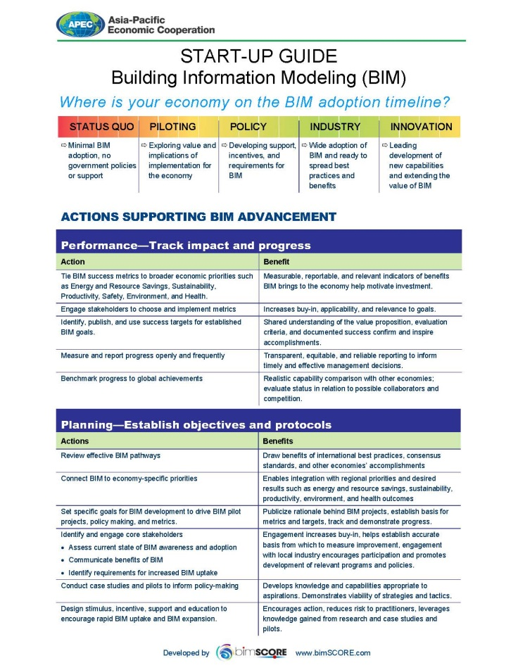
Start-Up Guide
Building Information Modeling
Provides economies with specific actions to take to advance BIM uptake, with associated benefits.
The Start-Up Guide details Actions and Benefits associated with:
Defining metrics aligned with an economy’s priorities
Planning BIM policies
BIM policy adoption
Technology to provide the right BIM tools
Published on APEC web site http://publications.apec.org/publication-detail.php?pub_id=1510

Slide 8
Green BuildingsWork in 2014
Work reoriented to continue emphasis on green codes and BIM
Ongoing ACCSQ engagement
Desire stronger linkage with EGEE&C
2014 Events
BIM Workshop Beijing/ SOM 3 in August
Green Codes Workshop New Orleans in October

Slide 9
Plans for 2014 – Other Projects
CTI 27 2013 A – Aligning Energy Efficiency Regulations for ICT Products – Implementing A Strategic Approach
First project under the newly formed ICT Global Energy Efficiency Convergence Forum
Workshop and Inaugural Meeting of ICT GEEC Forum at SOM III in Beijing, China - August 2014
Day 1 – Government and business discussion on aligning EE regulations
Day 2 – APEC Member regulators meet at ICT GEEC Forum
Progress
Completed Economy survey on utilization of IEC62623 for EE testing of personal computers
Preparing for implement of pilot projects to examine applicability of IEC E3 program for transportability of EE test data
Welcome collaboration with the EGEE&C

Slide 10
Plans for 2014 – Other Projects
APEC Regulatory Cooperation Advancement Mechanism (ARCAM) - Dialogue on Electric Vehicle (EV) Standards
Will build on discussions and recommendations from the 2011 ARCAM Smart Grid Interoperability Standards Dialogue
May 7, 2014, Qingdao, China
Session 1 – Overview of APEC Economies’ EV Regulations
Session 2 – Challenges of Convergence in International Standards for EVs
Session 3 – EV Technical Areas of Harmonization and Alignment
Session 4 – Overview of Efforts in International Fora to Harmonize EV Standards
Session 5 – What can APEC do to align EV regulations and promote harmonization of EV international standards?

Slide 11
For more information:
Green Buildings (M CTI 02 12A)
Renee.Hancher@trade.gov
ICT (CTI 27 2013 A)
Michael.Boyles@trade.gov
ARCAM
Edward_Brzytwa@ustr.eop.gov

