Slide 1
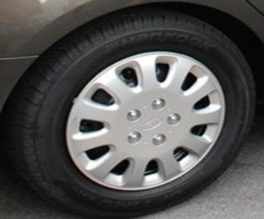
APEC Fuel Efficient Tyre Information
APEC EGEE&C 43 Meeting – 9 to 11 April 2014

Slide 2
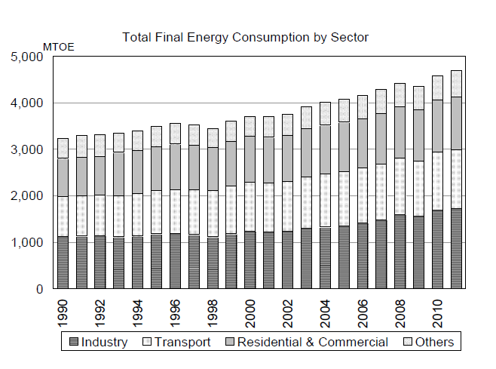
Background
Transport represents around 27% of all energy consumption across APEC
Significant energy and carbon saving potential
Several areas of intervention:
  Vehicle purchase
  Vehicle maintenance
  Driver behaviour
    How much they drive (PT, conservation)
    How they drive
  Low rolling resistance tyres

Slide 3
APEC Fit
2013 APEC leaders declaration:
  reiterates the importance of energy efficiency in transport and the commitment to the energy intensity reduction target of 45% by 2035
2011 APEC joint energy and transport ministers declaration
  We instruct the EWG and the Transportation Working Group (TPT-WG) to collaborate on joint activities …
2013 St Petersburg energy ministers declaration
  affirms that energy efficiency is one of the fastest, most environmentally sound, and cost effective ways to address climate change and energy security while stimulating economic growth

Slide 4
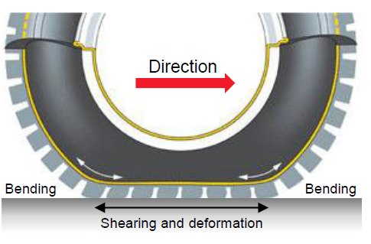
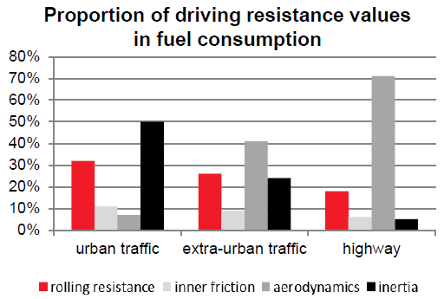
Fuel Efficient Tyres (FET)
Reduce the rolling resistance while maintaining breaking performance
Provide energy efficiency improvements of up to 7%
  Average 3-4% (Across APEC is equivalent to South Korea)
Market ready product
  Many brands and products
Largely economic
  Savings outweigh costs

Slide 5
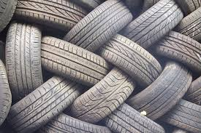
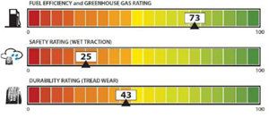
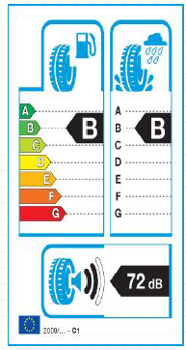
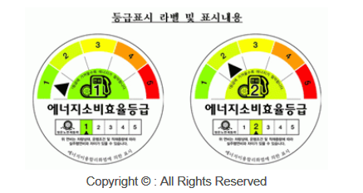

Problem
Low deployment
Low consumer awareness
  “black round things”
  a tyre is a tyre is a tyre
  Passive buyers
Limited action across the world
  EU
  US
  Japan
  Korea

Slide 6
Objectives
Ultimate objective is to improve deployment of Fuel Efficient Tyres
Project objectives:
Understand current FET initiatives in APEC
Identify success factors
Understand barriers
Look at standards and labelling options to overcome barriers.

Slide 7
Method
Analysis of opportunity from FET tyres.
Barriers analysis with a specific look at information
Stock-take and analysis of existing FET initiatives
Implement a capacity building workshop
Identify opportunities for collaboration

