Slide 1
PHILIPPINES: Key Developments in Energy Efficiency Policies and Programmes
APEC - EGEEC
MARCH 25, 2015
SINGAPORE

Slide 2
Status of Energy Efficiency Policies in the Philippines:
  Government Energy Management Program (GEMP): AOs 110, 110-A, 126)
  DOE Circular 93-03-05: Energy Consumption Monitoring
  DOE Circular 2008-09-0004: ESCO Accreditation System
  Energy Efficiency and Conservation Bill (16th Congress)
  The Philippine Energy Efficiency Roadmap

Slide 3
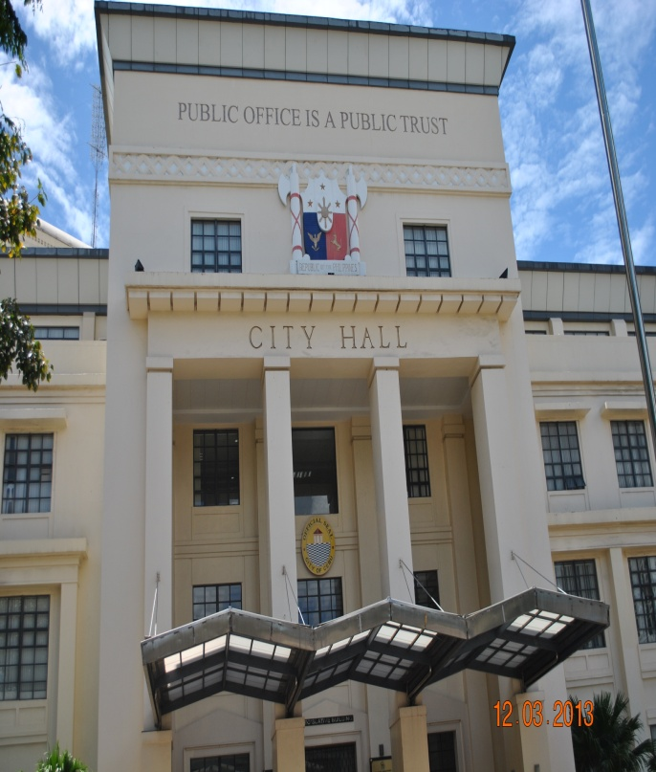
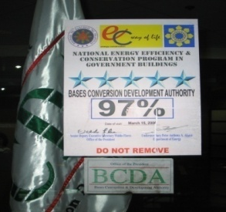
1
Government Energy Management Program (GEMP)
ADMINISTRATIVE ORDER NO. 110 - DIRECTING THE INSTITUTIONALIZATION OF A GOVERNMENT ENERGY MANAGEMENT PROGRAM (GEMP)
The Government shall aim to reduce its monthly consumption of electricity (in kilowatt-hours) and petroleum products (in liters) by at least ten percent (10%)
Administrative Order (A.O.)
A.O. 110-A (s.2006) | Amending A.O. 110 s. 2004 – Directing the institutionalization of a government energy management program.
A.O. 183 (s.2007) | Directing the use of energy efficient lighting/lighting system (EELs) in government facilities.
A.O. 126 | Strengthening measures to address the extra ordinary increase in world oil prices, directing the enhanced implementation of the governments energy conservation program .
Savings from Sept 2005 to December 2014:
Php 2.14Billion ( US$ 47.6 Million)
PhP 1.85 Billion on electricity
PhP 290Million on Fuel

Slide 4
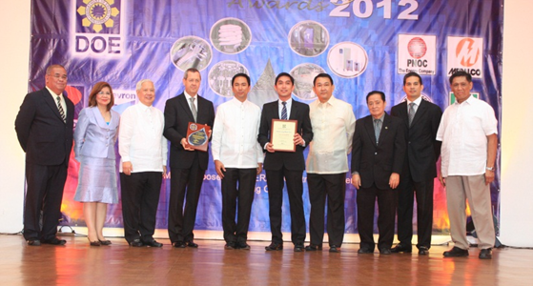
2
Energy Consumption Monitoring
DEPARTMENT CIRCULAR – 93-03-05
  To all Industrial, Commercial and Transport Sectors: Establishments consuming 1 million LOE annually are required to submit Quarterly Energy Consumption Report (QECR) to DOE. In addition, establishments consuming 2 million LOE, apart from the QECR are required to submit an Annual Energy Conservation Program Report (AECPR).
Recognition Award
DON EMILIO ABELLO ENERGY EFFICIENCY AWARD
Annual recognition given to companies with significant energy savings achieved thru the implementation of EE&C technologies & measures
FY 2014 Generated Saving:
95 million liters of oil equivalent (LOE) and monetary savings of Php 3.7 billion (US$82 million) and more than 188 million kilograms of avoided carbon dioxide from 83 commercial and industrial establishments

Slide 5
3
ESCO Accreditation System
Department Circular –DC-2008-09-0004
> enforces the requirement for an ESCO company to apply for a certificate of accreditation with the DOE while engaging in any energy efficiency related performance contracting projects.
DOE Accredited ESCOs
THERMAL SOLUTIONS, INC. –TYPE“A”
PHILCARBON, INC. – TYPE “A”
ELECTRO-SYSTEMS INDUSTRIES CORPORATION – TYPE “A”
DESIGN SCIENCE INCORPORATED – POWERBOSS – TYPE “A”
RENAISSANCE PACIFIC ENERGY SOLUTIONS ASIA (REPESA) – TYPE “A”
SCHNEIDER ELECTRIC PHILIPPINES, INC – TYPE “A”
COFELY PHILIPPINES – TYPE “A”
FILAIRCO, INC./ TRANE PHILIPPINES – TYPE “A”
OSP –ESCO INTERNATIONAL, INC. – Type “A”
MVCP BIOTECHNOLOGY & ENERGY RESOURCES –Type “A”
ENERGY AND AVIATION SUPPORT CORPORATION – Type “A”
HI-COOL ENGINEERING CORPORATION – Type “A”
MERALCO ENERGY, INC.

Slide 6
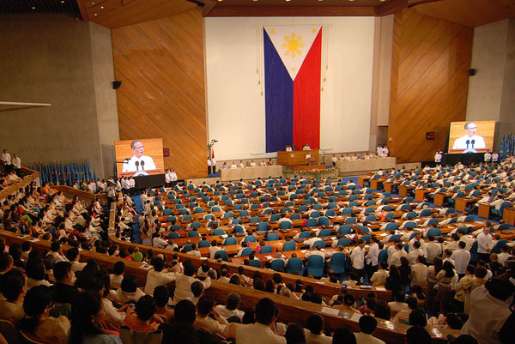
4
Energy Efficiency and Conservation Bill
(16th Congress)
SBN 1085 (Sen. Teofisto “TG” Guigona )
SBN 167 ( Sen. Sergio R. Osmena )
HBN 4393 ( Cong. Reynaldo V. Umali )
HBN 5053 ( Cong. Henedina Abad )
Short Title - This Act shall be known as the "Energy Efficiency and Conservation Act of 2014"
AN ACT INSTITUTIONALIZING ENERGY EFFICIENCY AND CONSERVATION, ENHANCING THE EFFICIENT USE OF ENERGY, AND GRANTING INCENTIVES TO ENERGY EFFICIENCY AND CONSERVATION PROJECTS, AND FOR OTHER PURPOSES

Slide 7

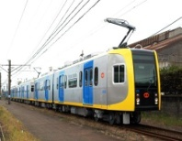



5
EE & C ROADMAP: MILESTONES (2014 – 2030)
SECTOR | TARGET MILESTONES
Transport | Vehicle Fuel Efficiency Standards developed to all vehicles for Labelling (Road Transport) *
 | E-Vehicle Program *
 | Reintegration of Urban Planning and transport energy use
 | Promotion of Fuel Efficient Vehicle Technologies, Awareness raising (driver’s education) to all public and private vehicle drivers *
 | Extend Energy Efficiency Program to include passenger and cargo ship vessels including the aviation industry sector
* - Started / on-going

Slide 8

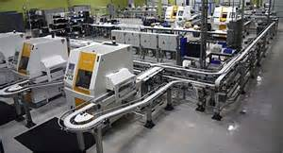
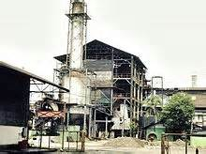
5
EE & C ROADMAP: MILESTONES (2014 – 2030)
SECTOR | TARGET MILESTONES
Industrial | Develop Energy Service Companies (ESCO) *
 | Development of Minimum Energy Performance Standards (MEPS) for Motors
 | Consider Demand Response as an “Option” to conserve energy *
 | Incentive for the use of energy efficient technologies (pioneering energy efficiency projects)
 | Awareness campaign to promote EE&C in the industry (i.e., Energy Management System, Systems Optimization) *
* - Started / on-going
Demand Response (DR) is defined as: “Changes in electric usage by end-use customers from their normal consumption patterns in response to changes in the price of electricity over time, or to incentive payments designed to induce lower electricity use at times of high wholesale market prices or when system reliability is jeopardized.” (Source: FERC)

Slide 9
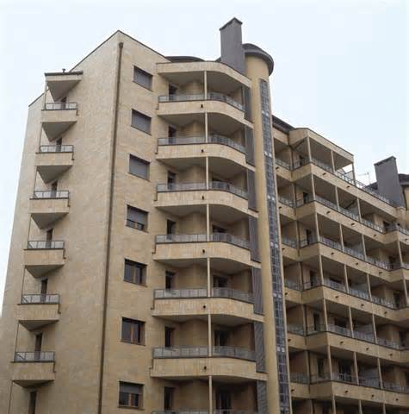


EE & C ROADMAP: MILESTONES (2014 – 2030)
5
SECTOR | TARGET MILESTONES
Residential Buildings | Enforce “Minimum Energy Performance Standards” (MEPS) for Home Appliances with emphasis on Space Cooling and Refrigeration. *
 | Adoption of “MEPS in Residential Building” through inclusion in the “National Building Code”
 | Promote EE&C through awareness raising, education and communication campaign *
 | Develop role of utilities as key implementation partners and information providers (Utility-driven DSM)
 | Building envelope measures – cool roofs and insulation
* - Started / on-going

Slide 10
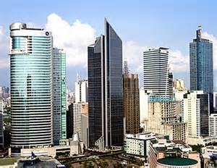
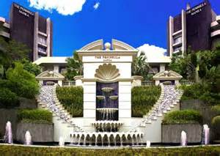

5
EE & C ROADMAP: MILESTONES (2014 – 2030)
SECTOR | TARGET MILESTONES
Commercial & Government Buildings | Compliance to designate Company’s Energy Manager or Enercon Officer *
 | Develop Energy Benchmark for Buildings
 | Promote adoption of “Guidelines on Energy Conserving Design in Buildings and Utility Systems” *
 | Promote ESCOs and financing model in Government retrofit projects *
 | Promote Green Building Rating System *
 | Reformulate group to oversee EE measures in Building Code
* - Started / on-going

Slide 11



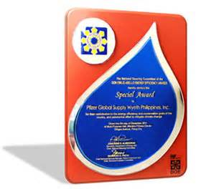
5
EE & C ROADMAP: MILESTONES (2014 – 2030)
SECTOR | TARGET MILESTONES
Cross-Sectoral | Enactment of Enercon Bill into Law *
 | Establish EE database, data collection regime, M&E framework*
 | Heighten-up EE&C promotion across all energy demand sectors *
 | National strategy for efficiency in power supply sector
 | Stronger coordination with other levels of government (LGUs) *
* - Started / on-going

Slide 12

Thank You !!!
www.doe.gov.ph

