Slide 1


Opportunities for APEC Countries in Leapfrogging to Efficient Lighting,
Appliances & Equipment
In support of
Pierre Cazelles, International Copper Alliance
In partnership with:
United Nations Environment Programme, United Nations Development Programme, CLASP & the Natural Resources Defense Council,
with the financial support of the Global Environment Facility

Slide 2


Efficient Appliances & Equipment – taking the en.lighten approach to the next low hanging fruits
In support of
UNEP, UNDP, ICA, CLASP and NRDC launched the
Efficient Appliances & Equipment Programme in 2014
The Programme aims to join forces with private and public sector
to expand the en.lighten approach to the next high impact opportunities,
supporting the second goal of the Secretary General’s SE4ALL initiative: double the global rate of improvement in energy efficiency
The programme forms part of the SE4ALL Energy Efficiency Accelerator
on Appliances & Equipment

Slide 3






















Project Partners on Lighting, Appliances & Equipment
Donors and International organizations
Partner Organizations
Supportive Private Sector
…the network is growing fast

Slide 4
Efficient Lighting, Appliances & Equipment
The Global Potential
Lighting, industrial motors, transformers, ACs, refrigerators, fans
Source: UNEP, 2014 (annual figures for 2030)

Slide 5

Program Approach
The Integrated policy approach
  Minimum Energy
  Performance
  Standards
  Supporting policies
  promoting demand for efficient products incl. innovative financing mechanisms, loans and grants
Successful market transformation
  Monitoring, verification and enforcement programmes discouraging non-compliant products
Environmentally sound
life-cycle management
mercury, electronic waste, ozone depleting substances…
Development of knowledge and tools by the “Centre of Excellence”
Support to all partner countries to develop and implement the integrated policy approach
Implementation of national (regionally harmonized) projects
1
2
3
5

Slide 6




Examples for National Implementation Projects
Example: Chile
Adopted National Efficient Lighting Strategy, December 2013
Phase-out of incandescent lamps started in 2014
National GEF-UNEP project ($2.5 M) to implement the NELS & accelerated promotion of LEDs
Example: Peru
Phase out of incandescent lamps
MEPS are being established for CFLs, fluorescent lamps, ballasts
National GEF-UNEP project ($1.6 M) to promote LEDs and quality control
Expanding the approach to appliances –
first steps taken in Costa Rica:
Integrated policy approach successfully proven in residential lighting; current scale up in cooling products
National GEF-UNEP Project ($2M) focused on creating a revolving fund for promoting efficient refrigerators,
air conditioners, and lighting
Example: Pakistan
Adopts MEPs for CFLs and ballasts for linear fluorescent lamps.
Development of a revolving loan fund for lighting
National GEF-UNEP project ($1.5 M) focused on development of financial instruments and promotion of LEDs.

Slide 7

The Programmatic Approach
Co-funding from private sector companies through in-kind or cash contributions.
GEF funding:
USD 1.5 million
Total co-funding:
USD 8 million
Mid 2014
Q2 2015
Q4 2016
Project
Launch
Preparatory phase
18 months medium size GEF project
Project implementation through National and Regional ‘Child Projects’
Start of ‘child projects’ varies, but does not need to wait for completion of the preparatory phase.
Public and private investment in energy efficiency programmes
& grants and loans
to facilitate the uptake
7

Slide 8
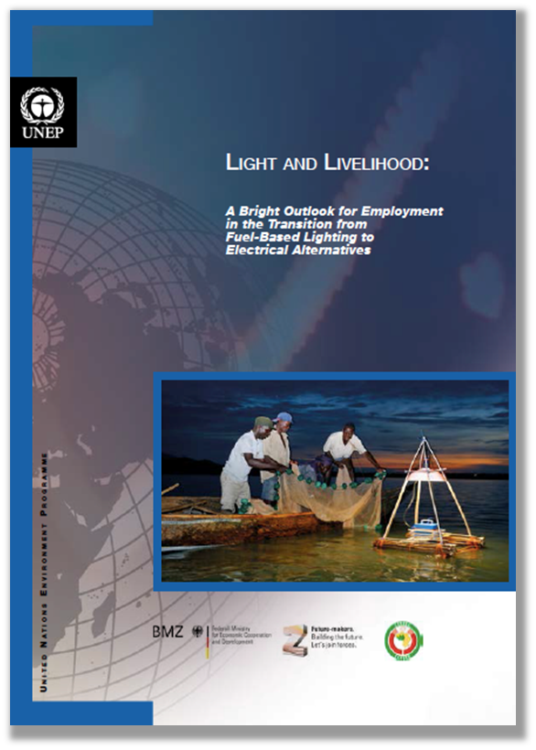
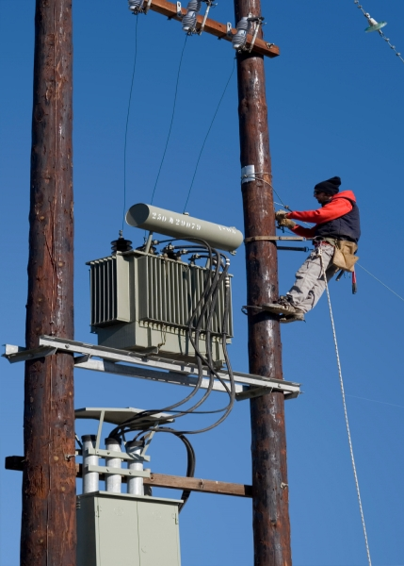
Opportunities for APEC Countries
Join the partnership!
Develop national – or regional – strategies for energy efficiency
Benefit from our Centre of Excellence and our tools based on global best practice
Implement national
– or regional – projects

Slide 9
Next steps
Join the Program (Governments sign a letter stating that they "promote the transition to efficient products and equipment“)
Work with UNEP on defining “child project”
Work with your country’s GEF Operational Focal Point to mobilize GEF country allocation to commit STAR funding
Possibility for regional projects
UNEP will provide support to drafting/conceptualizing the Child Project

Slide 10
Contacts
UNEP:
Gustau Mañez Gomis
Project Manager
UNEP en.lighten initiative
Email: Gustavo.Manez@unep.org
Tel: +33 1 44 37 19 97
Cell: + 33 614 502 254
www.enlighten-initiative.org
www.enlighten-initiative.org/forum
ICA:
Pierre Cazelles
Director – Partnerships Asia
Email: pierre.cazelles@copperalliance.asia
Tel: 86-159-0100-7376

