Slide 1
Updates on APEC ESIS and CAST
45th Meeting of the APEC Expert Group on Energy Efficiency & Conservation
Nicole Kearney
Senior Associate, CLASP
March 25, 2015
Singapore
Notes:
Energy Standards Information System
Collaborative Assessment of Standards and Testing

Slide 2
Presentation Overview
Introduction to CLASP
Introduction to the Super-efficient Equipment & Appliance Deployment (SEAD) Initiative
Program Status Report from the APEC-ESIS Secretariat
SEAD-funded APEC-CAST Project Updates

Slide 3
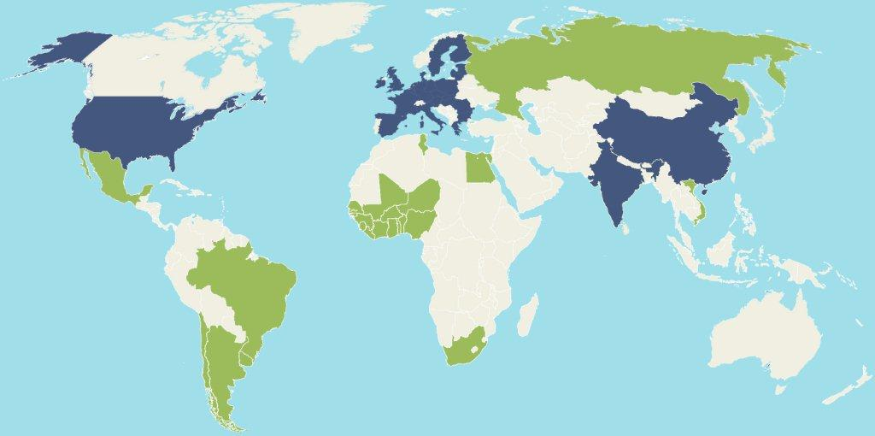
CLASP: Who We Are
CLASP is a non-profit organization that provides technical assistance to local policymakers and facilitates knowledge exchange among S&L practitioners around the world.
CLASP country program
Past or present project work
Notes:
CLASP has worked in over 50 countries across 6 continents in the past decade. In addition to ad hoc project-based technical assistance, we have had four on the ground programs in China, India, the European Union, and the United States. In addition, we maintain several global programs:
A Global Best Practice program that produces thought-leading pieces in the appliance energy efficiency field on a number of activities including standards and labelling, MV&E and market transformation policies – we develop technical tools that model the impacts of our work, and we conduct benchmarking analyses across various venues to compare countries on the efficiency of their products markets and stringency of their policies.
An Energy Access program – which includes the Awards program for CEM’s Global Lighting Energy Access Partnership (Global LEAP), which supports self-sustaining commercial markets for off-grid energy products by identifying and promoting the most energy-efficient, affordable, highest quality appliances.
We’ve also started a new Emerging Technologies programme, and
We also serve the role as Operating Agent to the SEAD Initiative – which I will talk about shortly.

Slide 4
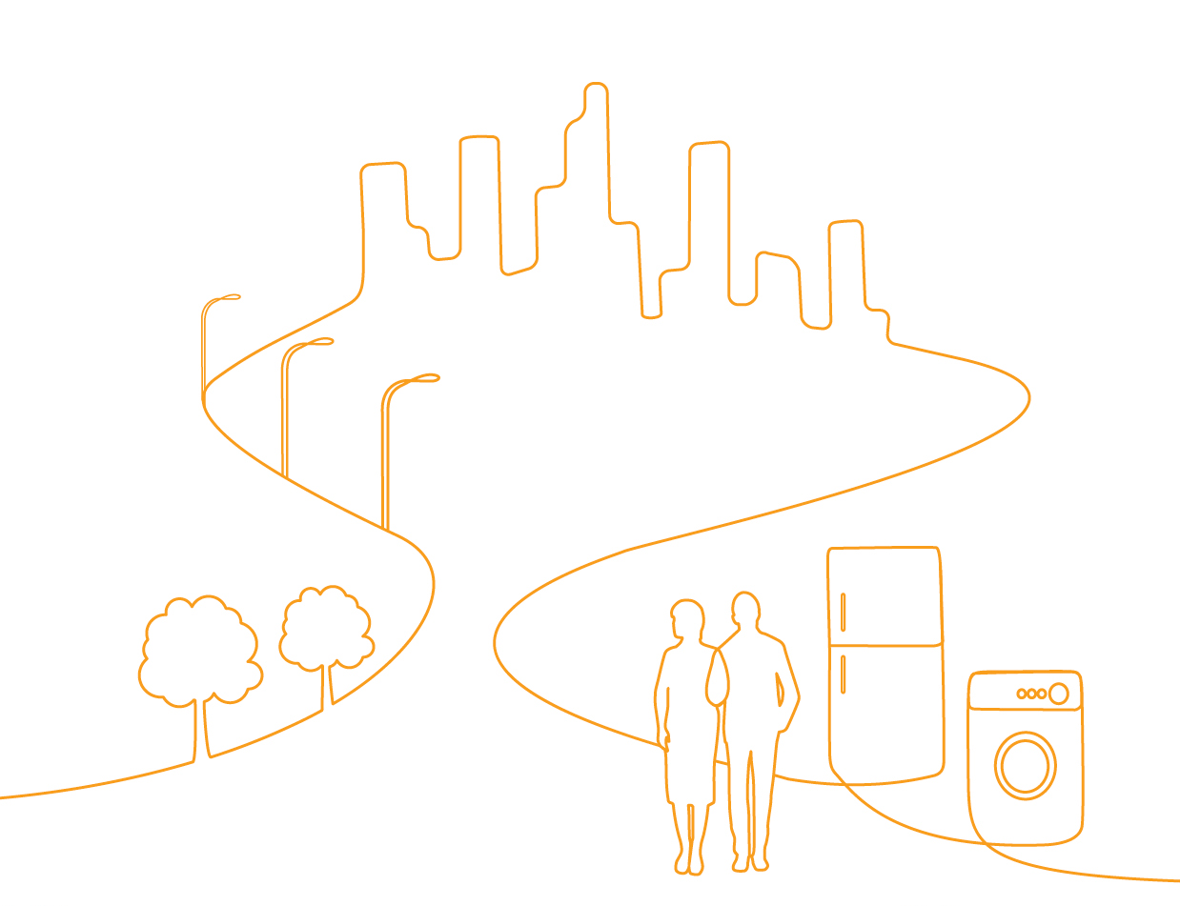
CLASP improves the environmental and energy performance of appliances & equipment
Policy design & implementation
Promoting highly efficient products
Monitoring & evaluation
Resources & tools for practitioners
Training & capacity building
Off-grid & energy access
Phasing down HFCs and high
GWP refrigerants
Raising consumer awareness & comprehension
Notes:
We work hand-in-hand with policymakers, manufacturers, utilities, and other stakeholders on every aspect of appliance efficiency
- By drawing on the best policy practices, most advanced technology, and leading technical expertise worldwide, CLASP helps to accelerate the development and implementation of demand-side energy efficiency, reducing greenhouse gas emissions and saving money for everyone.

Slide 5
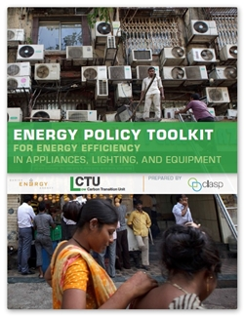
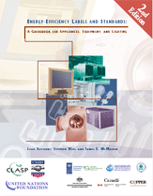
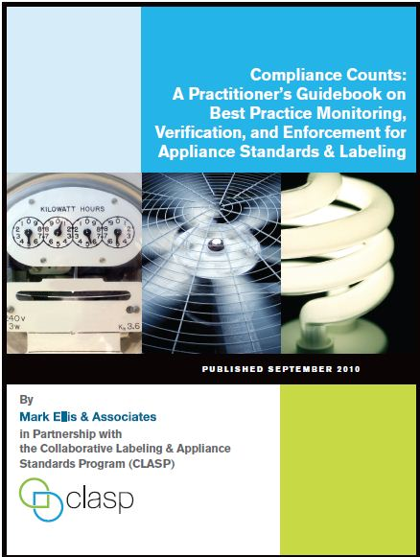
Free Resources & Tools for Policy Makers www.clasponline.org
Energy Efficiency Policy Toolkit
Standards & Labelling
Guidebook
Monitoring Verification & Enforcement
Guidebook
MVE Economy Profiles
CLASP Global S&L Database
APEC-ESIS Secretariat
Notes:
We produce a number of resources & tools to support policy makers across all stages of S&L program development
Our website contains detailed information on how different economies approach MVE
As well as a CLASP Global S&L DB
We are also the secretariat to the APEC-Energy Standards Information System – which is linked to our S&L DB
This activity has granted us a place as observer to the APEC EGEE&C

Slide 6

















The SEAD Initiative
Governments working together to save energy
Accelerating pace of market transformation to more energy efficient products
Through technical analysis and assistance, sharing of information and best practice, and joint activities
Australia
Brazil
Canada
Chile
European
Commission
Germany
India
Indonesia
Japan
Korea
Mexico
Russia
South Africa
Sweden
United Arab
Emirates
United Kingdom
United States
China is an observer to the SEAD Initiative
Notes:
SEAD is an initiative of the Clean Energy Ministerial, a global forum to share best practices and promote policies and programs that encourage and facilitate the transition to a global clean energy economy, - and it’s a task of the International Partnership for Energy Efficiency Cooperation (IPEEC)
17 participating governments – should also note that China is an observer to the initiative who strive to accelerate the pace of market transformation to more energy efficient products, through ….

Slide 7





SEAD
Initiative
Collaborator
Operating Agent
Technical Analysis
Efficient Electrical End-Use Equipment
International Energy Agency
Notes:
As I mentioned, the initiative sits under the umbrella of the CEM and is a task of IPEEC.
CLASP, as the SEAD Operating Agent, facilitates interactions among government entities participating in working groups, as well as among SEAD’s overall leadership bodies, the International Steering Committee and the Leadership Council.
LBNL leads the Initiative’s technical analysis efforts.
SEAD also has collaborative relationships with
the International Energy Agency’s Efficient Electrical End-Use Equipment Implementing Agreement (IEA-4E),
And it funds the APEC Expert Group on Energy Efficiency and Conservation (APEC EGEE&C) APEC ESIS activities, as well as some technical projects under APEC - CAST

Slide 8
Aim to Extract Maximum Savings
SEAD effectively links market transformation activities, developing strategies for accelerating demand for high-efficiency products for specific end-uses
Notes:
- Singling out new, best available technologies through awards,
- Artificially lowering prices for consumers through incentives, and
- Requiring the purchase of energy-efficient products through procurement programs

Slide 9

Providing Support to S&L Programs
SEAD provides technical analysis, tools and trainings to optimize energy efficiency policies. To date, SEAD has facilitated:
  Adoption of comprehensive LED quality & performance standards in India
  Revised TV rating label in Korea
  Improved test lab capacity in India and the Philippines
  Informed draft revised TV regulations in the EU
  Workshops in South Africa, on building capacity for MV&E and Incentives
  Hosting regular Policy Exchange Forums for SEAD
  participating governments and others, to increase
  collaboration and transfer of best practices across
  countries
… And more in progress

Slide 10
Program Status Report from the
APEC-ESIS Secretariat
45th Meeting of the APEC Expert Group on Energy Efficiency & Conservation
Notes:
Energy Standards Information System

Slide 11
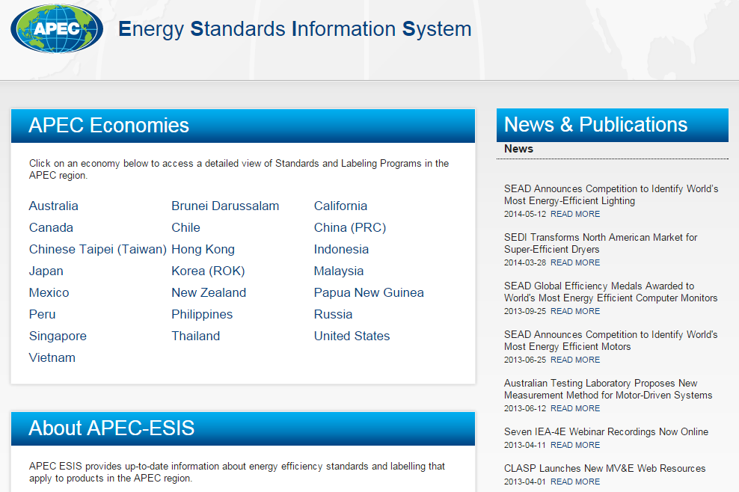
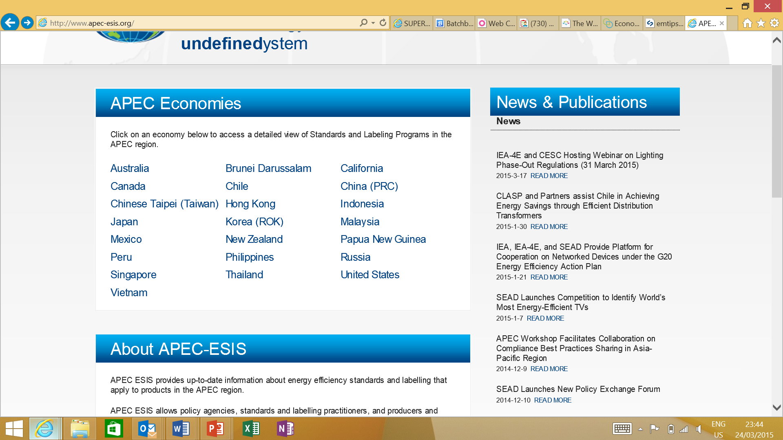
APEC ESIS Website
Notes:
Online resource that allows policy makers and S&L practitioners to compare policies and regulations across economies and by product.

Slide 12
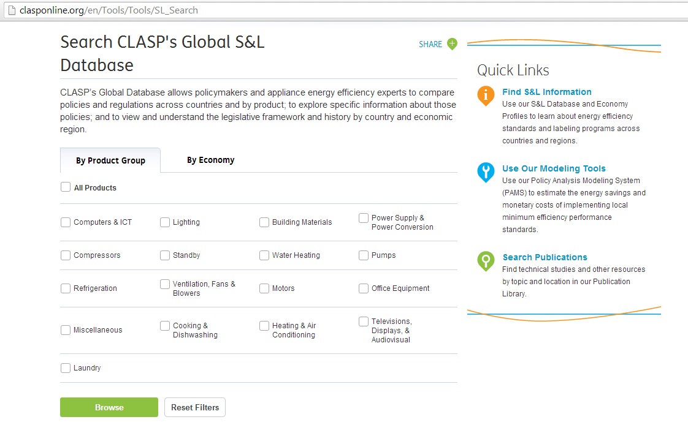
CLASP Global S&L Database
Notes:
Links to the CLASP global S&L database which captures information on many more countries beyond the APEC economies, including from the EU and Africa

Slide 13
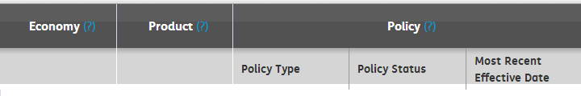
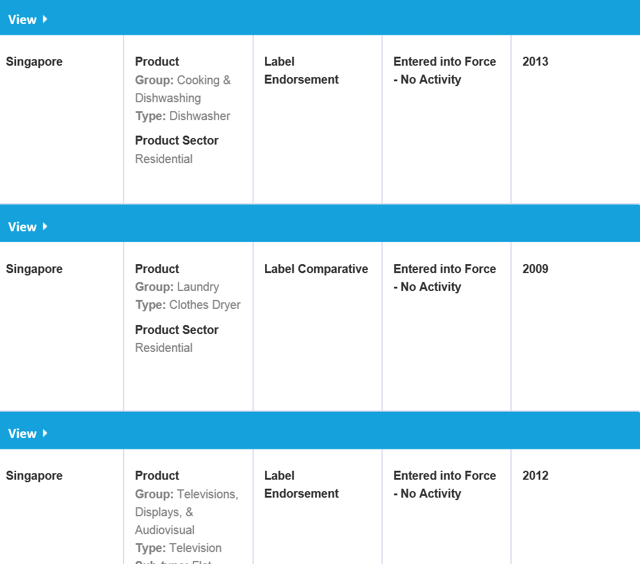
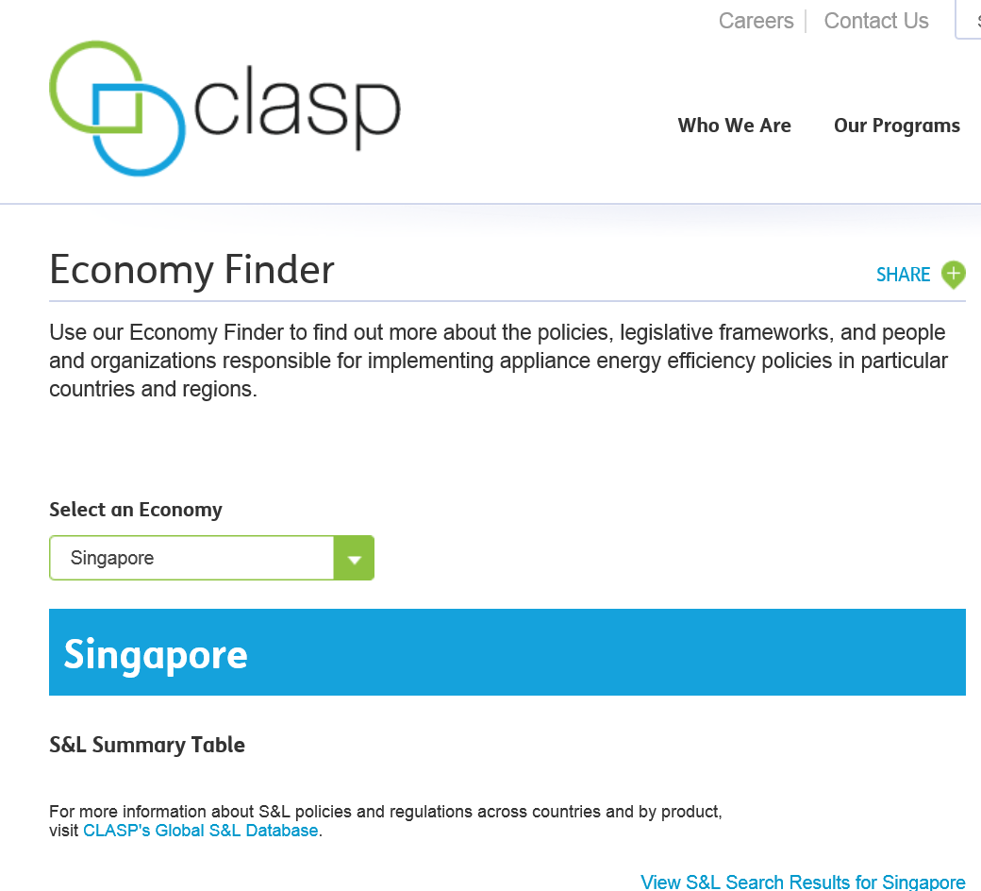
An overview of all the products covered by mandatory and voluntary regulation in that region
An overview of the Country or Economy including:
Introduction
Basic Organization
Legislative S&L History
S&L Regulatory Process
Economy Contacts, S&L Summary Table, and Web Links
Notes:
If you were to select the Singaporefrom the APEC ESIS website, you would be linked through to the Economy Profile (where unfortunately we are missing some information…), as well as the list of products regulated or under consideration for mandatory MEPS, labels, or voluntary initiatives

Slide 14
Global S&L Database
Online resource that allows policy makers and S&L practitioners to compare policies and regulations across countries and by product (excel feature)
Includes 49 economies and two regional associations (APEC and SEAD) which account for over 91% of the world’s total energy consumption
Covers 17 product categories of appliances, equipment and lighting
  Sectors include residential, commercial, industrial or multi-sector
Distinguishes policy types, policy status, and effective dates of implementation
  Policy types include MEPS, Endorsement label, Comparative label, and Codes of Conduct
Links to:
  Implementing Organization
  Policy or legislation document or website

Slide 15
Global S&L Database
2015 Improvement Plan
  Research
    Hire a consultant to assist with research for ~25 economies
    Add up to ten new economies (ASEAN, Sri Lanka, Myanmar to be considered)
    Updates will be completed by August 2015
  Improve user experience
    A survey will be distributed to database users giving them the opportunity to provide feedback that will inform future upgrades

Slide 16
ESIS Status Summary
Content Updates:
  Completed 2014 updates for most APEC economies listed in the S&L database
  The next round of updates will be completed for the APEC region by end 2015
Operations and Maintenance Updates:
  APEC-ESIS website has been updated and we will continue to update the website to include relevant APEC EGEE&C information and publications
  Creating better linkages to SEAD and APEC EGEE&C websites

Slide 17
2014 S&L Database Updates
Economy | Status
Australia | Completed
Brunei-Darussalam | Completed
Canada | Incomplete
Chile | Completed
Chinese Taipei | Completed
Hong Kong, China | Completed
Indonesia | Completed
Japan | Incomplete
Korea | Incomplete
Malaysia | Completed
Mexico | Completed
Notes:
The data for some of the economies wasn't updated last year in the database.

Slide 18
2014 S&L Database Updates
Economy | Status
New Zealand | Completed
Papua New Guinea | Completed
People’s Republic of China | Incomplete
Peru | Completed
Philippines | Completed
Russia | Incomplete
Singapore | Completed
Thailand | Completed
United States | Incomplete
Vietnam | Incomplete
If APEC EGEE&C Economy Profiles and Database information is inaccurate, please contact Nicole Kearney at nkearney@clasponline.org

Slide 19
Current Funding
The Super-efficient Equipment and Appliance Deployment (SEAD) Initiative of the Clean Energy Ministerial currently provides funding for the following activities:
  Hosting and maintenance of ESIS webpage;
  Update of economy content in the database;
  CLASP’s continued role as ESIS Secretariat; and,
  CLASP’s participation at APEC meetings
Currently ESIS has received no additional economy contributions

Slide 20
SEAD-funded APEC-CAST Project Updates
45th Meeting of the APEC Expert Group on Energy Efficiency & Conservation
Notes:
Collaborative Assessment of Standards and Testing

Slide 21
APEC- CAST
Collaboration between EGEE&C and the SEAD Initiative:
SEAD-funded APEC-CAST initiative
Leverage technical expertise provided through SEAD international technical collaborations
Fund one or more projects each year
Primary objectives:
  Promote harmonized test procedures
  Support development of aligned energy efficiency standards and labels (S&L) in APEC economies
  Support regional MV&E activities
Administrator: The Collaborative Labeling and Appliance Standards Program (CLASP), as the SEAD Operating Agent

Slide 22
Past and Current APEC-CAST Projects
SEAD-funded APEC CAST Project | APEC Economy Sponsor | Project Partners | Status
Evaluation and proposal for internationally aligned test methods and performance requirements for televisions | Australia Department of Industry (DoI) | DoI, CLASP, Intertek | Near Completion → Review of final report Presentations at ECEEE, EEDAL Webinar hosted by SEAD in April
Study of repair best practices and energy efficiency improvement potential through repair of electric motors | China National Institute of Standardization (China) | CNIS, CLASP, Econoler, International Copper Association | Completed Continue to liaise with other initiatives to implement recommendations
Evaluation and initial draft of harmonized test methods and level definitions for heat pump water heaters | Australia Department of Industry(DoI) | DoI, CLASP, George Wilkenfeld and Associates, Korea Testing Laboratory, International Copper Association | Completed

Slide 23
Internationally aligned test methods and performance requirements for televisions
  Draft final report proposes internationally-comparable and aligned test methods and efficiency class definitions for TVs
  Includes technical analysis of:
    regional, national and international test methods and performance requirements for TVs
    existing test loops associated with IEC 62087:2011 and ABC for TVs
    existing voluntary and mandatory standards for television energy performance
  Important updates:
  Policy Maker Summary handouts summarise contents of report
  Report available for final review for interested APEC economies
  Webinar to present results of report in end-April
  The European Commission has incorporated recommendations into the revision of EU TV Ecodesign and Labelling Regulations

Slide 24
Televisions
  Project schedule:
Timeline | Activity
November 2013 | Project kick-off
May 2014 | Draft Reports on: TV test methods Energy performance levels in APEC region
May 2014 | Workshop to present reports and seek feedback in conjunction with the IEC 62087 technical committee meeting in Seattle, USA
December 2014 | Final draft reports
April 2015 | Publication of Reports on relevant websites & SEAD hosted Webinar
June 2015 | Poster Display and Paper presented at European Council for an Energy Efficient Economy (ECEEE) Summer Study Conference, France
July 2015 | Paper and Presentation presented at the Energy Efficiency for Domestic Appliances and Lighting (EEDAL) Summer Study Conference, Switzerland
August 2015 | End of project

Slide 25
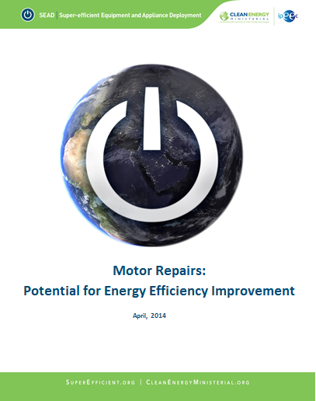
Project Dissemination
Motor Repairs Report
Available on the SEAD website

Slide 26
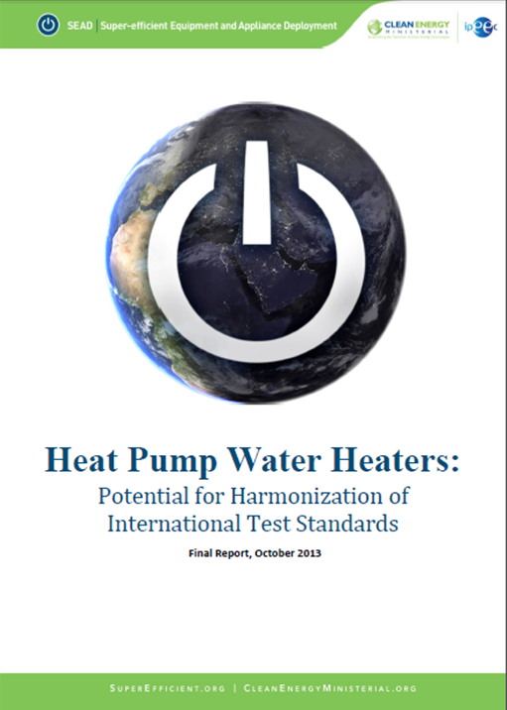
Project Dissemination
Heat Pump Water Heater Report and Workshop Presentations
Available on the SEAD website
Available on CLASP website

Slide 27
Thank you!
Please contact Nicole Kearney at nkearney@clasponline.org with any questions or comments
For more information, please visit:
CLASP - www.clasponline.org
SEAD – www.superefficient.org
APEC-ESIS – www.apec-esis.org

