Slide 1
Update from the United States
Standards and Conformity Assessment Work in the
Sub Committee on Standards and Conformance

Slide 2
Project:
The Role of Standards and Conformity Assessment Measures in Enhancing the Performance of the Commercial Building Sector (M CTI 02 12A)
Objectives:
Encourage consistent, transparent, and appropriate green building standards-related measures, thus avoiding the creation of unnecessary obstacles to trade.
Identify best practices in standards and code development, and testing and rating of building products that support a cleaner, more energy efficient commercial building sector.
The
Notes:
The multi year project M CTI 02 12, launched in 2012 and ending this year, has advanced SCSC work on green building, focusing on how regional communication and cooperation on standards and conformity assessment can facilitate trade and minimize technical barriers to trade in this fast-growing new technology area.

Slide 3
Workshops Completed
Multi-Year project focal areas: tools to increase building performance
Building codes and green building codes
Building Information Modeling (BIM)
The
Workshop 1 | Lima, Peru March 2013 | Sharing Experiences in the Design & Implementation of Green Building Codes
Workshop 2 | Medan, Indonesia June 2013 | How Building Information Modeling Standards Can Help Increase Building Performance
Workshop 3 | Beijing, China August 7-8, 2014 | Utilizing Building Information Modeling to Increase Building Performance
Workshop 4 | New Orleans, USA October 20-21, 2014 | Utilizing Green Building Codes to Increase Building Performance
Notes:
The project has been multifaceted. One element has been a series of workshops in 2013 and 2014 that have focused on two specific tools for improving building performance, namely 1) the use of green building codes and standards and 2) the application of building information modeling.
Since the SCSC met in Beijing last August, the United States implemented the last of four workshops - - an event in New Orleans, Louisiana that took place on the margins of the Greenbuild trade show. The focus of the workshop was on using green building codes to improve building performance. Over 50 delegates from 13 economies attended the two-day workshop. ASEAN delegates from Cambodia and Lao PDR also participated.

Slide 4
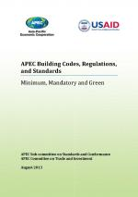
Study: Building Codes, Regulations, and Standards
Objective: Understand how economies utilize building codes
to increase building performance.
For each of the 21 APEC economies, the study provides in-depth information about:
Approach to building regulation
  Development, adoption, administration, enforcement
Roles of government and private sector
Existing building codes
  Minimums for key elements
  Referenced standards
Green elements of existing codes
Stand-alone green codes
Protocols for monitoring, review, and assessment
Available at: http://publications.apec.org/publication-detail.php?pub_id=1442
Notes:
Another facet of the project has been research on the state of play in the region and tools for economies to use.
A building codes study was completed in 2013.

Slide 5
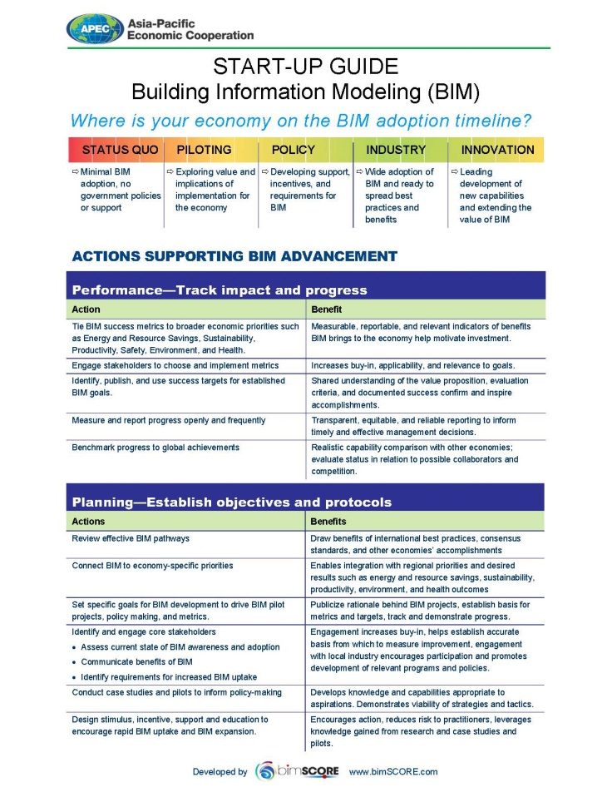
Start-Up Guide
Building Information Modeling
Objective: Provide economies with specific actions to take to advance BIM uptake, with associated benefits.
The Start-Up Guide details Actions and Benefits associated with:
Defining metrics aligned with an economy’s priorities
Planning BIM policies
BIM policy adoption
Technology to provide the right BIM tools
Notes:
Another deliverable was a Start Up Guide for Building Information Modeling published in 2014. There have been nearly 2000 hits on the Guide since it was posted on the APEC web site.

Slide 6
2015 Deliverables
BIM Metrics Guide
  Provides concise best practice approaches to identifying measurable targets and outcomes associated with utilizing BIM to advance green building.
  Will include approaches to defining relevant metrics to demonstrate BIM for green building’s contribution to broader economy-level objectives, such as energy, water, and other resource savings, as well as other sustainable construction goals.
  Economies surveyed on BIM policies
  Ready by mid-2015
Notes:
Work this year is focused on additional value-added deliverables that will enable APEC economies to utilize codes and BIM.
A BIM Metrics Guide is currently being developed.
It will detail approaches economies can use to demonstrate the value of BIM as a tool to support green building policies and goals.
The United States would like to thank the economies that responded to the survey on BIM policies circulated in December and January.
A draft will be ready in about one month, with the final guide ready by May. SCSC members will have the opportunity to review and comment on the draft Metrics Guide.

Slide 7
2015 Deliverables
U.S. Self-funded Deliverable: Green Code Infrastructure Guide
  Best practice guidance on building code-related readiness elements that form an infrastructure supporting the successful development, implementation, enforcement, and evolution of a green building code
  Ready Spring 2015
Notes:
Additionally, the United States is preparing a Green Codes Infrastructure Guide that will identify best practices that support the successful development and application of green building codes. The idea is that the completion of a green code isn’t enough; a fulsome infrastructure is necessary to ensure that the code performs as intended.
The Guide will be ready this spring.
Thank you.

Slide 8
EGEE&C and SCSC Cooperation
Current project: MLA Readiness in ISO 50001 Training Workshop , April 6-9, 2015 in Thailand
Builds on previous U.S. –led project on ISO 50001 from 2011

Slide 9
Project:
Aligning Energy Efficiency for ICT Products – Implementing a Strategic Approach (CTI 27 2013)
Objectives:
  Prevent unnecessary market access barriers for ICT products, increase the availability and use of innovative, energy efficient products in markets worldwide and assist APEC economies with national energy policy objectives.
  Advance the ongoing public-private dialogue among APEC economies regarding ways to align ICT product energy efficiency requirements through the development and use of global standards and trade-friendly conformity assessment procedures.
  To implement specific strategies to accomplish this alignment
    Identify priority products and areas (ex. computers, servers, imaging equipment, low power modes with network connectivity)
    Examine testing methods
    Propose solutions to any identified barriers and potential capacity building requirements for developing economies.

Slide 10
Work Completed
Workshop | Beijing China August 7 2014 | Aligning Energy Efficiency for ICT Products – Implementing a Strategic Approach Workshop
Forum | Beijing, China August 8 2014 | ICT Energy Efficiency Convergence (ICT EEC) Forum
Workshop | Beijing, China October 24, 2014 | SCSC Workshop on Margins of 44th Meeting of the APEC EGEE&C
The
Notes:
Last year the SCSC held a one day workshop to share information and ideas on priority products for harmonizing efficiency testing methods and use of common data sources as a means for aligning energy efficiency regulations with the objective of promoting trade, consumer product choice, innovation, and longer-term energy efficiency gains.
The workshop was followed by the first meeting of the ICT Energy Efficiency Convergence Forum (ICT EEC), which brought together regulators and representatives from the APEC Economies to discuss the workshop outcomes and agreement to actions to improve alignment of energy efficiency regulations for ICT products.
APEC Expert Group on Energy Efficiency and Conservation (EGEE&C) members participated in the workshop and forum and EGEE&C Chair, Terry Collins, co-chaired the ICT EEC Forum
A half-day workshop was held on the margins of the 44th Meeting of the APEC Expert Group on Energy Efficiency and Conservation (EGEE&C) to discuss pilot projects to test the usability of the IECEE E3 program for personal computers (IEC 62623) and plan for project completion

Slide 11
August Workshop and Forum Outcomes
Identify pilot participants Facilitate ongoing communication and information sharing between the APEC ICT EEC and SEAD, including evaluation of the SEAD Toolkit for the establishment of voluntary and mandatory programs Provide input to enable finalization of the IEC62623 Test Report Form (TRF) Invite EE regulators to engage through the IECEE economy representation process either directly or via a liaison to IECEE E3 Monitor or participate in the revision of IEC62623, by inviting all stakeholders , including EE regulators, to engage in IEC economy representation process either directly or via a liaison to IEC TC 100 APEC ICT EEC will evaluate capacity building assistance needs for developing economies and consider drafting a future project proposal to accomplish this work; this may include the IECEE E3 program and products in the scope Endorse use of the IECEE E3 program via leveraging of the IEC62623 TRF for transportability of test results SCSC will engage with EWG 12/2013A Assessment of Verification Testing Capacity in the APEC Region and Identification of Cost Effective Options for Collaborations by providing information on the monitoring, verification and enforcement of EE equipment to ensure EE regulators are confident with the accuracy and reproducibility of ICT products to IEC62623 and aligned energy efficiency standards.
The
Notes:
The August Workshop and Forum concluded with multiple outcomes, including endorsing work with the Energy Working Group on EWG 12/2013A Assessment of Verification Testing Capacity in the APEC Region and Identification of Cost Effective Options for Collaborations; and
Supporting work with the Pacific Area Standards Congress (PASC) to discuss recommendation for APEC Member Economies to monitor or participate in the revision of IEC62623 and in the finalization of the IEC62623 Test Report Form (TRF)

Slide 12
October Workshop Outcomes
Attendees agreed that an extension to the project should be requested from the APEC Secretariat Comments on IEC 62623 Test Report Form (TRF) should be collected from the economy representatives in SCSC IEC EE should be coordinated to collect feedbacks from its certified laboratories. Input should be used to refine the TRF Pilot testing for verifying the TRF should be implemented in volunteer economies once the updates to TRF were completed A workshop should be organized to discuss barriers for adopting IEC 62623 and the TRF and seek the endorsement of policy makers for accepting transportable testing results based on IEC 62623. Training and round robin testing should be carried out to assess the testing capacity in APEC and improve the reliability of the test results.
The
Notes:
Due to the many outcomes and limited time under the project proposal, the SCSC ICT EEC Forum held a half day workshop on the margins of the 44th Meeting of the APEC Expert Group on Energy Efficiency and Conservation (EGEE&C) to discuss a completion plan
Workshop attendees agreed that a project extension was required to complete the ambitious project goals and carry-out the proposed pilot projects

Slide 13
2015 Deliverables
CTI 27 2013 received an extension until December 2015
Primary 2015 Deliverable: Complete pilot project testing for verifying the IEC 62623 Test Report Form(TRF) for transportability of test results

