Slide 1

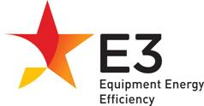
Australia’s Clean Energy Future and the role of energy efficiency
Tim Farrell
Appliance Energy Efficiency Branch
November 2012

Slide 2

Clean Energy Future
Energy Efficiency
Renewable Energy
Carbon Price
Land Sector

Slide 3
The Carbon Pricing Mechanism - staged process of introduction
2008-09 2011-12
Reporting and regulatory frameworks
National Greenhouse and Energy Reporting System
Australian National Registry of Emissions Units
2012-13 2014-15
Fixed price period
The Government sets the price to support the transition to carbon pricing
2015-16 2017-18
Flexible price period with price controls
2018-19
onwards
Fully operational emissions trading scheme
One way linking with the EU ETS
The market sets the price and the sources of abatement. Full linking with the EU ETS

Slide 4
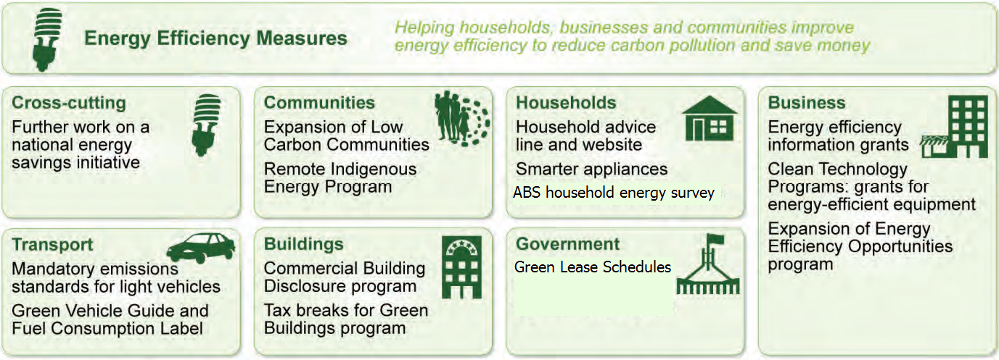
Encouraging Energy Efficiency

Slide 5
Equipment Energy Efficiency (E3) Program
MEPS - 2004
Distribution Transformers
Single Phase A/Cs
Commercial Refrigeration
Linear Fluorescent Lamps
MEPS - 2005
Electric Storage Water Heaters
Refrigerators & Freezers
MEPS – 2009
Incandescent GLS lamps
Compact Fluorescent lamps
External Power supplies
Chillers (Commercial A/C)
Televisions
MEPS – 2010
Incandescent GLS lamps
Compact Fluorescent lamps
Refrigerators & Freezers
Air Conditioners
MEPS – 2011
Gas Water Heaters
Labelling - 1986
Refrigerators & Freezers
Clothes Washers
Clothes Dryers
Dishwashers
Air Conditioners - non ducted single phase
Labelling - 2009
Televisions
Voluntary Labelling – 2010
Swimming Pool Pumps
MEPS - 1999
Electric Storage Water Heaters
Refrigerators & Freezers
MEPS - 2001
Three-Phase Electric Motors
Three Phase Air Conditioners
MEPS - 2003
Fluorescent Lamp Ballasts

Slide 6
A Success Story – Reducing Energy Consumption of New Frost Free Refrigerators & Freezers, 1986 to 2006

Slide 7
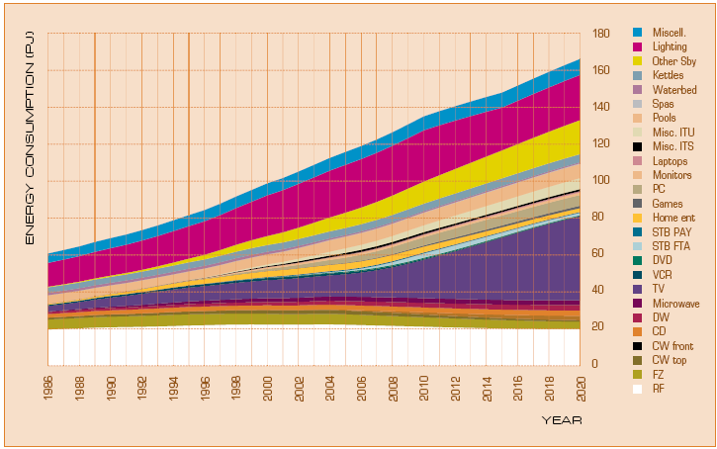
Trends in Electrical Appliance Energy (1986-2020)

Slide 8
New National Legislation
New National Legislation – Greenhouse and Energy Minimum Standards Act 2012 – commenced on 1 October 2012
Broader coverage
Replaces 4 state-based regulators with a single Australian GEMS Regulator
Requirement for the provision of sales data
Fines and other enforcement measures for non-compliance

Slide 9
Greenhouse and Energy Minimum Standards Act
Victoria
NSW
Queensland
One
Australian Regulator
Northern Territory
Western Australia
Tasmania
South Australia
ACT

Slide 10
Under the GEMS Act there are a range of penalties and enforcement measures
These penalties and enforcement measures include:
  Suspension and cancellation of registrations
  Infringement notices
  Civil and criminal penalties (fines)
  Injunctions to put a stop to non-compliant activity
  Enforceable undertakings – agreements to rectify an alleged wrong and compensate consumers and the environment

Slide 11
Penalties are per offence but the Regulator may develop rules where multiple offences apply
One penalty unit currently equals $110.00
Category A Products:
  Infringement notice for an individual: $660
  Infringement notice for a corporation: $3,300
  Civil/criminal penalty for an individual: $6,600
  Civil/criminal penalty for a corporation: $33,000
Category B Products:
  Infringement notice for an individual: $1,320
  Infringement notice for a corporation: $6,600
  Civil/criminal penalty for an individual: $13,200
  Civil/criminal penalty for a corporation: $66,000

Slide 12
The Regulator can publicise contraventions
The Regulator can report enforcement action including the name of any ‘person’ who has been issued with or paid an infringement notice.
This ensures transparency and ensures that purchasers can monitor the history of non-compliance. This may be relevant to future purchasing decisions.

Slide 13
For more information
Clean Energy Future package | www.cleanenergy future.gov.au
Appliance and equipment energy efficiency | www.energyrating.gov.au
Energy efficient buildings | www.climatechange.gov.au/what-you-need-to-know/buildings
Energy efficiency in households | www.livinggreener.gov.au
Industrial energy efficiency | www.energyefficiencyopportunities.gov.au

