Slide 1
Updated development of APEC Energy Working Group
EWG Secretariat

Slide 2
Change of rule: New management of Energy Efficiency and Low Carbon (EELCM) Sub-Fund
Since session 1 of 2018, EWG will be responsible for endorsing, assessing eligibility and scoring the CNs applying EELCM Sub-Fund.
EWG Sub-fora, namely, EGCFE, EGEDA, EGEEC, EGNRET, LCMT-TF, ER-TF, will be responsible for reviewing relevant CNs and providing advices and feedbacks to PO to strengthen the CNs, without the right to endorse any of the CNs.

Slide 3
Eligibility Criteria
Have at least 4 co-sponsoring economies from the project’s originating forum;
In line with and can contribute to APEC’s aggregate energy intensity reduction goal of 45% by 2035, and/or renewable energy doubling goal by 2030;
Demonstrate the project will meet capacity building needs for APEC developing countries;
Upper limits for Category 2 projects: USD 100,000.

Slide 4
Priority for funding
Category 1 (top priority)
-Low-Carbon Model Town (LCMT) projects
-maximum of 1 project per year can be funded.
-No funding cap of USD 100,000.
Category 2
-All other energy efficiency and low carbon measures
projects, including renewable energy projects.
-Peer Review on Energy Efficiency (PREE), Peer Review on
Low Carbon Energy Policies (PRLCE), and other LCMT related
projects not funded under Category 1 can be included.
-Requires 50% of total average score as a minimum to be
eligible to enhance project quality.

Slide 5
Project application process
Step 1: Project Development with EWG Review (optional)
PO drafts CN in consultation with proposing Economy’s APEC Forum representative
Proposing Economy Forum Representative can contact other economies’ Fora representatives seeking project inputs and possible co-sponsorship
The proposing Economy Fora Representative submits project CN to EG/TF and APEC Secretariats by the optional EWG Project Review Deadline which is no later than 4 weeks before EWG meeting.
Or Proposing Economy Fora Representative forwards CN to APEC Secretariat by the optional EWG Project Review Deadline with justification for not going through EWG EG/TF.
Project Refinement through EWG, EGs/TFs
-APEC Secretariat circulates all CNs received from the EG/TF chairs 2 weeks before EWG meeting with co-sponsorship Declaration Form.
-CNs are discussed at EWG meeting. Proposing Economy EWG Representative communicates EWG feedback to PO.
EG/TF members review CNs and provide feedback to PO and Proposing Economy Fora Representatives. PO resubmits revised CN to EG/TF Chairs and Secretariat.
EG/TF Chair forwards latest CN version to APEC Secretariat no later than 2 weeks before EWG meeting.

Slide 6
Step 2: Formal Submission, Co-Sponsorship (mandatory)
PO can choose to go straight to this step!
PO finalises CN and Proposing Economy Fora Representative submits Final CN to APEC Secretariat by the APEC Internal Deadline.
Originating Fora Representatives submit Co-sponsorship Declaration Form to APEC Secretariat by the APEC Internal Deadline.
Step 3: EWG and EELCM Sub-Fund project Endorsement, Eligibility Assessment and Scoring
APEC Secretariat reviews final CNs received for compliance. APEC Secretariat circulates to EWG members all CNs eligible for applying EELCM Sub-Fund.
EWG members make endorsement for all CNs, and score all CNs eligible for applying EELCM Sub-Fund.
APEC Secretariat informs PO and originating APEC Fora members of BMC ”approval in-principle” outcome for CNs.

Slide 7
Recent EWG decision on Project Management
Expert groups and task forces are requested to assist POs with familiarizing with APEC project procedures and to provide POs with technical advices for the sake of project quality.
Members/EG Chairs are requested to present in the EWG meeting a 2 page summary of each EWG project completed since the last EWG meeting, including policy recommendations/suggestions for further APEC consideration or action.
All projects should closely follow the rules of submission including the co-sponsorship and deadline.

Slide 8
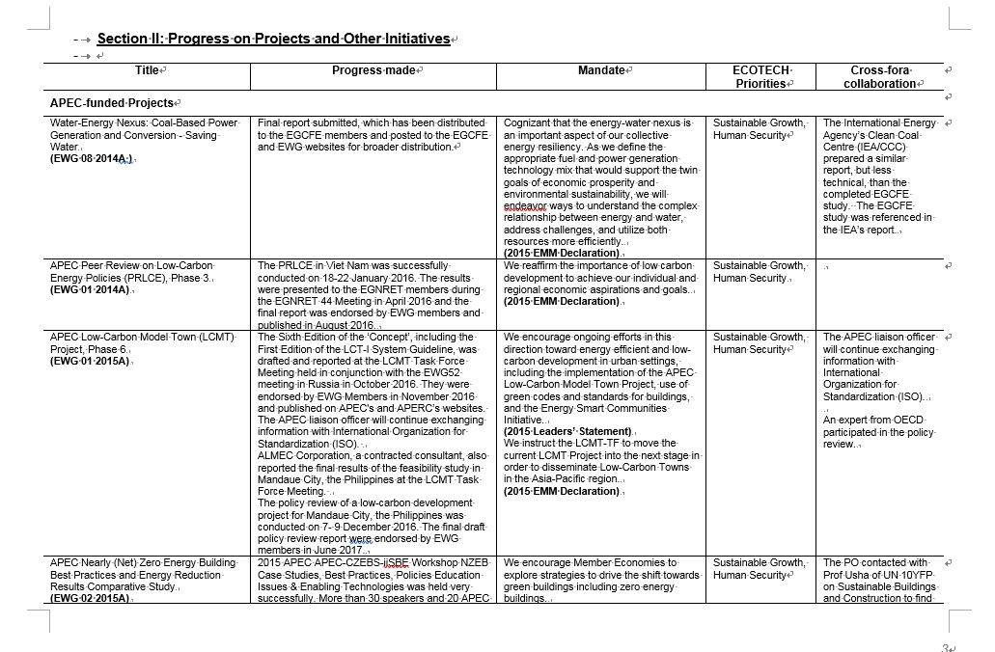
Outreach within and beyond APEC
All projects are encouraged to provide high-level policy recommendations upon completion and seek greater visibility.
Expert groups are requested to be supportive in providing detailed and sound information to demonstrate work achievements which are to be submitted to APEC senior officials, such as fora report or other surveys.
Expert groups are encouraged to conduct cross-fora cooperation and should report to EWG for endorsement.
Fora report submitted to APEC SCE

Slide 9
Lynn Wan-Ling Wang APEC Energy Working Group Secretariat ewg.secretariat@tier.org.tw Tel: 886-2-25865000 ext.837
Your comments are welcome!

