Slide 1
Program Status Report from the APEC-ESIS Secretariat 39th Meeting of the APEC Expert Group on Energy Efficiency & Conservation 28 February 2012
Anna Lising
Senior Associate
Collaborative Labeling and Appliance Standards Program (CLASP)

Slide 2
Agenda
Overview of APEC-ESIS
CLASP as the ESIS Secretariat
ESIS Status Summary
Review: Decisions from 38th APEC EGEE&C Meeting
Review of US DOE funding
Global S&L Database Re-launch
Overview of new design and features
2012 database information updates

Slide 3
APEC-ESIS
Primary objectives:
Provide up-to-date information about S&L
Provide S&L expert contacts
Provide regular news updates
Provide user-friendly way for Key Contacts to update the database
Provide “Communities of Practice” to harmonize and rationalize S&L
History:
2004 ESIS is created
2006 ESIS is improved and expanded
2007 CLASP begins to serve as Secretariat
2011 New ESIS webpage is developed
Notes:
2004 – ESIS was an S&L spreadsheet (very rudimentary)
2006 – Expansion includes economy profiles

Slide 4
ESIS Secretariat
CLASP serves as Secretariat of APEC ESIS under the direction of the APEC ESIS Project Overseer (currently NZ) and EGEE&C
Secretariat Responsibilities:
Be a central repository for all economy contributions to ESIS;
Request and collect updates to ESIS economy content;
Integrate data inputs and other content to APEC ESIS from other sponsors (e.g. SEAD & CLASP);
Develop and manage subcontracts to run, maintain and improve ESIS;
Raise Funds for ESIS within and outside of APEC;
Report to the Project Steering Committee twice a year at the EGEE&C meetings; and
Develop and maintain a strategic Plan for long-term sustainability

Slide 5
About CLASP
The Collaborative Labeling and Appliance Standards Program’s (CLASP) mission is to serve as the primary international voice and resource for practitioners of energy efficiency standards and labeling (S&L) worldwide
CLASP roles:
APEC-ESIS Secretariat
ClimateWorks Foundation (CWF) Best Practice Network (BPN) for the appliance sector
Super-efficient Equipment and Appliance Deployment (SEAD) Initiative Operating Agent

Slide 6
Summary of Decisions: 38th EGEE&C Meeting
Design for the new APEC-ESIS webpage was approved
EGEE&C members agreed to expanding the APEC branding to APEC economy and product webpages
Funding commitments needed to meet one-time cost of $20,000 USD
Estimated 4 to 8 weeks to develop and deploy the APEC-branded “economy pages” and “product pages”

Slide 7
ESIS Status Summary
Operations and Maintenance Updates:
CLASP launched the new ESIS webpage in December 2011
Transitioned from the former ESIS website to the new webpage without interruption
As-needed technical maintenance and incident trouble-shooting; no trouble since last report
Content Updates:
CLASP completed a comprehensive update to database entries for multiple APEC economies (Australia, Canada, Chile, Chinese Taipei, Japan, Mexico, New Zealand, People’s Republic of China, & United States)
Additional updates scheduled for June and December 2012

Slide 8
ESIS Webpage Launch

Slide 9
Current Funding
APEC-ESIS has received generous support from SEAD to fund the following:
Hosting and maintenance of ESIS webpage;
Update of economy content in the database;
CLASP’s continued role as ESIS Secretariat; and,
CLASP’s participation at APEC meetings
ESIS budget expenditures for 2012 are on track.
Currently ESIS has received no additional economy contributions

Slide 10
Global S&L Database Re-launch
Online resource that allows policy makers and S&L practitioners to compare policies and regulations across countries and by product.
Includes 36 economies and two regional associations (APEC and SEAD)
Covers 17 product categories of appliances, equipment and lighting
Sectors include residential, commercial, industrial or multi-sector
Distinguishes policy types, policy status, and effective dates of implementation
Policy types include MEPS, Endorsement label, Comparative label
Links to:
Implementing Organization
Policy or legislation document or website

Slide 11
New APEC Search Feature

Slide 12
Economy Information Webpage

Slide 13
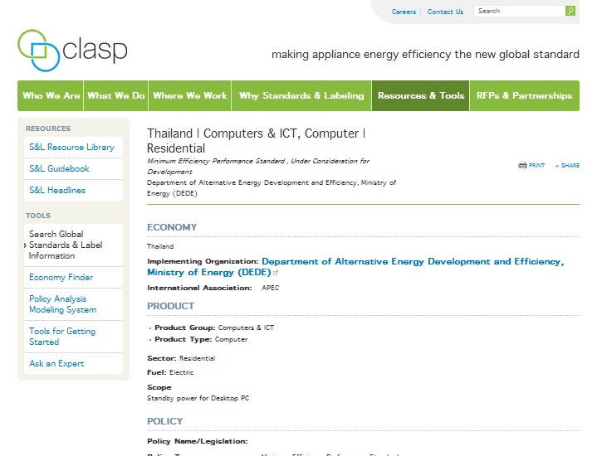
Product Information Webpage

Slide 14
Global S&L Database Updates
S&L program information updates were conducted in July 2011 in anticipation for the re-launch
Information gathered from government websites
Not all countries could be updated – either current S&L information was not publicly available or information could not be accessed due to language barriers
2012 Database updates are planned for June and December
Assistance needed from APEC EGEE&C Members:
Contact person who can provide current and updated S&L program information for your economy

Slide 15
Thank you! Please contact Anna Lising at alising@clasponline.org with any questions or comments.

