Slide 1
APEC EGEE&C 52 and EGNRET 51 Chiang Mai, Thailand 10-14 September, 2018 Overview of APERC Activities
Tom Willcock
Researcher
Asia Pacific Energy Research Centre (APERC)

Slide 2
APERC
APERC was established in Tokyo in 1996 after the Osaka APEC leaders meeting in 1995.
Primary objective is to foster a common understanding of energy challenges facing APEC member economies.
Through analysis of the supply and demand outlook.
The development of energy markets.
Discussion of policy responses.

Slide 3
APERC overview
EMM
EWG
EGCFE
LCMT-TF
EGNRET
EGEEC
EGEDA
YEARLY OVERVIEW
Cooperative Projects
PREE
PREE & FU
EEP WSS
Research and training
PRLCE
TOPICAL RESEARCH
Energy Demand and Supply OUTLOOK
LCMT
OGSI
EXERCISE
NETWORK
STUDIES
Oil, Gas and Coal Reports
Annual Conf.
Data network
LNG P-C Conf.
Model Training
APERC ACTIVITIES
JS APERCxIEEJ
METI - IEEJ

Slide 4
APERC activities
Research activities
APEC Energy Demand and Supply Outlook (EDSO)
Yearly APEC Energy Overview
APERC Oil/Gas/Coal Reports
Topical studies
Cooperative Projects
Peer Review on Energy Efficiency (PREE)
Renewable Energy Projects (PRLCE, LCMT)
Energy Security Projects (OGSI)
Training and Data Collection
Annual Conference and Advisory Board meeting
Other activities/missions

Slide 5
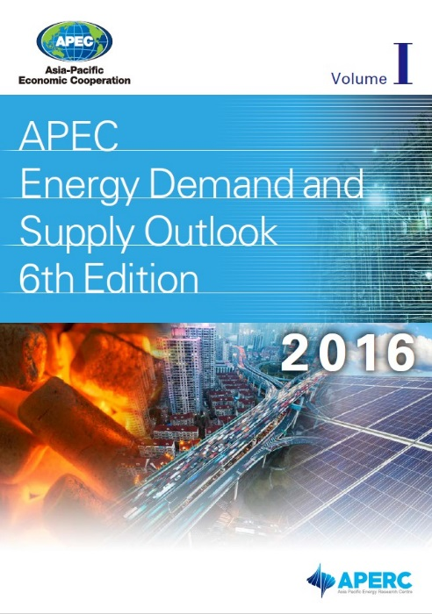
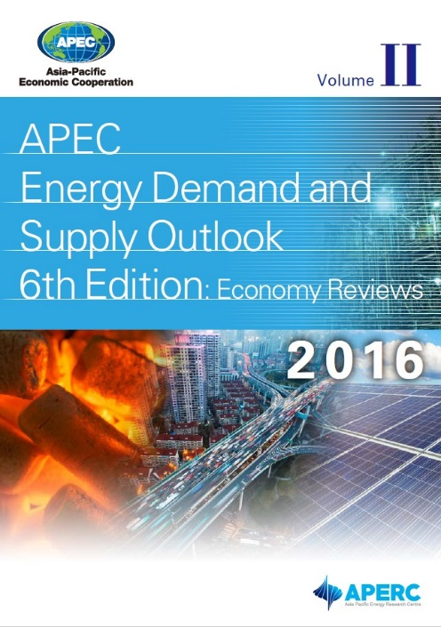
The APEC Energy Demand and Supply Outlook
The ‘APEC Energy Demand and Supply Outlook’ project is a priority task, published every 3-4 years.
Two volumes: APEC as a region and individual economy reviews.
The 6th edition was released in May 2016.
The 7th edition is well underway. Similar in structure to the 6th, but with expanded modelling and new scenarios. Drafts have been sent for expert review (some have already been returned). Publication release at EWG 57 (April/May 2019).

Slide 6
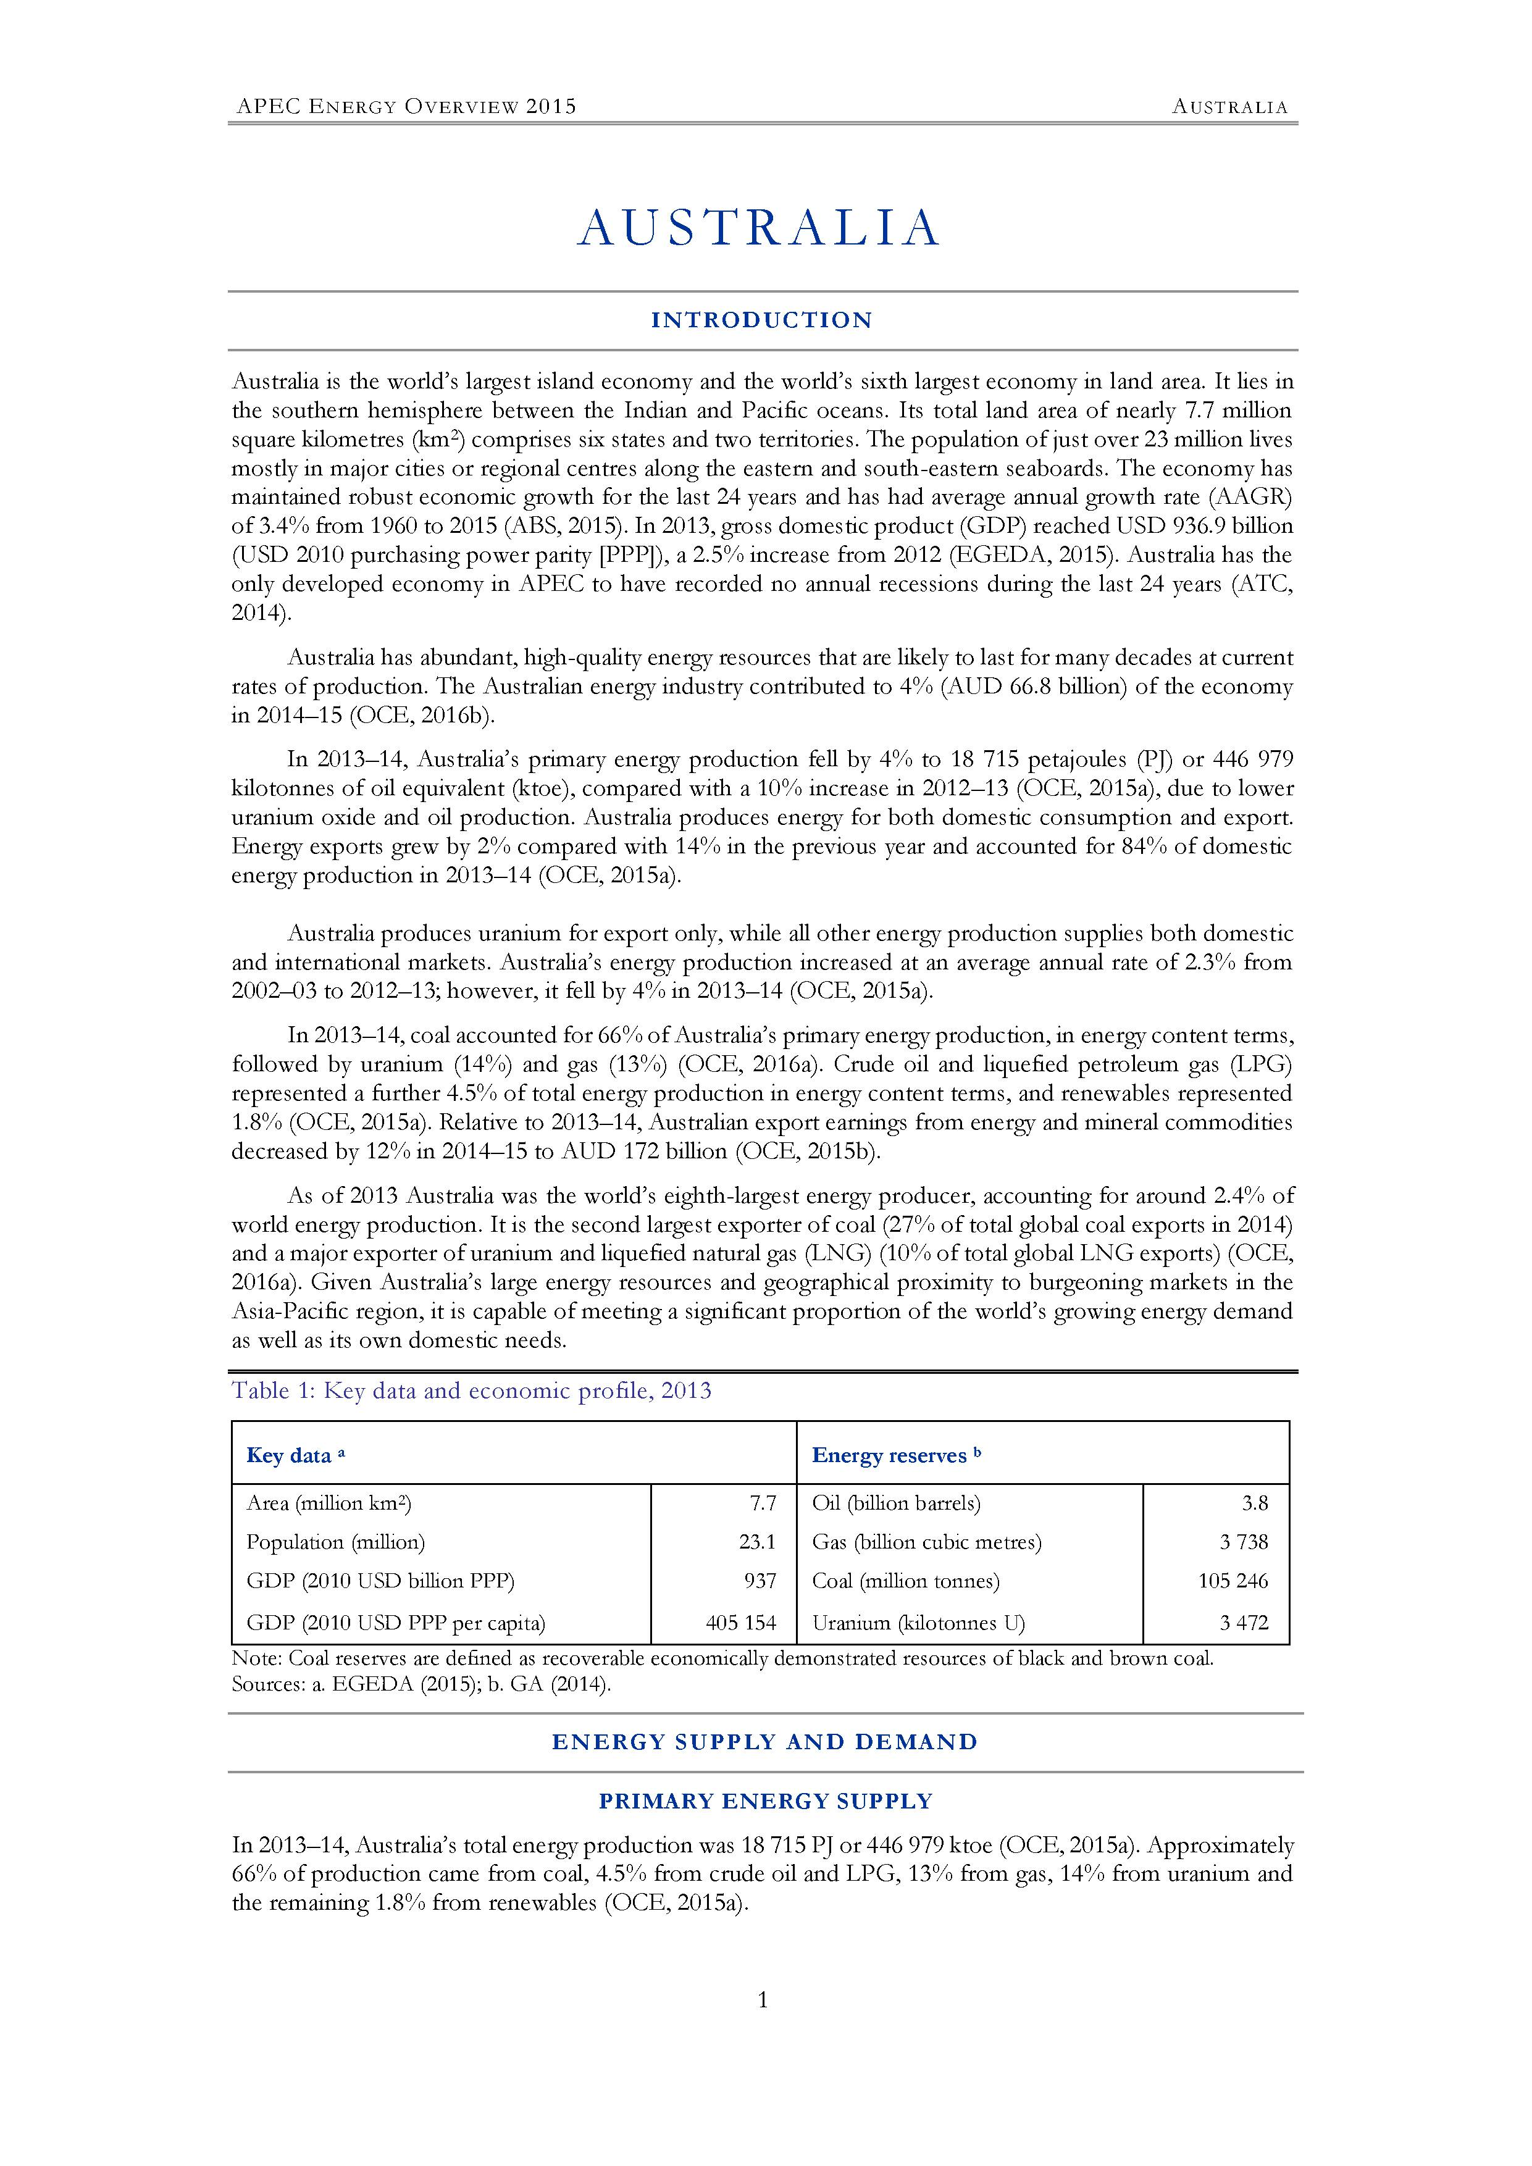
APEC Energy Overview 2017
Energy Overview focuses on supply, demand and policy
Introduction
Energy Supply and Demand
Primary Energy Supply
Final Energy Consumption
Energy Intensity Analysis
Policy Overview
Energy Policy Framework
Energy Markets
Energy Efficiency
Renewable Energy
Climate Change
Notable Energy Developments
References
Useful Links
For more information visit: http://aperc.ieej.or.jp/publications/reports/energy_overview.php

Slide 7
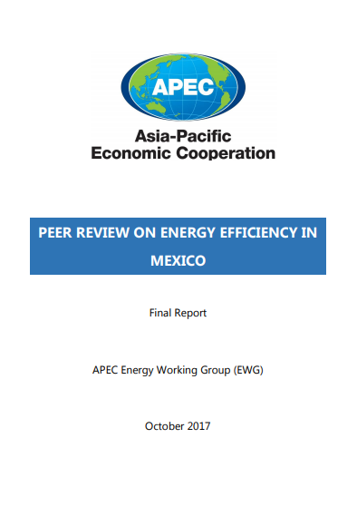
APEC Peer Review on Energy Efficiency (PREE)
Review on Energy Efficiency and follow up
7 phases, across 11 economies so far: New Zealand, Chile, Viet Nam, Thailand, Chinese Taipei, Peru, Malaysia, Indonesia, Brunei Darussalam, and Mexico.
Russia in November [TBC].
Peru in March next year.
Energy Efficiency Policy Workshop (EEP)
Most recently held in Washington at EGEE&C 50.
Energy Efficiency Policy Compendium
Latest and last publication: October 2017
For more information, visit http://aperc.ieej.or.jp/publications/reports/compendium.php

Slide 8
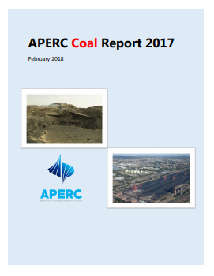
Topical research in 2017/8
APERC Coal Report 2017
Investments in Natural Gas Supply Chain under the Low Price Environment
APERC Oil Report 2018
APERC Gas Report 2018
Analysis of cost-optimal deployment of variable renewables and grid interconnection in northeast Asia.
APEC oil and gas security exercise.
Oil and Gas Security newsletters.

Slide 9
Cooperative activities
2007
2018
2019
PREE
FU PREE
PRLCE
LCMT
LCMT Symposium
LCMT Dissemination
OGSE
OGSNF
1.NZ
2.CHL
3.VN
4.THA
5.CT
6.PE
7.MAS
8.INA
9.RP
10.BD
11.MEX
12.RUS (TBC)
1.VN
2.RP
3.THA
4.MAS
5.PE (TBC)
1.THA
2.RP
3.INA
4.MAS
5.VN
6.PNG
1.Yujiapu PRC
2.Samui THA
3.Da Nang, VN
4.San Borja
PE
5.Bitung
INA
6.Mandaue RP
7.Krasnoyarsk RUS
1.Jakarta
INA
2.Da Nang VN
3.San Borja
PE (TBC)
1.Band Aceh, INA
1.Hang Tuah Jaya, MAS
1.Shah Alam, MAS
SE Asia
INA
launched
OGSI
3.PE
1.RP
2.AUS
4.CHL (TBC)
1.Kitakyushu
JPN
2.Kagoshima
JPN
3.Irkutsk RUS
4.Tokyo
JPN
5.Sendai
JPN
EMM8
EMM9
EMM10
EMM11
EMM12
APEC Leaders
Sydney Meeting
APEC EMM
in Fukui
APEC Leaders Honolulu meeting
APEC EMM in
St. Petersburg
APEC EMM
in Beijing
APEC EMM
in Cebu
Energy intensity reduction goal of APEC region by at least 25% by 2030
Introduction of PREE
Launch of
PRLCE & LCMT
Continuation of
PREE & CEEDS
APEC's aggregate energy intensity reduction goal of 45% by 2035
Instruction on improving the response to oil and gas emergency situations (OGSE)
Approval of OGSI
Goal of doubling the share of renewables by 2030
Instruction on enhancing the quality of electric power infrastructure
Move LCMT to the dissemination stage

Slide 10
Training activities
APERC accepts energy modelling trainees from developing economies.
Seminar in Tokyo from 5-13 November 2018.
Also dispatch experts to develop energy data and modelling capacities around the region.
Five workshops in FY 2017/18: Mexico, PNG, Peru and Indonesia (twice). Chinese Taipei in August.
A cooperation course on ‘Energy Issues in the Asia-Pacific Region’ at Waseda University (Tokyo) started April 2016.

Slide 11
Thomas.Willcock@aperc.ieej.or.jp

