Slide 1
Progress towards APEC’s energy intensity reduction goal
The 51st Meeting of the APEC EGEEC 11-13 April, 2018
Washington, DC
Tom Willcock
Researcher, APERC

Slide 2
Background

Slide 3
Milestones
Honolulu Declaration 2011
To reduce APEC's aggregate energy intensity by 45% percent by 2035.
EWG Meetings
APERC has been reporting progress since EWG41 in 2011.
EGEEC49
APERC reported progress and made suggestions on updated TOR.
Proposal and approval of the current definition.
EWG53 Meeting
After reporting three different energy intensity measures using IEA data, agreement was reached at EWG 53 to analyse final energy (excluding non-energy) intensity, using APEC data.

Slide 4
Notes on data sources
Energy data collected by ESTO with support from EGEDA (2015 is current but we should have 2016 in time for the next meeting).
GDP data from the World Bank (constant 2011 USD PPP – available through 2016).
Exceptions:
APERC/ESTO estimates for Papua New Guinea’s (PNG) energy consumption.
Chinese Taipei and PNG’s GDP data are estimates from the APEC Outlook 7th Edition.
Notes:
Energy Statistics and Training Office
Expert Group on Energy and Data Analysis

Slide 5
Updates since Moscow
No new data, but very slight revisions to energy intensity.
Mostly due to GDP revisions by the World Bank (Malaysia, Mexico, New Zealand, PNG, Russia and the US).
Very slight energy consumption change for Chinese Taipei.
Continuing work on the 7th edition of the APERC Energy Demand and Supply Outlook.
Notes:
Energy Statistics and Training Office
Expert Group on Energy and Data Analysis

Slide 6
Results

Slide 7
What has happened to intensity since EWG54?
APEC Final energy (excluding non-energy) consumption intensity
 | 2006 | 2007 | 2008 | 2009 | 2010 | 2011 | 2012 | 2013 | 2014 | 2015 | 2005-2015 | Trend to 2035
Change in Final Energy (ex. non-energy) | 1.9% | 4.3% | 1.1% | -1.7% | 5.9% | 4.4% | 1.9% | 0.9% | 1.3% | 0.0% | 21.5%
Change in GDP (2011 US $PPP) | 5.4% | 5.6% | 3.0% | 0.0% | 5.8% | 4.4% | 4.3% | 3.9% | 3.8% | 3.7% | 47.9%
Change in Final Energy Intensity (ex. non-energy) | -3.3% | -1.3% | -1.8% | -1.7% | 0.1% | 0.0% | -2.4% | -2.9% | -2.5% | -3.5% | -17.9% | -44.6%
Source: APERC analysis of ESTO data.
Final energy consumption intensity (ex. non-energy) has been improving reasonably consistently with the largest reduction from 2014 to 2015.
Final energy consumption intensity (ex. non-energy) fell 17.9% between 2005 and 2015.
If the current trend continues, final energy consumption intensity (ex. non-energy) reduction would fall just short of the APEC goal, reaching 44.6% in 2035 (the APEC goal would be reached the following year).

Slide 8
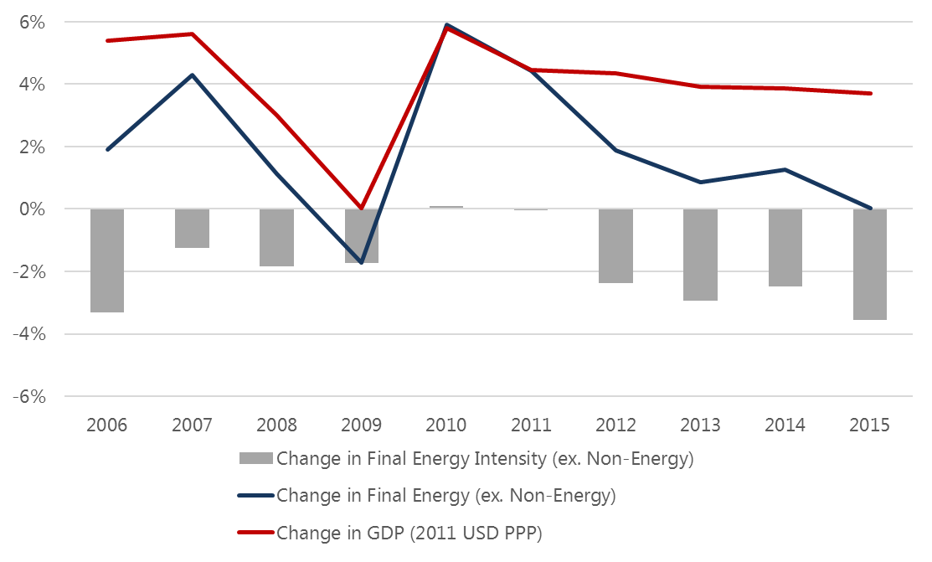
YoY changes to intensity, energy demand and GDP

Slide 9
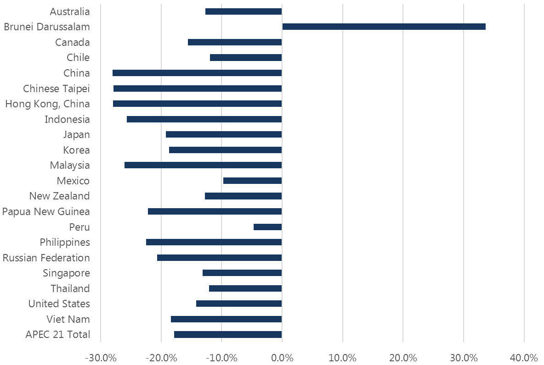
Economy level results, 2005 to 2015
Notes:
Good progress across APEC. Brunei obviously stands out (due to subsidised energy and flat GDP), but a very very small proportion of the total.
Non-OECD with larger decreases than OECD.
APEC total -17.6%

Slide 10
What does this tell us?
Change in final energy consumption (excluding non-energy) in 2015 compared with the previous year is only 0.01%...
…and growth in GDP (PPP) has been stable for the last three years (3.9%, 3.8% and 3.6%, in 2013-14-15, respectively).
So in 2015, GDP growth decoupled from energy consumption growth, resulting in a significant energy intensity reduction of 3.5%.
These trends look encouraging, so how do we think APEC is tracking against the goal…
Notes:
3.5% is the largest in the time series.

Slide 11
Looking forward

Slide 12
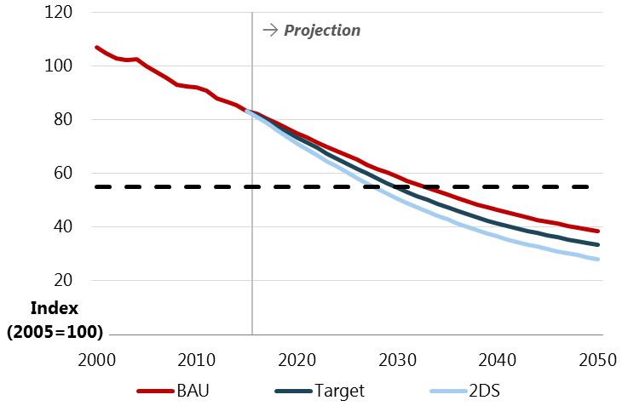
7th edition preliminary APEC results
Currently finalising modelling for the 7th edition of the APERC Energy Demand and Supply Outlook.
BAU achieves the 45% reduction goal in 2033, Target in 2030 and 2°C Scenario in 2028.

Slide 13
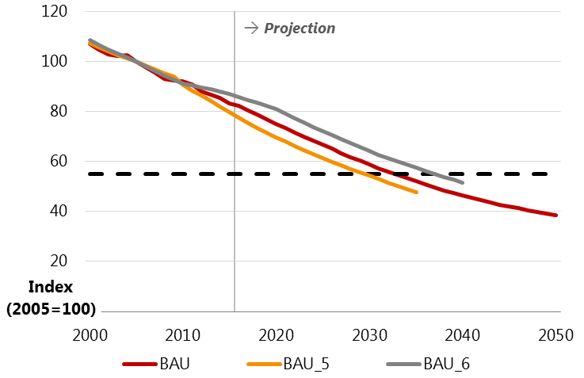
7th compared with past editions
5th edition BAU achieves goal in 2030, 6th edition in 2037.
6th edition probably reflects poor intensity improvements in 2010 and 2011. Much better since then.

Slide 14
Closing Thoughts
Similarly to last time, recent history looks good…
And the 7th edition results are encouraging…
But it raises the question: if the BAU scenario achieves the intensity goal two years ahead of schedule, do we need to think about making it more ambitious?
This has already been done once. The original goal, set in 2007, was a 25% improvement by 2030 (with a 2005 base year).

Slide 15
Thomas.Willcock@aperc.ieej.or.jp

Slide 16
Additional slides

Slide 17
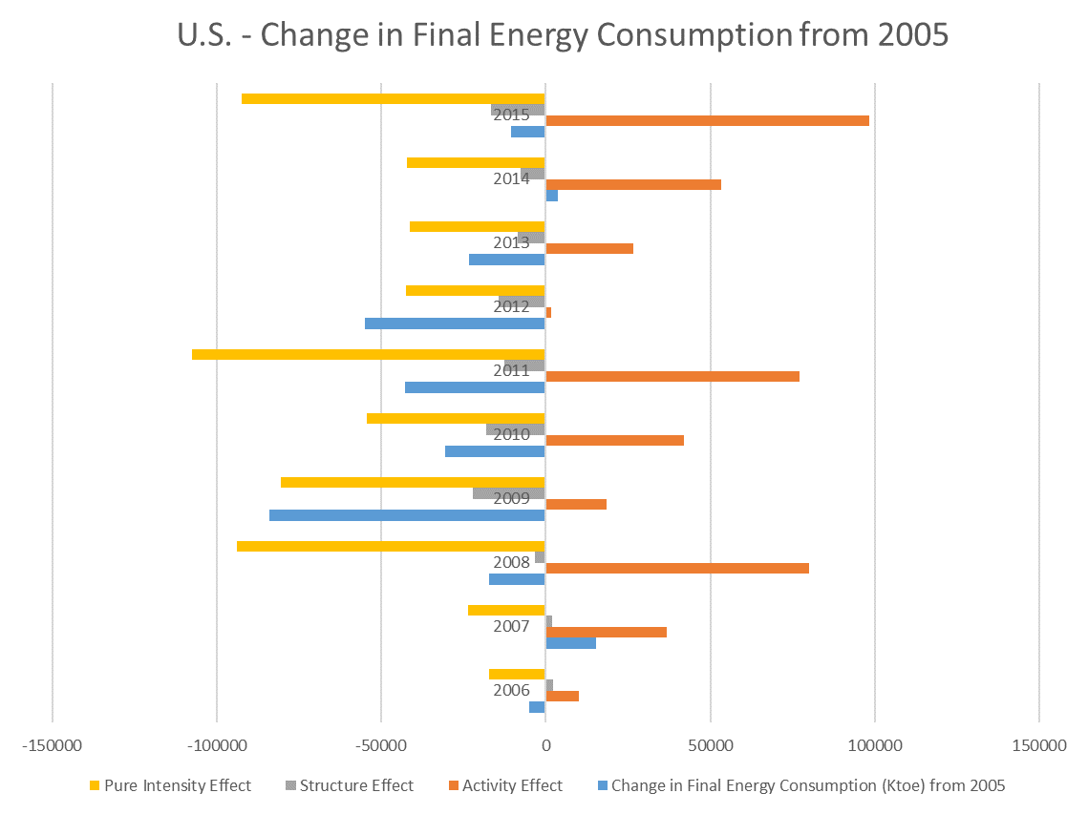
Decomposition analysis – U.S.
Ktoe

Slide 18
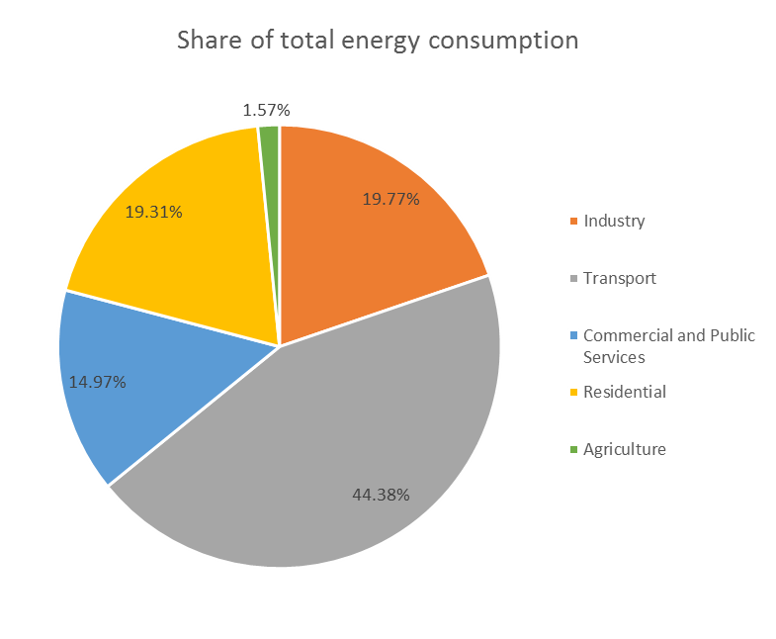
Decomposition analysis – U.S.
2005-2015

Slide 19
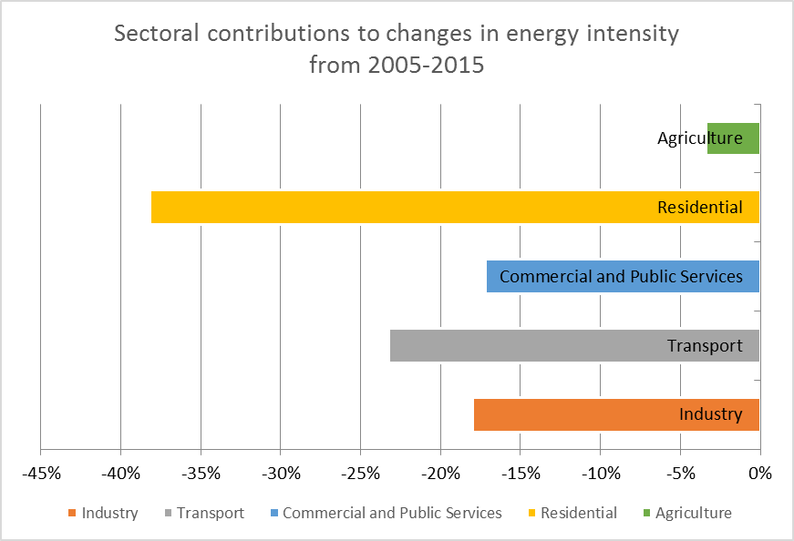
Decomposition analysis – U.S.

Slide 20
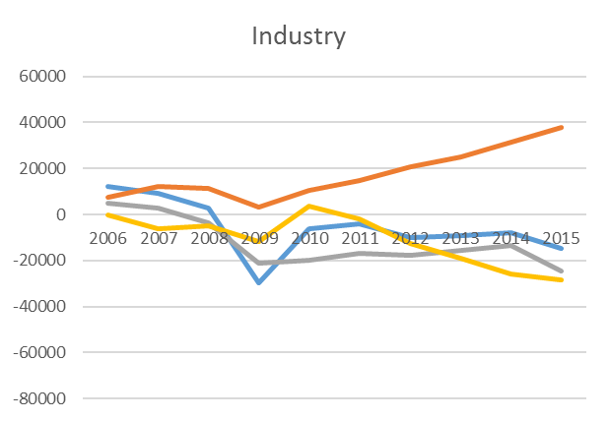
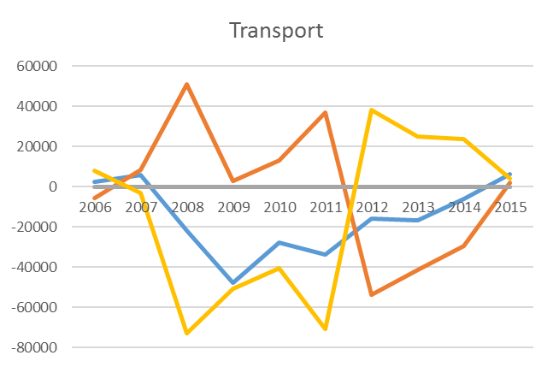
Decomposition analysis – U.S.
Ktoe
Ktoe

Slide 21
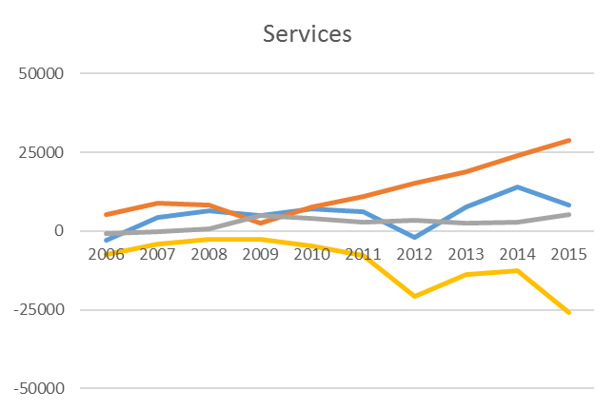
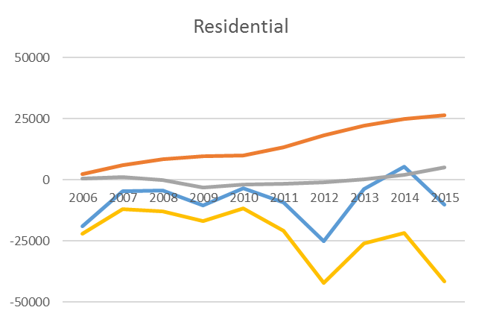
Decomposition analysis – U.S.
Ktoe
Ktoe

Slide 22
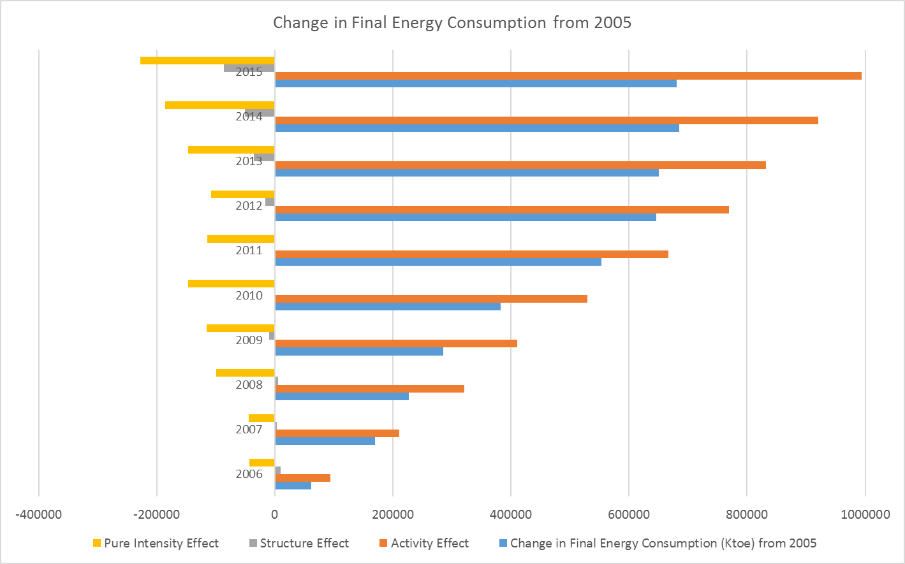
Decomposition analysis – China
Ktoe

Slide 23
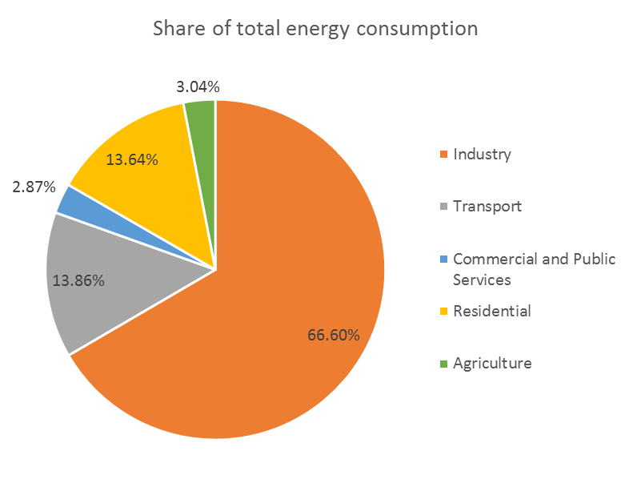
Decomposition analysis – China
2005-2015

Slide 24
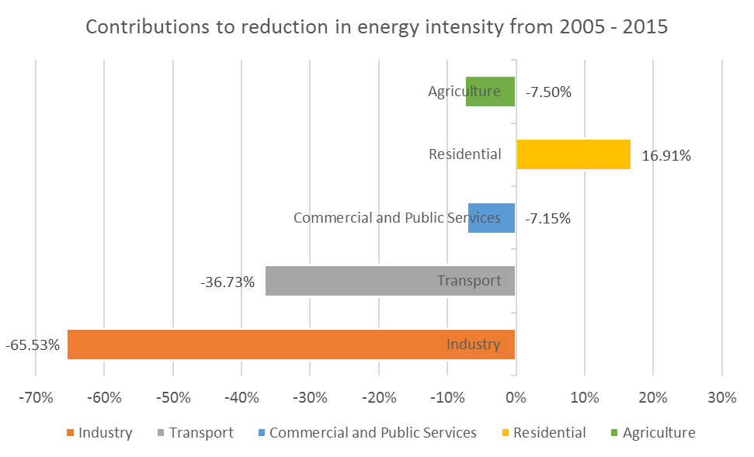
Decomposition analysis – China

Slide 25
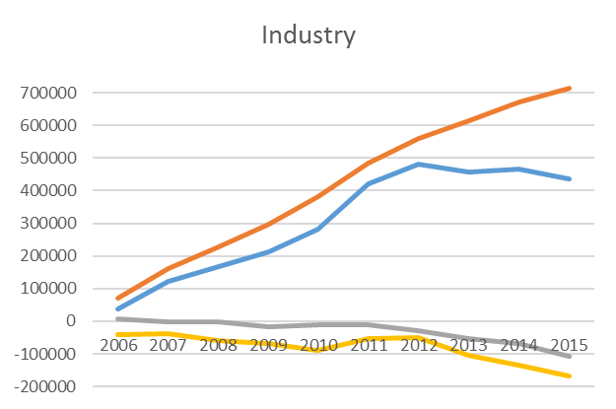
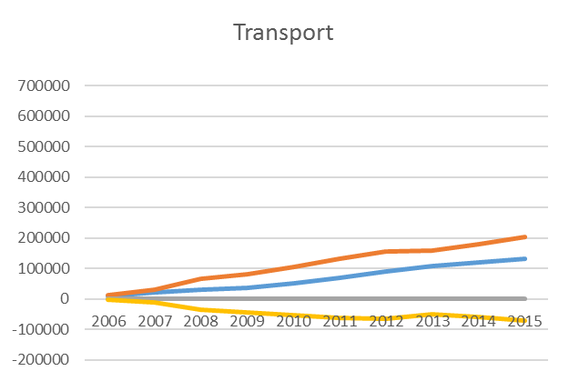
Decomposition analysis – China
Ktoe
Ktoe

Slide 26
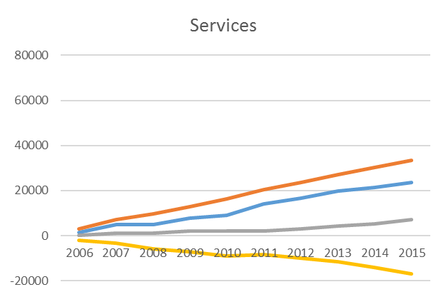
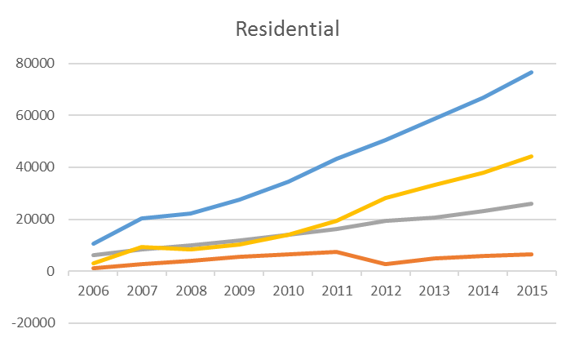
Decomposition analysis – China
Ktoe
Ktoe

Slide 27
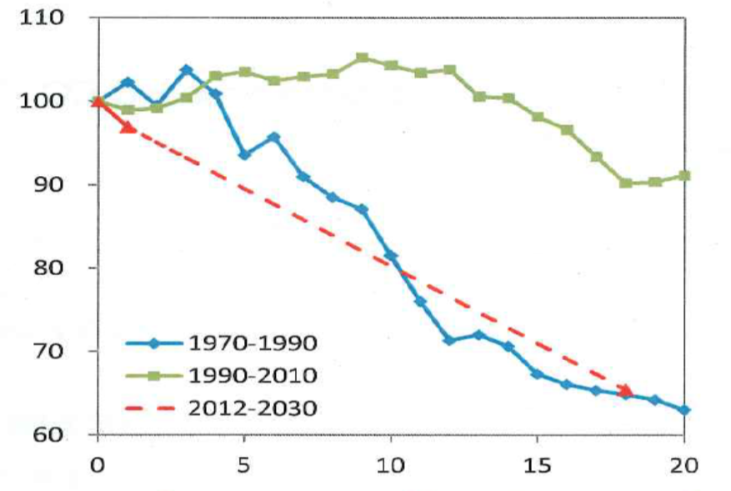
Japan’s experience
Japan’s energy intensity, 1970 to 2030
Source: Naoka Doi, IEEJ, “Current status of energy conservation policies in Japan,” Sept. 19, 2017
Very challenging to continually improve efficiency while GDP grows.

