Slide 1

Progress Report of
Low-Carbon Model Town (LCMT) Project
April, 2018
LCMT-TF Secretariat
METI, Japan

Slide 2
Background, the APEC LCMT Project
Declaration of the 9th APEC Energy Ministerial Meeting
(Fukui, Japan, June. 2010)
Establish a Task Force (LCMT-TF)
The LCMT-TF should
1. develop the concept of a Low Carbon Town,
2. conduct feasibility studies to encourage creation of low-carbon communities in urban development plans, and
3. share best practices for making such communities a reality.
Instructions from APEC Energy Ministers, the 12th APEC EMM
(Cebu, the Philippines, Oct. 2015)
We instruct the LCMT-TF to move the current LCMT Project into the next stage in order to disseminate Low-Carbon Towns in the Asia-Pacific region.

Slide 3
Key Activities of the LCMT Project (Phase 1-7)
Development and refinement of the “Concept of the Low-Carbon Town in the APEC Region (Concept)”
The Concept shows a basic idea/principle of low-carbon town and provide guidance.
The APEC Low-Carbon Town Indicator (LCT-I) System has been developed based on the Concept.
2. Feasibility Studies for Case Towns
3. Policy Reviews for Case Towns
2

Slide 4
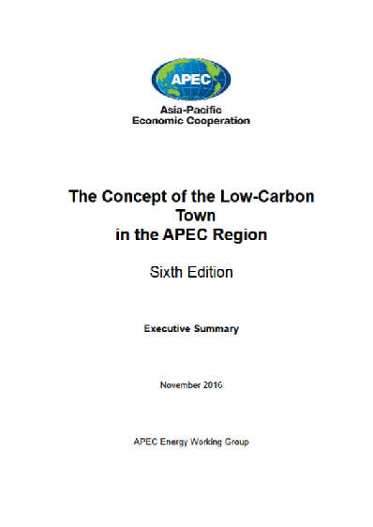
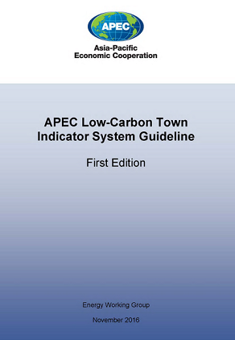
The Concept and the LCT-Indicator System
The Concept of the Low-Carbon Town in the APEC Region (Sixth Edition)
http://publications.apec.org/publication-detail.php?pub_id=1796
APEC Low-Carbon Town Indicator System Guideline (First Edition)
http://publications.apec.org/publication-detail.php?pub_id=1797

Slide 5
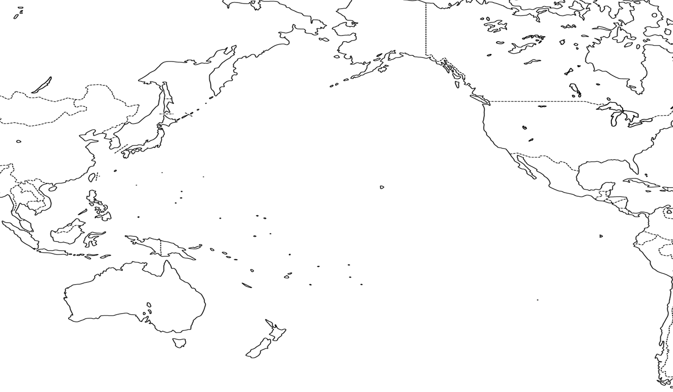
Case Towns of Feasibility Study and Policy Review
Phase 7
Krasnoyarsk
Russia
Phase 1
Tianjin
China
Inland region with high demand for heating and cooling
Central
Business
District(CBD)
Phase 3
Da Nang
Viet Nam
Phase 6
Mandaue
The Philippine
Re-developing
mixed-use
urban district
Cooperation with neighboring cities
Phase 4
San Borja
Peru
Phase 2
Samui
Thailand
Phase 5
Bitung
Indonesia
Residential area
Island
resort area
Industrial area

Slide 6
Transition of the LCMT Project
Phase 1 – Phase 6 (2011-2016)
Refinement of the “Concept” (including the LCT-Indicator System)
Feasibility Study (full scale)
of the Case Town
Policy Review
of the Case Town
Phase 7 (July 2016 - June 2018)
Feasibility Study (full scale)
of Krasnoyarsk city
Policy Review
of Krasnoyarsk City
Volunteer Towns Nomination/Selection
Self-assessment with LCT-Indicator
1st LCMT Symposium
（Sep. 2017)
Dissemination Phase 1 (Aug. 2017 – Dec. 2018)
Feasibility Study (specific area) of 3 Volunteer Towns
Volunteer Towns Nomination/Selection
Self-assessment with LCT-Indicator
2nd LCMT Symposium
(Sep. 2018)
Dissemination Phase 2 (The Concept Note under scoring process for 2018 Session 1)
Feasibility Study (specific area) of Volunteer Towns
Volunteer Towns
Nomination/Selection
3nd LCMT Symposium

Slide 7
Transition of the LCMT Project
Phase 7 (July 2016 - June 2018)
Feasibility Study (full scale)
of Krasnoyarsk city
Policy Review
of Krasnoyarsk City
Volunteer Towns Nomination/Selection
Self-assessment with LCT-Indicator
1st LCMT Symposium
（Sep. 2017)
Banda Aceh City, Indonesia
Hang Tuah Jaya, Malaysia
Shah Alam City, Malaysia
FS Consultant:
Nikken Sekkei Research Institute
Dissemination Phase 1 (Aug. 2017 – Dec. 2018)
Feasibility Study (specified area) of 3 Volunteer Towns
Volunteer Towns Nomination/Selection
Self-assessment with LCT-Indicator
2nd LCMT Symposium
(Sep. 2018)
Nominated volunteer towns are being reviewing under selection process.

Slide 8
Key Objectives of the Dissemination Phase
To disseminate the basic ideas and effective approaches of the Concept through utilizing the LCT-Indicator System, which helps to assess the progress and status of low-carbon development of various area in the APEC region;
To provide Feasibility Studies for specified areas of low-carbon development project of the volunteer towns in order to identify how to improve low-carbon development plans; and
To share best practices and real-world experiences of low-carbon development with planners and policy makers in the APEC region.

Slide 9
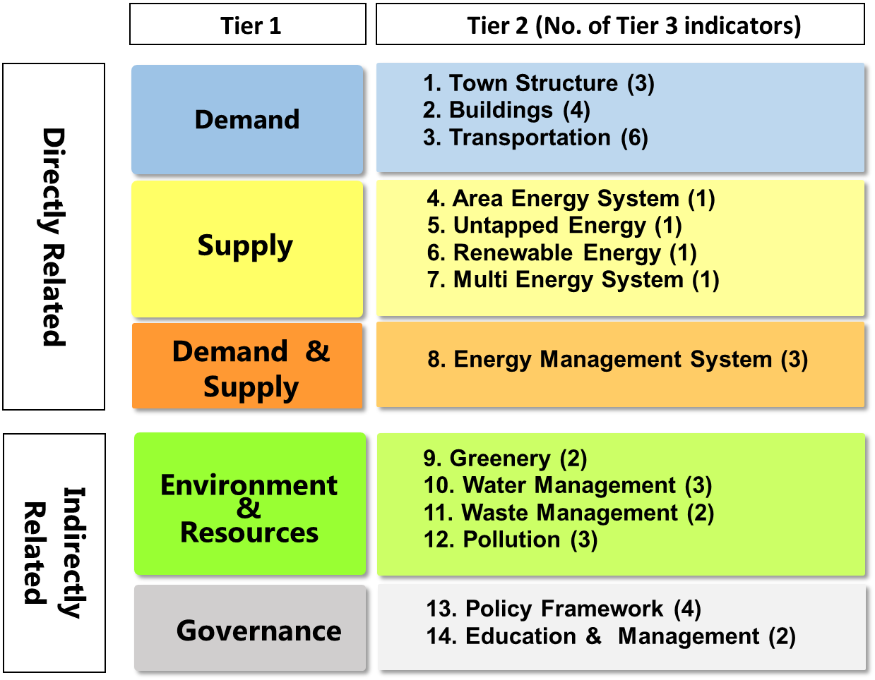
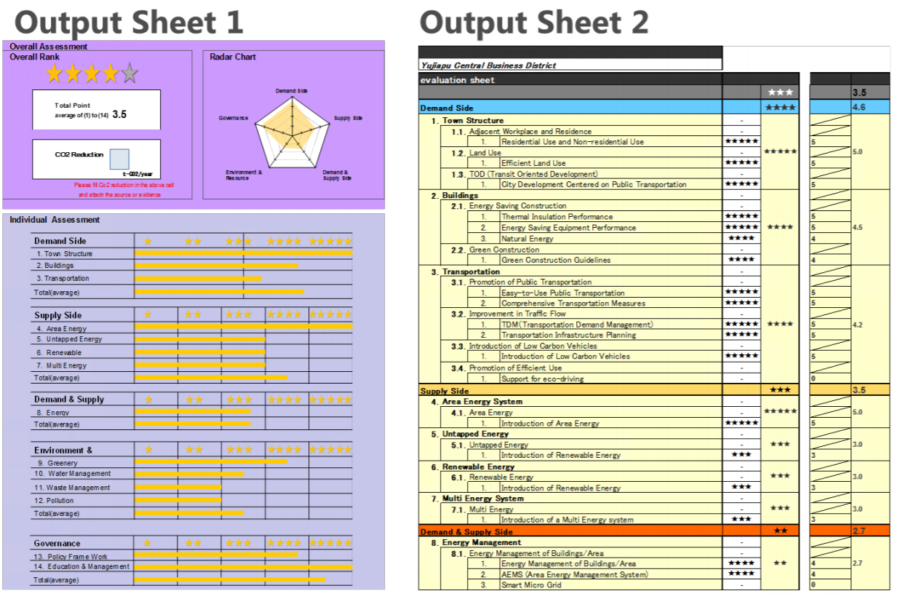
APEC Low-Carbon Town Indicator (LCT-I) System
Self-assessment tool designed as simple as possible for users to easily to carry out an assessment of low-carbon development with various scales, characteristics, and progress stages.

Slide 10
Case :LCT-I self-assessment by the Volunteer Town
LCT-I self-assessment result of Hang Tuah Jaya City, Malaysia
(Source: Hang Tuah Jaya City, 2017)

Slide 11
Timeframe of projects
2018
2019
Jan Feb Mar Apr May Jun Jul Aug Sep Oct Nov Dec
LCMT TF15
EWG55
Hong Kong
LCMT TF16
EWG56
Peru
Phase 7
Feasibility Study Report
Krasnoyarsk, Russia
Policy Review Report
Dissemination Phase 1
Feasibility Study
- Banda Aceh
- Hang Tuah Jaya
- Shah Alam
Bidding
Feasibility Study
Report
New Volunteer Towns
&
Symposium
Nomination of
Volunteer Towns
& Experts
Review of LCT-I Volunteer Towns’ Self Diagnoses
Symposium
(September 2018 in Viet Nam)
Report
Dissemination Phase 2
Approval of the Project
Selection of Consultant
Feasibility Study
Nomination of
Volunteer Towns
& Experts

Slide 12
Thank you for your kind attention!

